Slide 1


WELCOME TO Open House t.h. rogers SCHOOL
TECH. APPS. 6
FUND. OF COMP. SCI. 8
SEPTEMBER 21, 2022
PRESENTED BY: | MR. J. ORLANDO

Slide 2
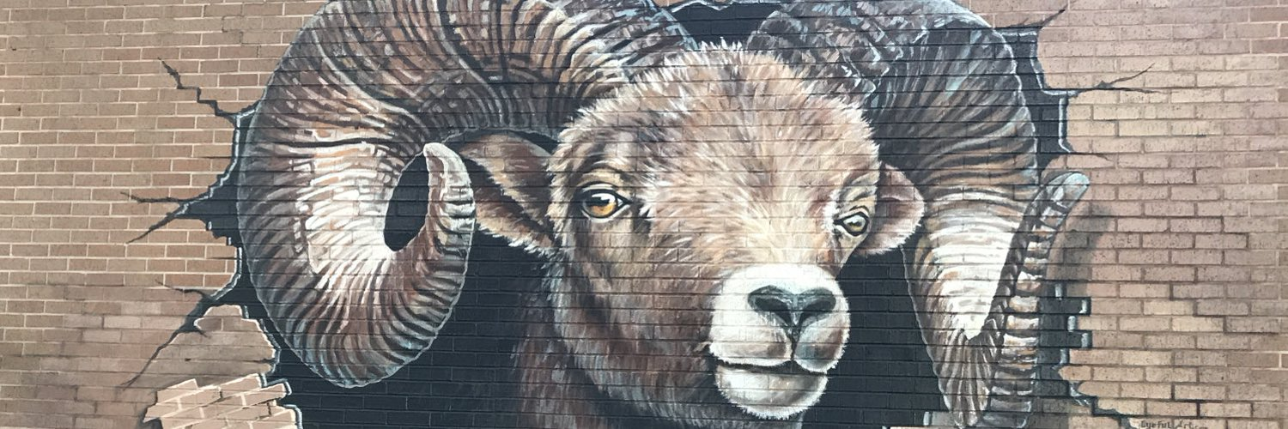
Open house agenda
A BRIEF HISTORY
YEAR AT A GLANCE
CLASSROOM AT A GLANCE
BEHAVIOR MANAGEMENT PLAN
METHODS OF COMMUNICATION
2022-2023 OPEN HOUSE PAGE 2 OF 7 MR. ORLANDO

Slide 3





A BRIEF HISTORY
I am a native Houstonian.
I attended the High School for Performing and Visual Arts
and majored in Instrumental Music.
I attended the University of Houston and graduated with
a Bachelors of Business Administration in Management Information Systems.
I worked at NASA for ~ten years in all three programs:
Space Shuttle, International Space Station, and Constellation.
I worked and lived in Vietnam for two years teaching English, Math, and Science under the Canadian International School System.
This is my seventh year in HISD and really looking forward to getting to know you better and teaching your child this year.
2022-2023 OPEN HOUSE PAGE 3 OF 7 MR. ORLANDO

Slide 4

Year at a glance – Tech. Applications
In Technology Applications 6, we have already covered
Unit 1: Digital Citizenship and are currently in Unit 2:
Word Processing (MS Word).
However, these are the units I have planned in the
coming months:
  Spreadsheets (MS Excel)
  Presentations (MS PowerPoint)
  Graphic Design (Pixlr/Adobe Expressions)
  Website Development (Adobe Spark/HTML)
  Video Game Design (Gamestar Mechanic)
  Sound/Video Editing (Audacity/WeVideo
2022-2023 OPEN HOUSE PAGE 4 OF 7 MR. ORLANDO

Slide 5
ClASSROOM AT A gLANCE
Technology Applications 6 students learn from
a variety of methods and platforms:
  Learning.com
  Brainpop.com
  TEDtalks
  Code.org
  Canvas LMS
  Pixlr Editor
  Adobe Spark
  WeVideo
  Guided Instruction & Independent Study
  Class Lecture
  Late Assignment Policy*
  1 day late = 10% deducted
  2 days late = 20% deducted
  3 days late = 30% deducted
  3+ days late = 0
  * - Absences due to illness not counted.
  While a percentage is taken from the overall score, this is not taking into consideration the accuracy of the work submitted.
  40% Tests/Projects
  30% Classwork
  20% Quizzes
  10% Homework/Daily Participation
2022-2023 OPEN HOUSE PAGE 5 OF 7 MR. ORLANDO

Slide 6

Behavior Mangement Plan
Step 1: Warning/Individual Conference
Step 2: Telephone Conference with Parent
Step 3: Discipline referral to administrator
These steps may be modified depending on the
severity of the infraction.
Prior to and during instruction, I have employed the following measures:
  Computer Lab Rules
  Assigned seating
  Active monitoring
  Proximity Control
  Implement engaging, relevant content
2022-2023 OPEN HOUSE PAGE 6 OF 7 MR. ORLANDO

Slide 7

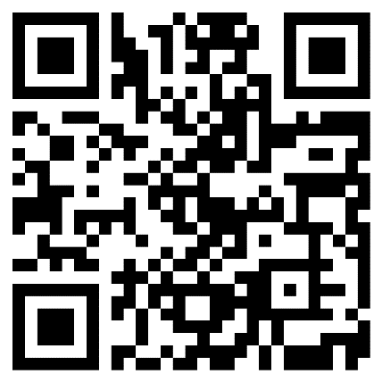
Methods of Communication
My preferred method of communication is via email: jason.orlando@houstonisd.org
My secondary method of communication will be via Canvas, usually in the form of announcements.
Once all email addresses are obtained, I will be able to create an email distribution list for mass email capabilities.
Please allow 24-48 hours for a response.
For any questions or concerns, please enter them in the QR code below:
2022-2023 OPEN HOUSE PAGE 7 OF 7 MR. ORLANDO

