Slide 1
Welcome!
Digital Media & Technology Applications
2022-2023
Mr. Gonzales

Slide 2
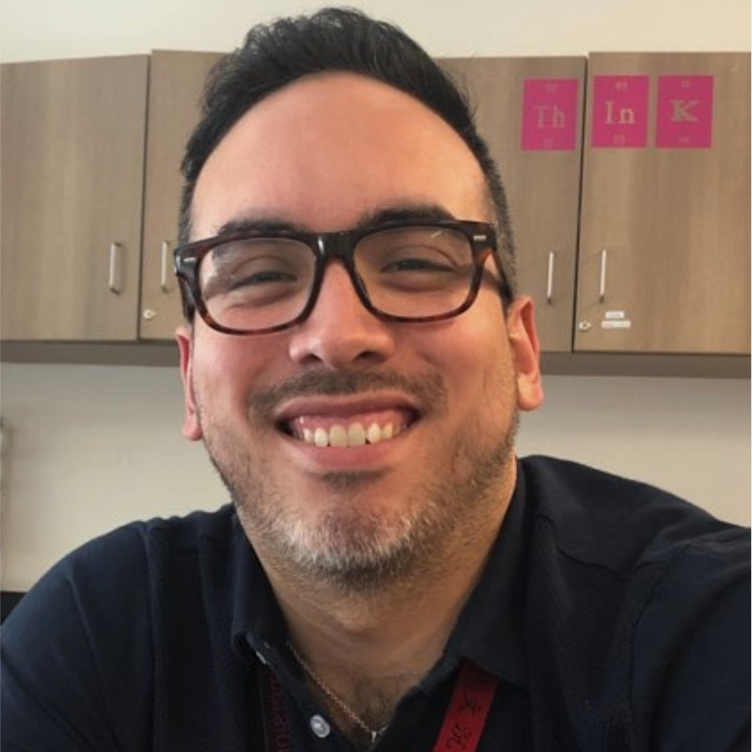
ABOUT ME
This is my second year at Rogers. I have been in education for 10 years.
1
I graduated from UT-Austin in 2007 and from Texas State University in 2010.
2
3
I enjoy spending time with my family, friends, and 3 cats.
4
I enjoy exercising and playing volleyball for fun.

Slide 3
Topics Covered:
DIGITAL MEDIA
Digital Safety
Introduction to Digital Media
Video Production
Animation
Digital Graphics
Planning, Design, and Development
1
2
3
4
5
6

Slide 4
Topics Covered:
TECHNOLOGY APPLICATIONS
Digital Safety
Google Suite
Coding
Graphic Design
Game Design
3D Modeling
1
2
3
4
5
6

Slide 5
Grading & Late Work Policy
Project or Test - 40%
Classroom - 30%
Quiz - 20%
Homework - 10%
Any work turned in late is automatically 10% off for each school day it is late, on top of any other missed points on the assignment.

Slide 6
NORMS AND EXPECTATIONS
1
2
3
I will see your child either two or three times according to the schedule the block schedule.
Students are to participate in verbal and online discussions, moderated by the teacher.
Students are expected to turn in all work and assignments on time.

Slide 7
Parent Communication
1
Please email
tgonza12@houstonisd.org

