Slide 1
Welcome to the 22-23school year!
Welcome to T.H. Rogers!

Slide 2
Let’s talk about--Me.
I am Dr. Tingli Yang.
Ph.D. in Biomedical Sciences from Texas A&M University
Adjunct Faculty member of HCC biology dept.
3rd year in T H Rogers
Precious teaching in high school, including Physics, AP Chemistry, Dual credit biology.

Slide 3
8TH GRADE SCIENCE COURSE OVERVIEW
Eighth-grade science is a survey of the natural sciences, including physics, chemistry, astronomy, geology, and biology.
The information studied in the eighth-grade year builds on what students have learned in grades six and seven to establish a solid foundation of scientific knowledge for students as they enter high school.
The specific topic areas we will explore this year are listed below:
The Structure of Atoms
The Periodic Table
Chemical bond
Chemical Reactions
Force, Motion & Energy
The Earth, Moon & Sun System
Stars, Galaxies and the Universe
Plate Tectonics
Ecosystems

Slide 4
INTEGRATED PHYSICS AND CHEMISTRY(IPC) COURSE OVERVIEW
Integrated Physics and Chemistry (IPC) is an introductory high-school level course exploring fundamental chemistry and physics principles. Students will master basic chemistry and physics concepts and gain a deeper understanding of the application of chemistry and physics in everyday life.
The specific topic areas we will explore this year are listed below:
Structure and Properties of Matter
Changes in Matter
Atomic Structure and the Periodic Table
Solutions
Chemical Bonds and Chemical Reaction
Forces and Motion
Energy and work
Electricity and Magnetism
Waves and sound

Slide 5
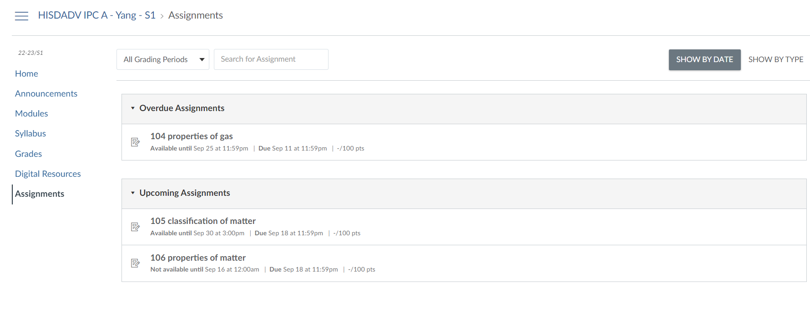
Assignments/homework would be like:
Late work should be submitted within 2 weeks after the due date.
1st week of late: 10 point less
2nd week of late: 20 point less.

Slide 6
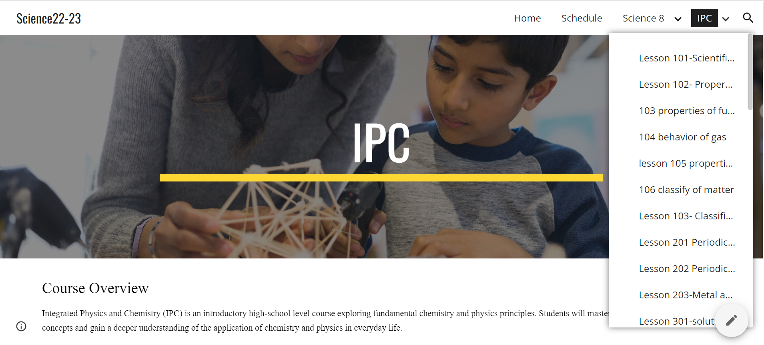
Each of your class would be looking like:

Slide 7
How do we keep connected?
All the assignment is on canvas(including study island).
Email the teacher when out of school hour
Your Grade will be on PowerSchool.

Slide 8
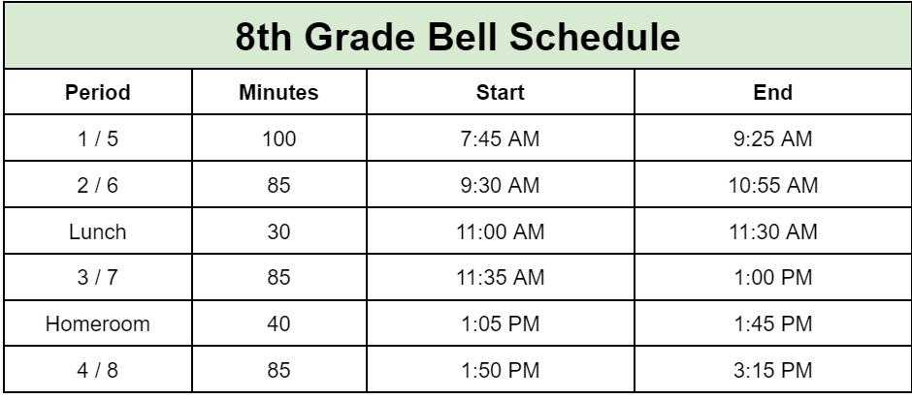
Your current bell schedule:

