Slide 1
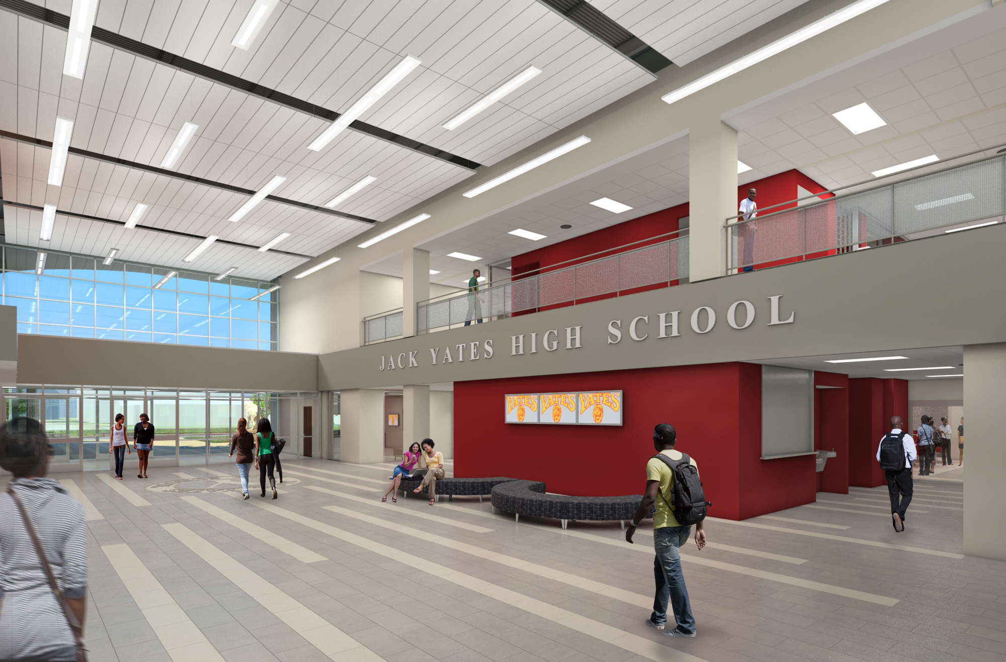
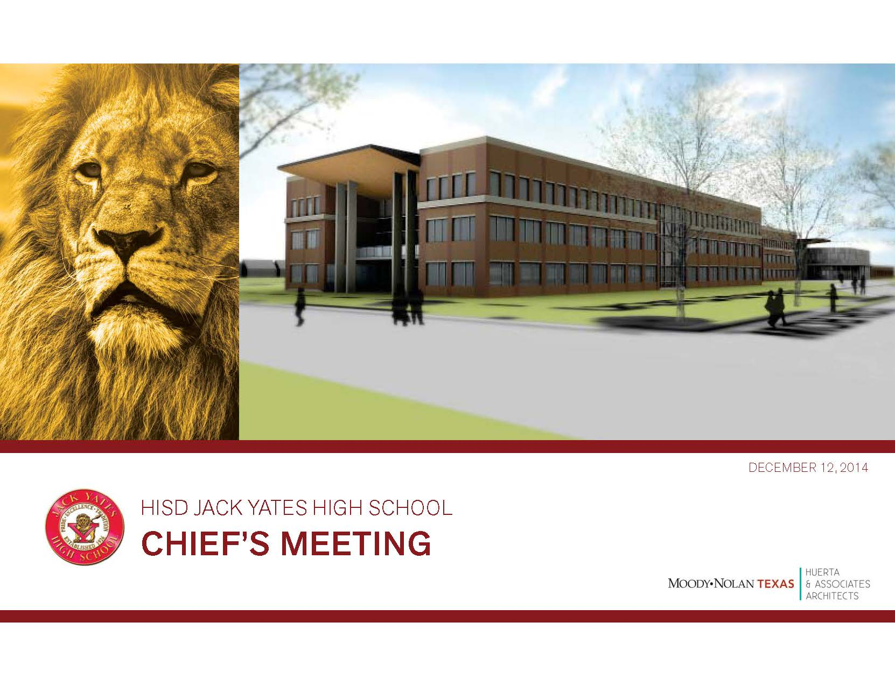

PAT MEETING
HISD JACK YATES HIGH SCHOOL
February 16, 2017
PAT MEETING

Slide 2
PAT MEETING
AGENDA
AGENDA
Introduction - Participants
Construction Progress Update – Turner Construction
General Questions
Remaining PAT Meetings Schedule for 2017
HISD JACK YATES HIGH SCHOOL
February 16, 2017
PAT MEETING

Slide 3
PAT MEETING
INTRODUCTIONS
PARTICIPANTS
Eric Ford, Project Manager, HISD Facilities Design
Linda McClure, Project Manager, Turner Construction Company
Cándido Lizárraga , Project Engineer, Turner Construction Company
Luke Hiller , Assistant Engineer, Turner Construction Company
Wardell Ross Jr., Project Manager/Architect, Moody Nolan
Jonathan Mitchell., Construction Administrator, Moody Nolan
HISD JACK YATES HIGH SCHOOL
February 16, 2017
PAT MEETING

Slide 4
PAT MEETING
Construction Progress Update
HISD JACK YATES HIGH SCHOOL
February 16, 2017
PAT MEETING

Slide 5
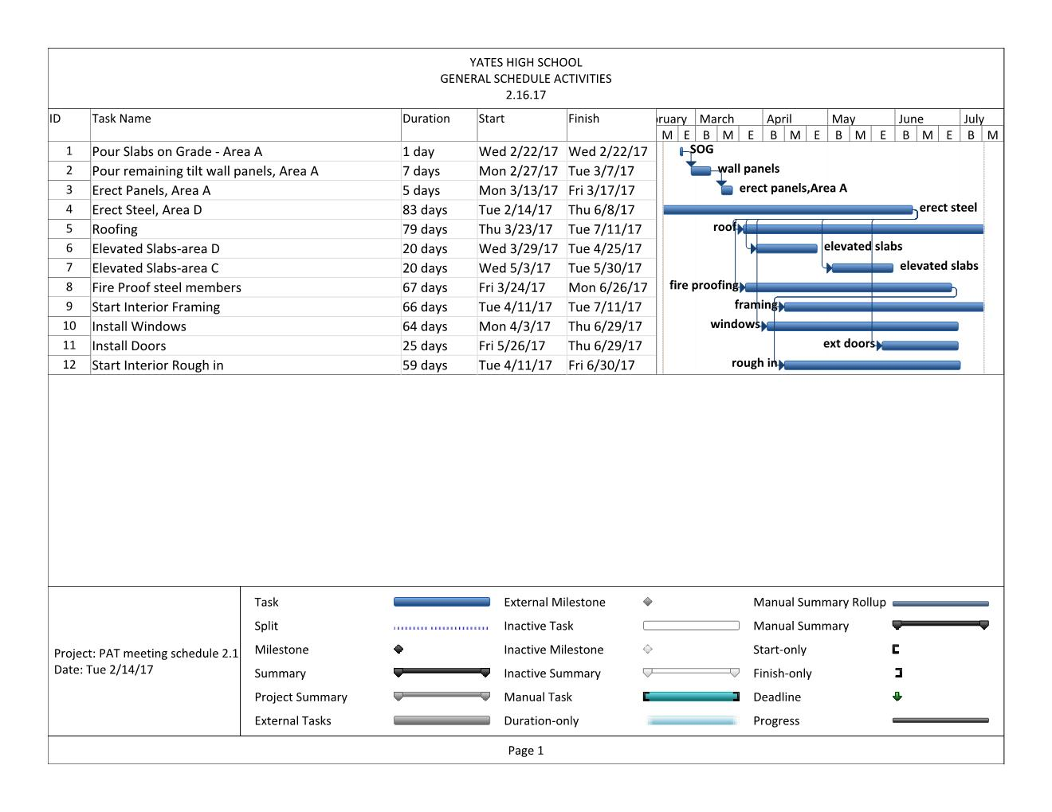
PAT MEETING
CONSTRUCTION PROGRESS UPDATE
CONSTRUCTION PROGRESS SCHEDULE
HISD JACK YATES HIGH SCHOOL
February 16, 2017
PAT MEETING

Slide 6
TURNER SAFETY & COMMUNITY
Turner is working to maintain a safe jobsite for the community and the workers
  Complete site perimeter fencing with lockable gates including signage to ensure authorized entry only.
  On site cameras with 24 hour monitoring to alert us when someone has entered the site without authorization.
  Full time on-site safety manager to ensure construction processes are safe and to improve worker safety.
  Weekly site weeks with the Yates students to monitor and record construction progress.

Slide 7
PAT MEETING
CONSTRUCTION PROGRESS UPDATE
CONSTRUCTION PROGRESS UPDATE
Building Pad and Piers have been completed.
Mockup panels are erected & painted, metal panels are up, storefront/window is installed.
Temporary metal panels are installed at building B & building A Separation.
Slab on Grade and forming/pouring of the tilt wall panels has begun, Area D & C are complete. U/G Plumbing/Electrical is moving ahead of this activity by Area and will be complete by 2/13/17.
Site utilities have been completed to the extent they can until Summer 2017.
BIM Coordination is 95% complete, working through clashes and resolutions.
Lifting or “tilting” the panels has begun on 2/2/17 in area D.
Steel Erection will follow the lifting of the panels.
HISD JACK YATES HIGH SCHOOL
February 16, 2017
PAT MEETING

Slide 8
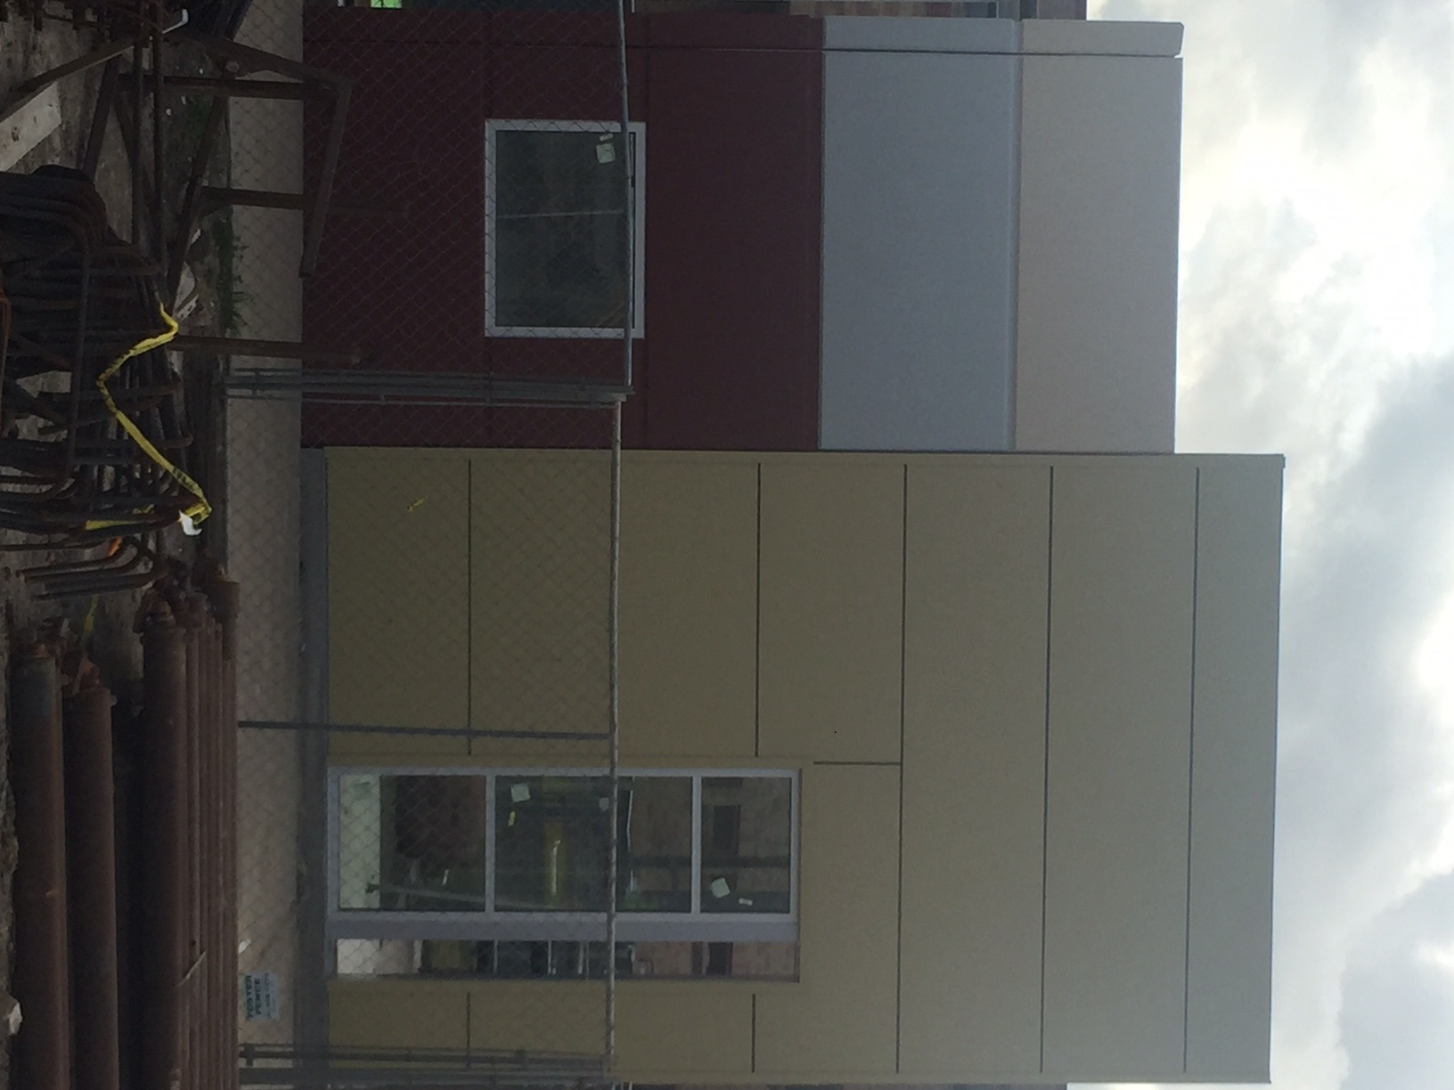
Building Exterior Mockup
PAT MEETING
CONSTRUCTION PROGRESS UPDATE
HISD JACK YATES HIGH SCHOOL
February 16, 2017
PAT MEETING

Slide 9
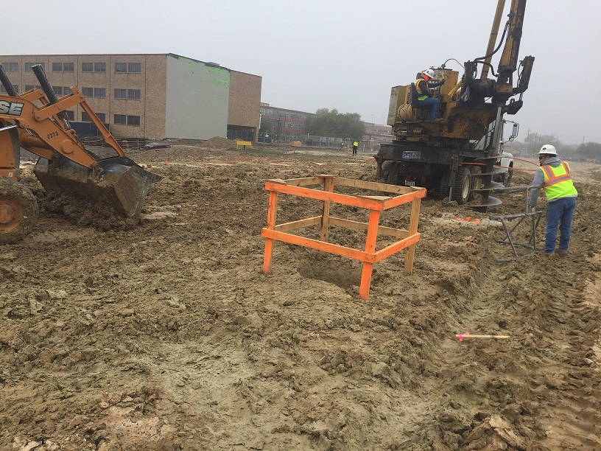
Building Pad and drilling piers.
PAT MEETING
CONSTRUCTION PROGRESS UPDATE
HISD JACK YATES HIGH SCHOOL
February 16, 2017
PAT MEETING

Slide 10
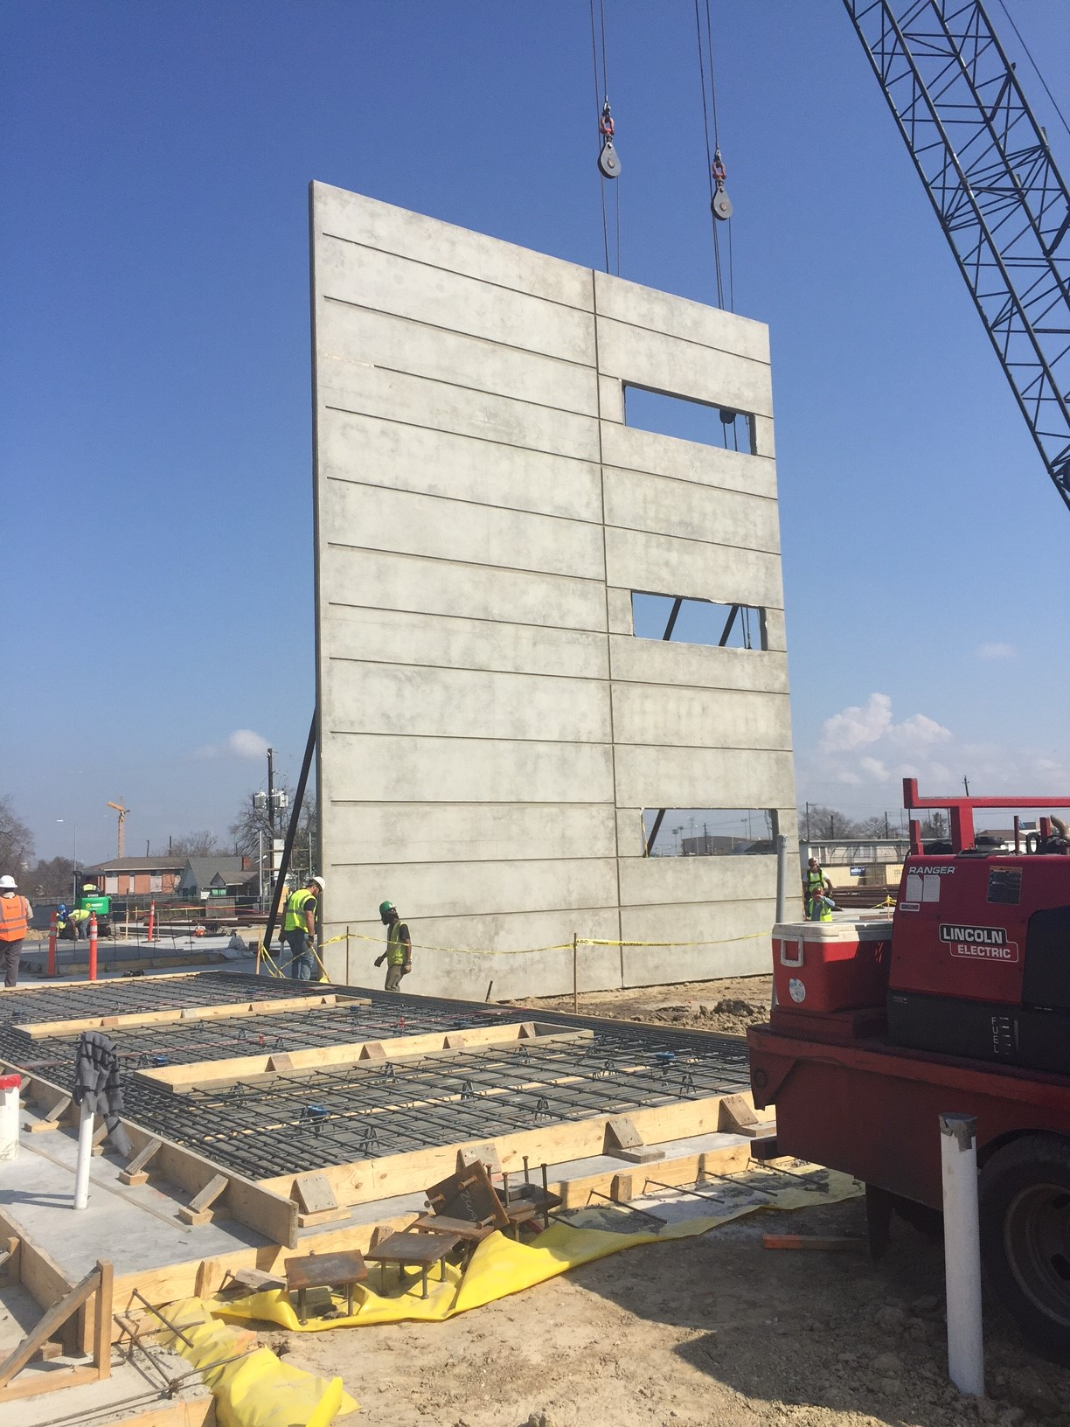
Tilt Wall Panel Erections
PAT MEETING
CONSTRUCTION PROGRESS UPDATE
HISD JACK YATES HIGH SCHOOL
February 16, 2017
PAT MEETING

Slide 11
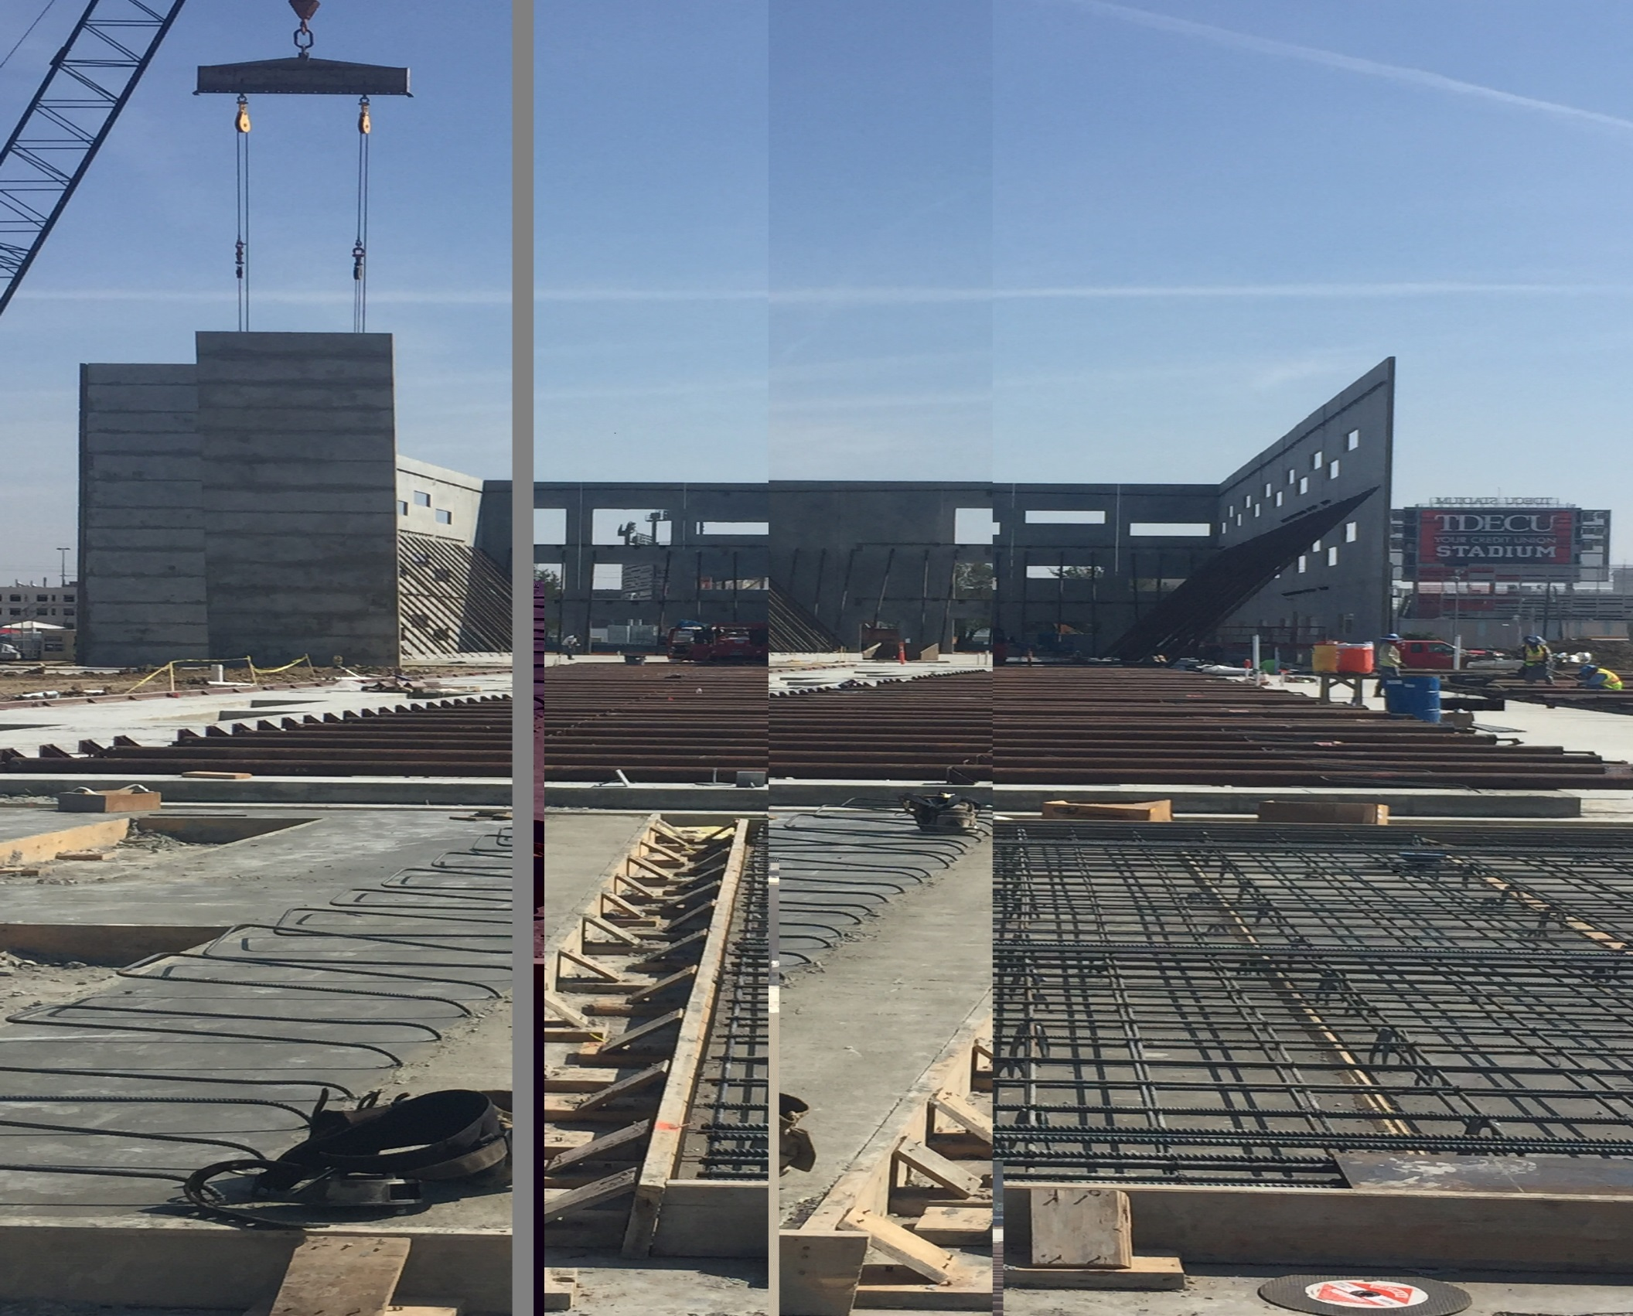
Tilt Wall Panel Erections & Slab Pours
PAT MEETING
CONSTRUCTION PROGRESS UPDATE
HISD JACK YATES HIGH SCHOOL
February 16, 2017
PAT MEETING

Slide 12
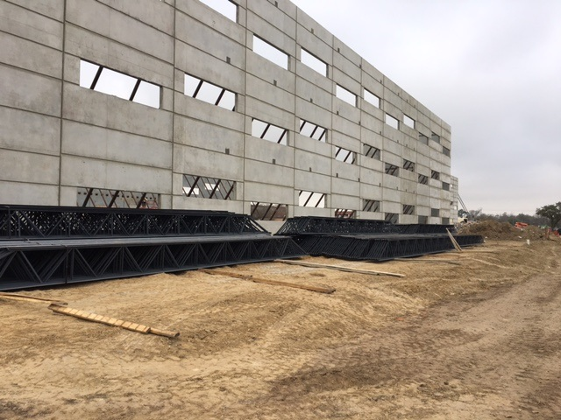
Steel Joists Delivery
PAT MEETING
CONSTRUCTION PROGRESS UPDATE
HISD JACK YATES HIGH SCHOOL
February 16, 2017
PAT MEETING

Slide 13
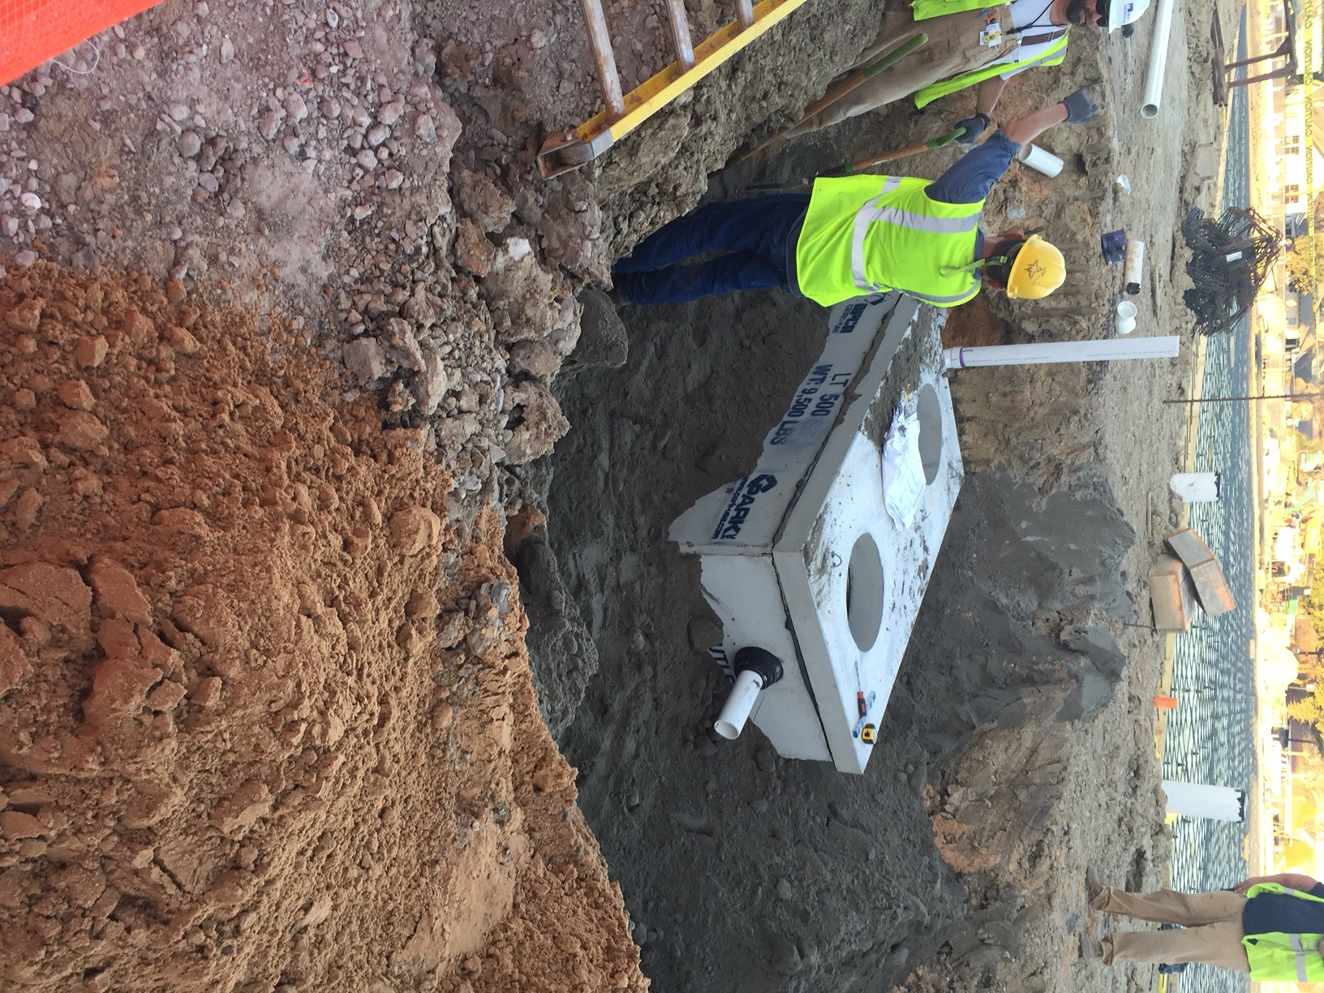
Lint Trap – 9,500 #’s
PAT MEETING
CONSTRUCTION PROGRESS UPDATE
HISD JACK YATES HIGH SCHOOL
February 16, 2017
PAT MEETING

Slide 14
PAT MEETING
SCHEDULE FOR 2017
February 16, 2017 – Construction Progress Update
May 18, 2017 – Construction Progress Update
September 21, 2017 – Construction Progress Update
December 14, 2017 – Construction Progress Update
HISD JACK YATES HIGH SCHOOL
February 16, 2017
PAT MEETING

Slide 15
PAT MEETING
Questions
HISD JACK YATES HIGH SCHOOL
February 16, 2017
PAT MEETING

