Slide 1

Student Deployment
Notes:
1. Review your list of students eligible to receive a laptop.
2. Send one student at a time to the netsync representative to get their laptop. As each student receives their laptop, instruct them to power on the device and log in with their PS Connect (gradespeed) username and password. Note: Initial startup may take up to 5 minutes.
3. While you wait on all students to receive their laptop, begin to review laptop specs (slide 2) and what to do if (slide 3)

Slide 2
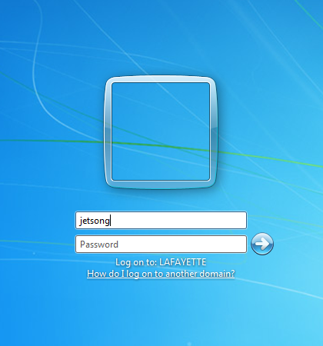
Logging In
When you receive your computer, you will log in using your PS Connect login. This is the username and password you use to check your grades on Gradespeed.

Slide 3



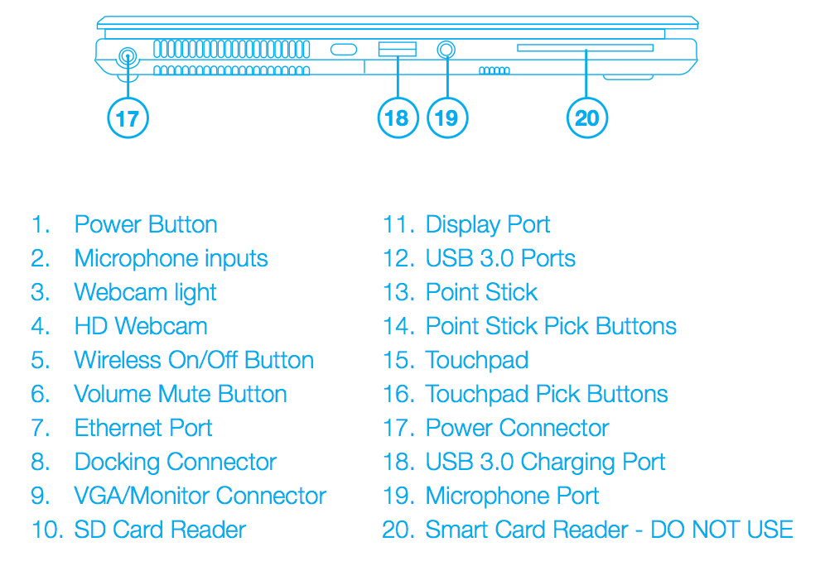

Notes:
Review the laptop spec sheet items 1-20 (if limited on time, review this slide with students before the day of deployment and highlight the following on the day of deployment):
#5 wireless On/Off button
#6 volume mute button
#18 USB 3.0 charging port
Also, review how to disable and enable the touchpad.

Slide 4

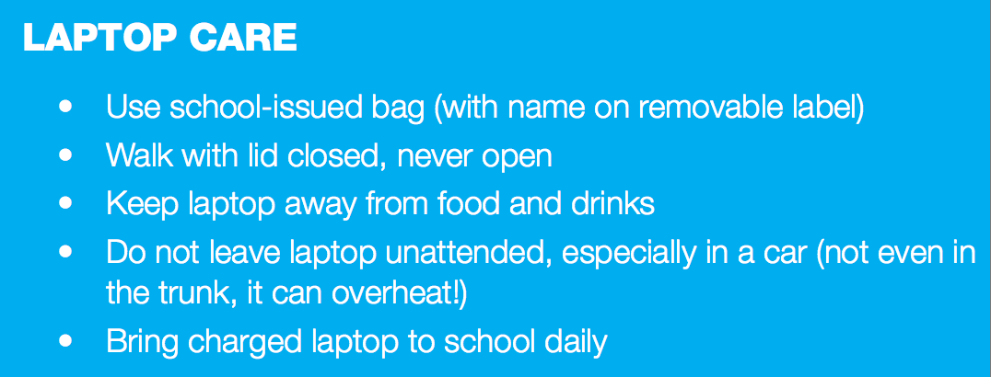
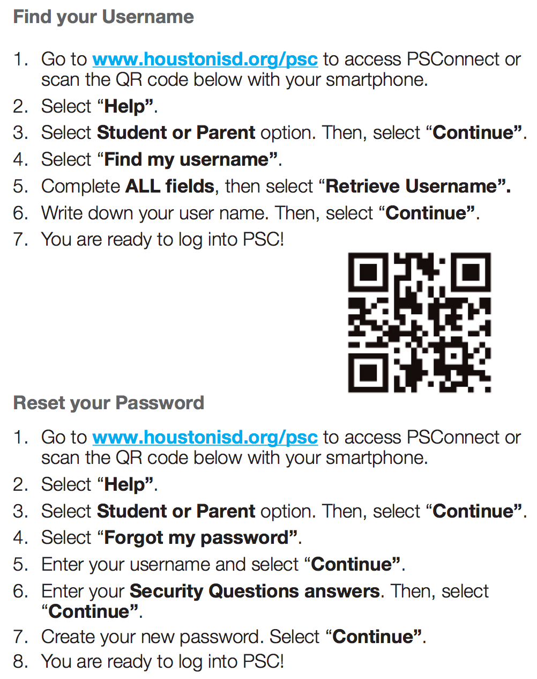
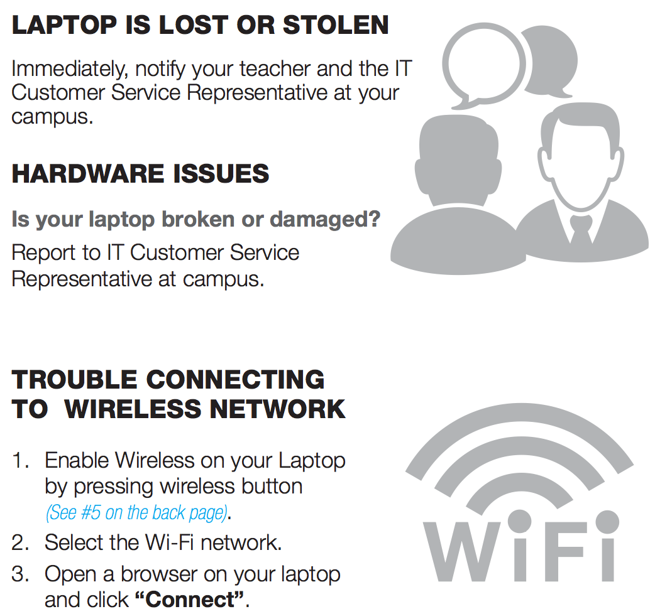
3
Notes:
To reset password or find your username go to www.houstonisd.org/psc or call the help desk 713-892-7378
Basic care of laptop section –
Keep the laptop in its case otherwise you will void the warranty
Do not close the lid with anything inside (i.e earbuds, stapled papers) Most laptop tickets are from cracked screens due to lids being closed with things still on the keyboard.
Do not leave laptop unattended anywhere.
Charge it daily and bring it to school daily
Laptops lost or stolen -
Laptops have low jack installed meaning devices can be tracked and recovered if lost or stolen. Report lost/stolen devices to Mr. Thorn IMMEDIATELY. A report needs to be filed within 10 days for insurance to cover it. Any problems with the laptop, see Mr. Lewis (Room ____) to submit a help desk ticket.
Trouble with WiFi –
first make sure WiFi is enabled. If the WiFi button on your keyboard is glowing orange (#5 on laptop spec slide 2) then WiFi is off, press the button to turn it on. If this doesn’t resolve your issue, then press the WiFi button to disable, wait a few seconds, and press it again to enable WiFi (next to mute volume button)

Slide 5
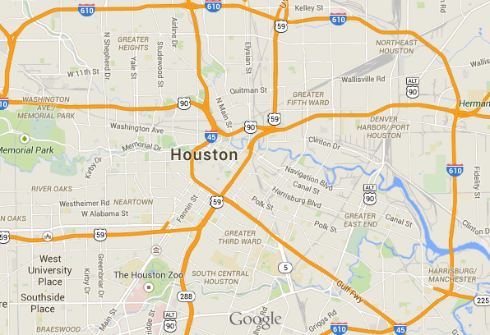


Computrace (LoJack)
Each computer is equipped with a GPS location tracking system. In the event that your computer is lost or stolen, report it to your school immediately. Students must report a lost or stolen computer to school authorities within 7 days.

Slide 6
Student Guide – Syncing your OneDrive
Notes:
Now we are going to walk through the steps to sync your OneDrive with your laptop.
Note to students that you will be going through the following steps as a class and that it is very important that no one jumps ahead. After each step check with a thumbs up that students are ready to proceed.
At this point, you can discuss with students what OneDrive is and what it is for:
1 TB of cloud storage space
The place where they will be saving their documents

Slide 7
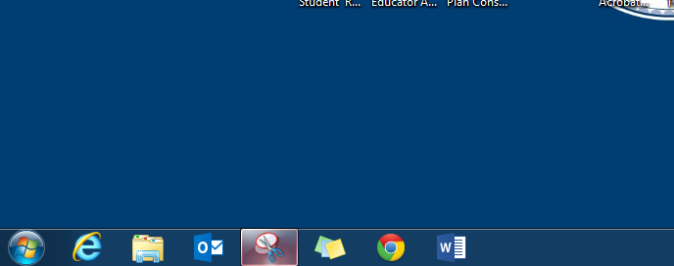
Step 1:
Open the Internet Explorer web browser.
4
Notes:
Use internet explorer for this because OneDrive works best in IE

Slide 8
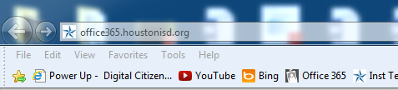
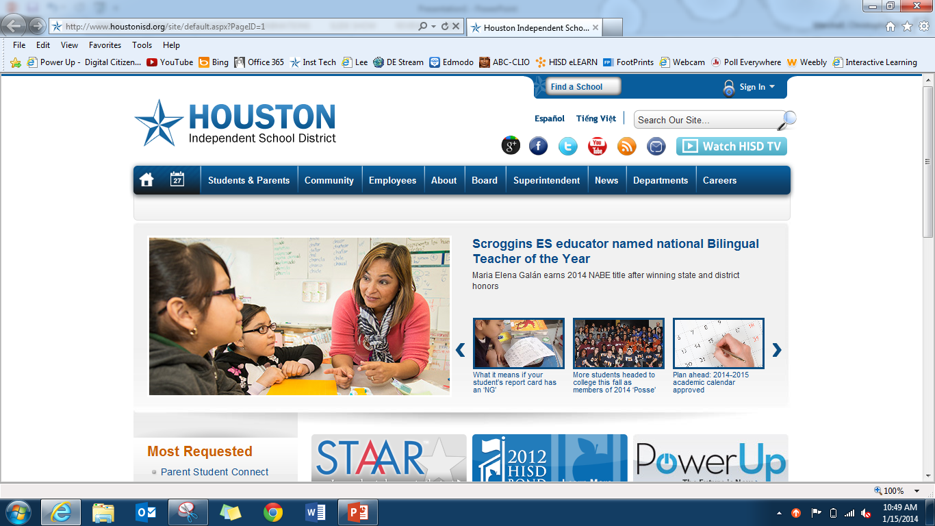
Step 2:
In the address bar, type office365.houstonisd.org
5
Notes:
In the address bar type in the website office365.houstonisd.org.
Encourage students to write down the site so they can remember later. This is especially important if they have home computers they use and need to access their saved documents from that device for printing. Moreover, after syncing you will also show them that this is the website where they will access their HISD email. Students only have web outlook access via Office 365…not desk type access like teachers have.

Slide 9
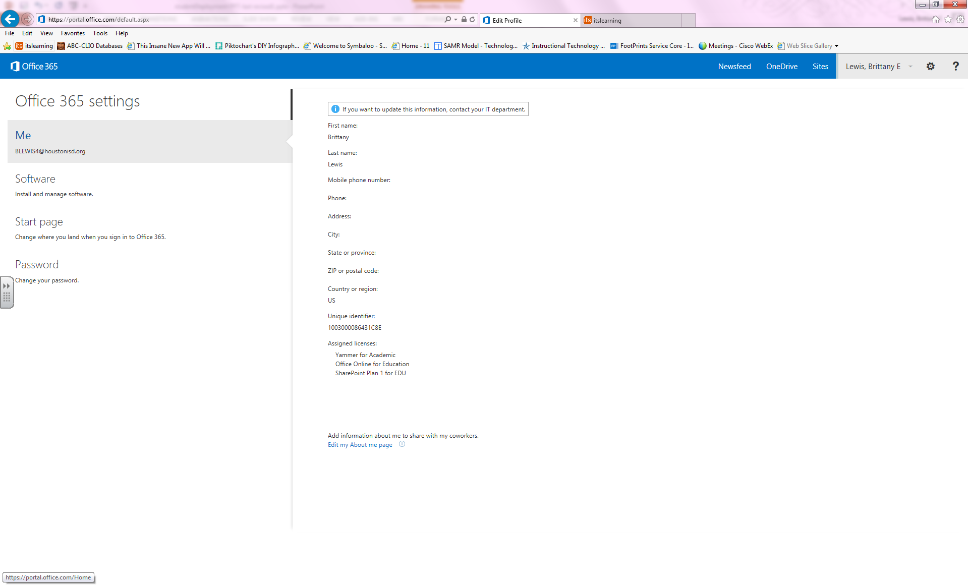
Step 3:
Click on the word “OneDrive”
at the top right.

Slide 10
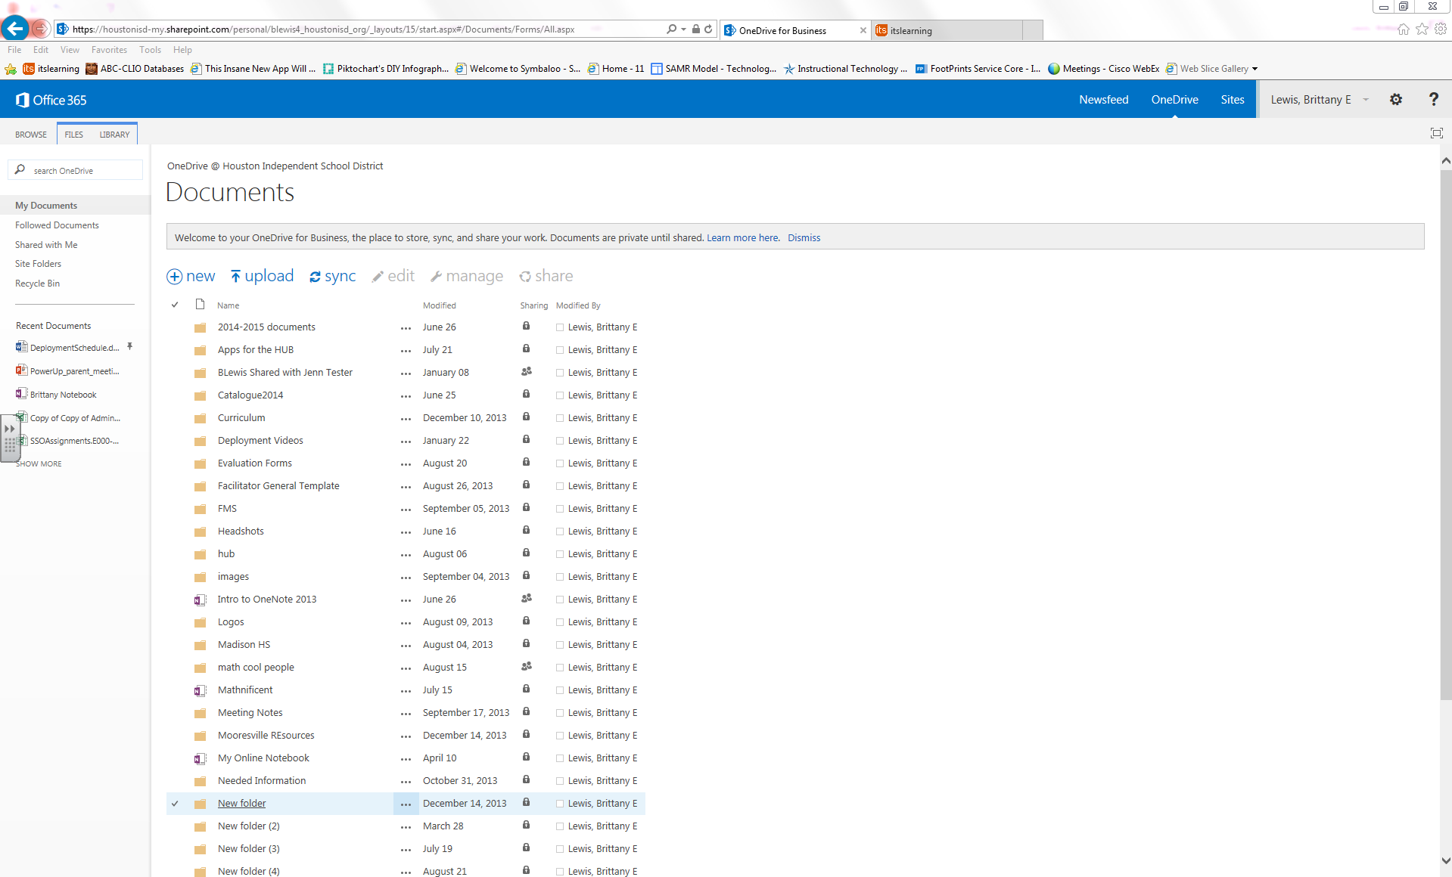
Step 4:
Now click on the word “Sync”
at the top of the screen.
Notes:
Different things may happen at this point. For most students they will see what’s on the next slide.
If nothing happens when they click on sync, instruct students to repeat this step, click on sync and that usually resolves it.
Some students may see an external protocol request screen, tell students to click on launch protocol.

Slide 11
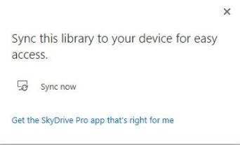
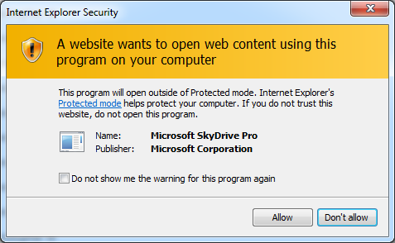
Step 5:
Click on “Sync now”
Next click on “Allow”
Step 6:
And then STOP, do not click on anything else!
8
Notes:
After step 6, before moving to the next slide…. instruct students to remove hands from keyboard…all eyes on you.

Slide 12
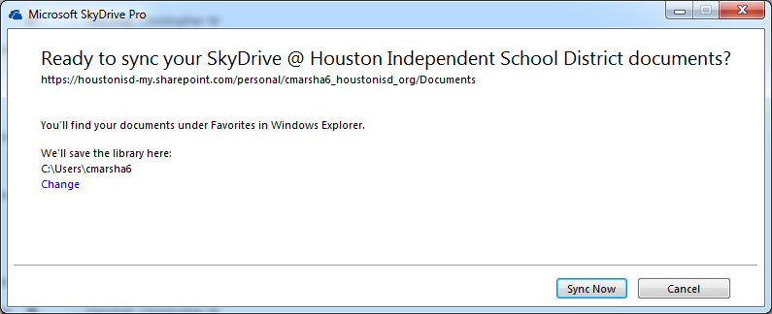
DO NOT CLICK
Sync Now
Step 7:
Click the blue change link
9
Notes:
VERY important for students not to get ahead during this step otherwise you will have to show them how to unsync and go through the syncing steps again starting with step 1.

Slide 13
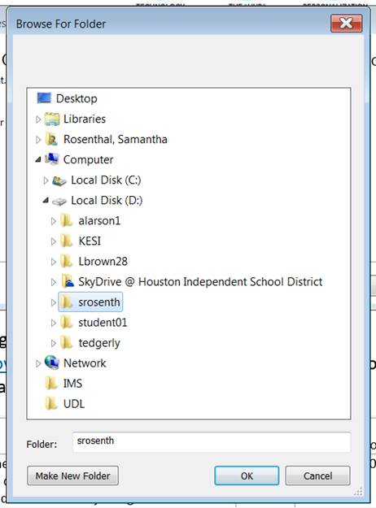
Step 8:
Click on Computer.
Click on Local Disk (D:)
Click on the folder with your Username.
Click OK once you are done.
If you do not see your folder with your name, select “Make New Folder” and create one under Local Disk (D:)
a
b
c
d
10

Slide 14
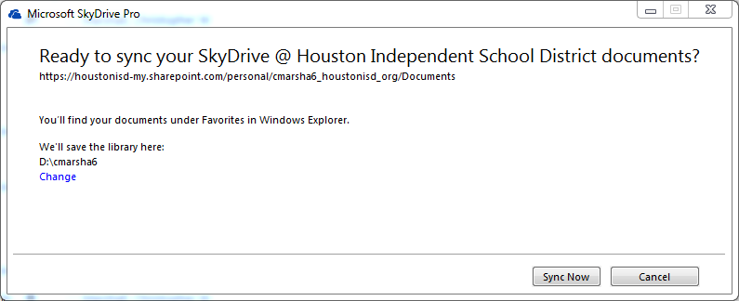
a
b
Step 9:
The window should show D:\yourusername
Click on
Sync Now
11
Notes:
Once syncing is complete students can close the show my files box.
To confirm they synced correctly:
Ask students to click on the file icon next to the start menu.
Ask students to look under favorites for their OneDrive/Skydrive
Note to students that this is where they will save their documents.
If they do not see their OneDrive/Skydrive they did not sync correctly…students will need to repeat the syncing steps.

Slide 15

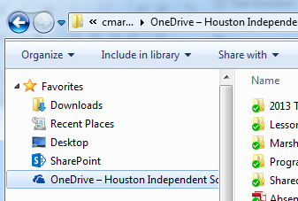
Checking Your OneDrive
Click on the folder at the bottom right.
Look for your OneDrive. It is represented with a cloud icon.
11

Slide 16
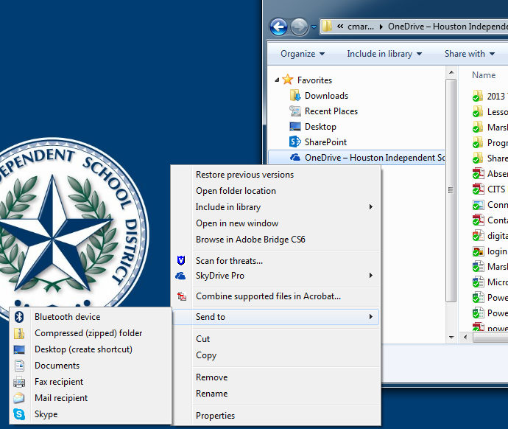
Shortcut Your OneDrive
Right click on your Onedrive.
Hover your mouse over “Send to.”
Left click on (create shortcut)
11

Slide 17
Why should I remember this website? office365.houstonisd.org
OneDrive – where you save your documents
Outlook - access your HISD email (username@online.houstonisd.org)
11
Notes:
Tell students that by syncing they have created a pathway between Office 365 OneDrive and their laptop. They need to remember this website (write it down) in case they need to access their saved documents from another device, like a home computer, for printing. Moreover, via this website is how they will access their HISD email. Students only have web outlook access via Office 365…not desk type access like teachers have.

Slide 18
Student Guide – Web Outlook – HISD email

Slide 19
Go back to office365.houstonisd.org
5
Notes:
In the address bar type in the website office365.houstonisd.org (students should have the Office 365 site open since they just finished syncing)

Slide 20
Click on the word “Outlook”

Slide 21
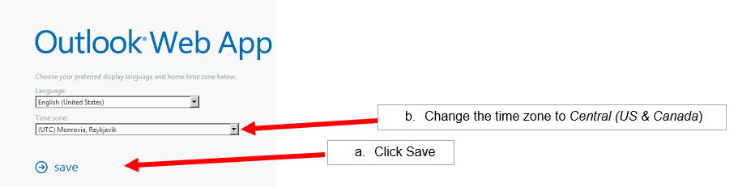
Set the time zone

Slide 22
Student e-mail address: username@online.houstonisd.org
You should now be in your email inbox!
Notes:
At this point you can help students create a shortcut to their web outlook. Students can click and drag the “O” icon on the address bar down to the task bar.

Slide 23
Let’s Talk HUB
12
Notes:
At HAIS, the next set of information (HUB slides 19 – 23) will be covered with students the next class period.

Slide 24
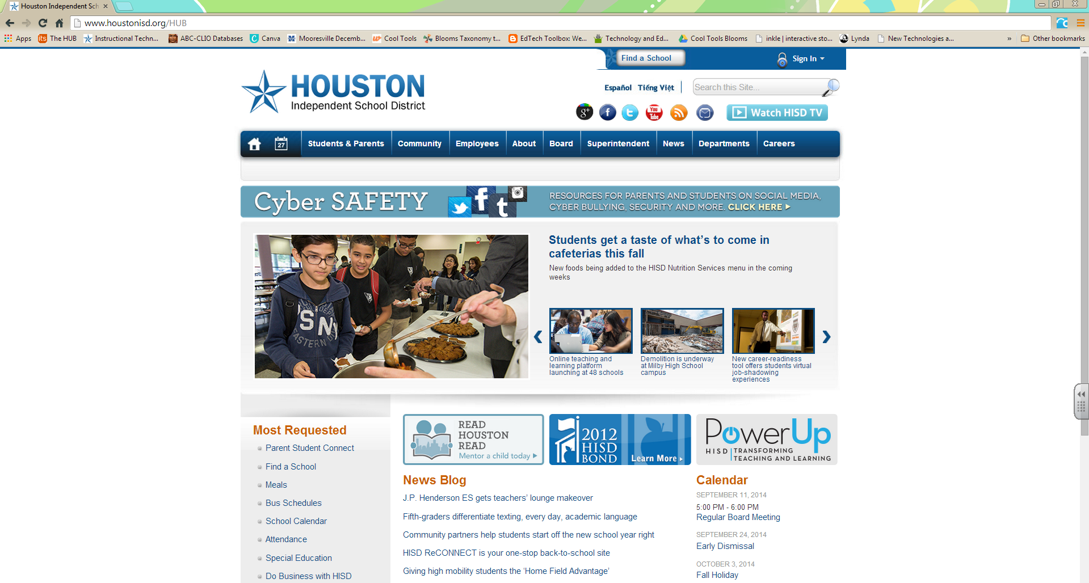
How to login
Using a web browser, go to www.houstonisd.org/HUB

Slide 25
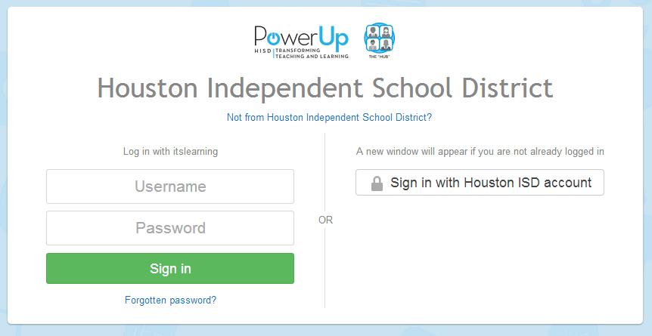
If you get this screen, click on
“Sign in with Houston ISD account”.

Slide 26
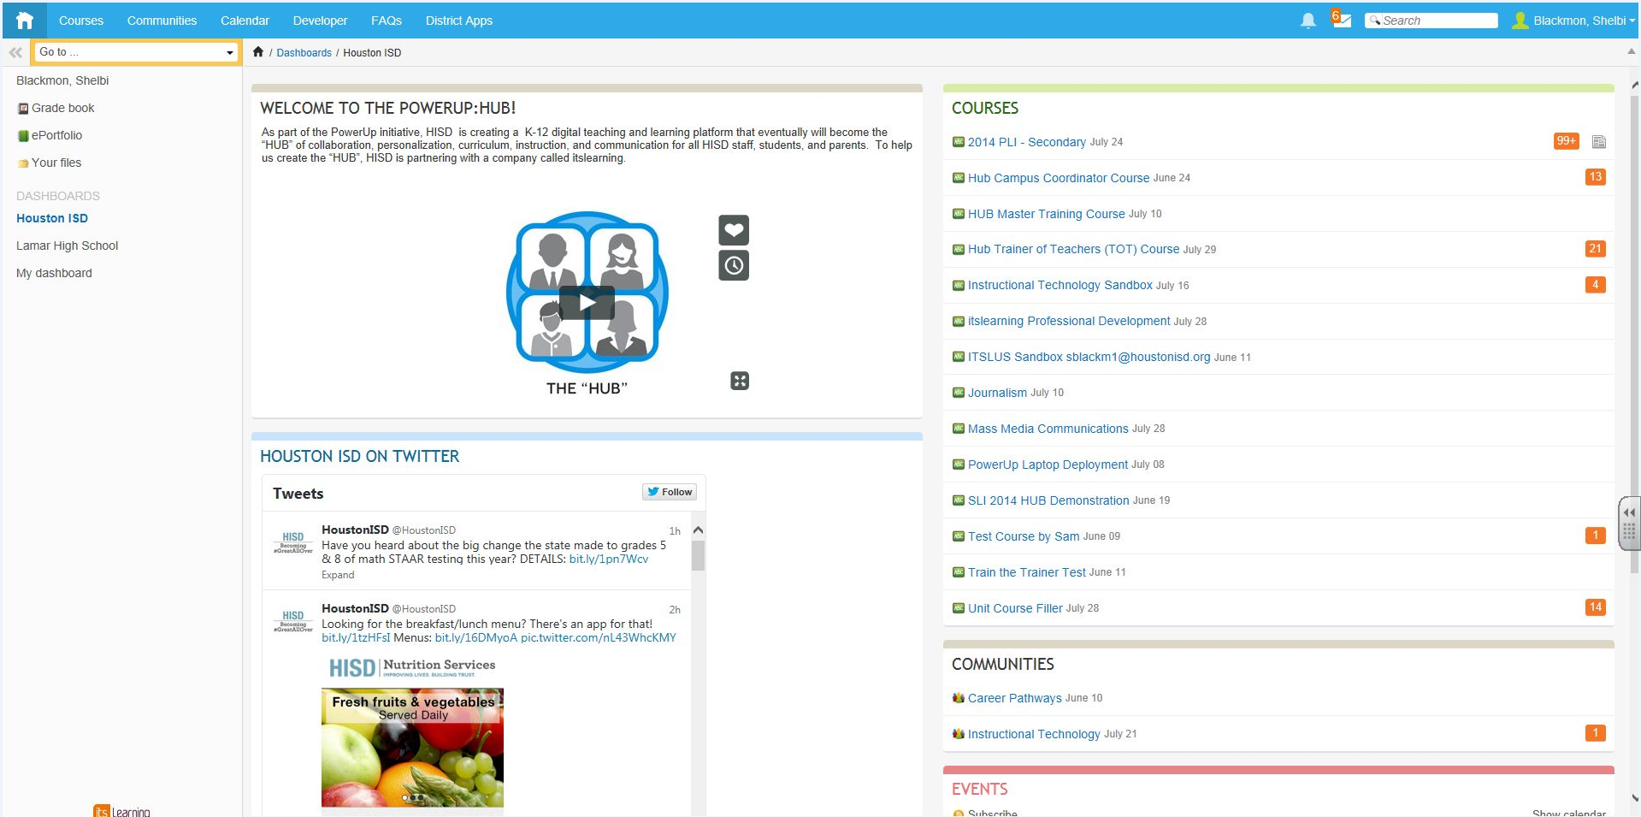
HUB Dashboard
View other Dashboards here.
Your Courses

Slide 27
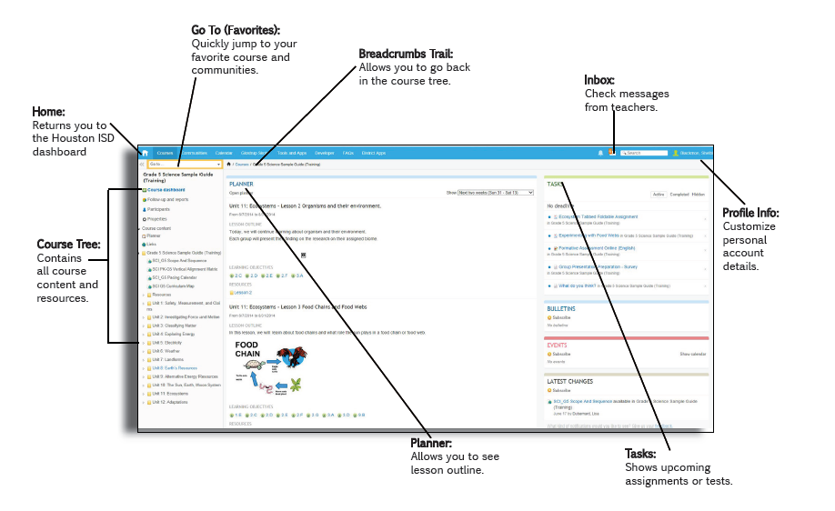
Course Dashboard

Slide 28
Things to remember:

Slide 29
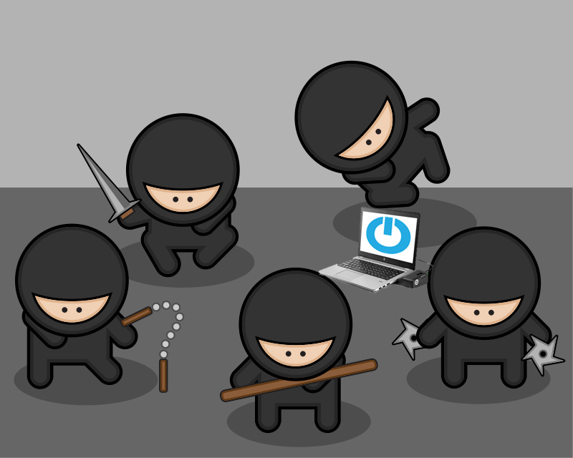
Do not leave your computer unattended
It could be stolen by Ninjas…
Original Image from: http://blog.hathix.com/2012/06/why-be-developer/
12

Slide 30

Remove everything from your keyboard before you close your computer
be gentle, computers are sensitive…
Image from: http://hdw.eweb4.com/search/broken+screen/
12

Slide 31

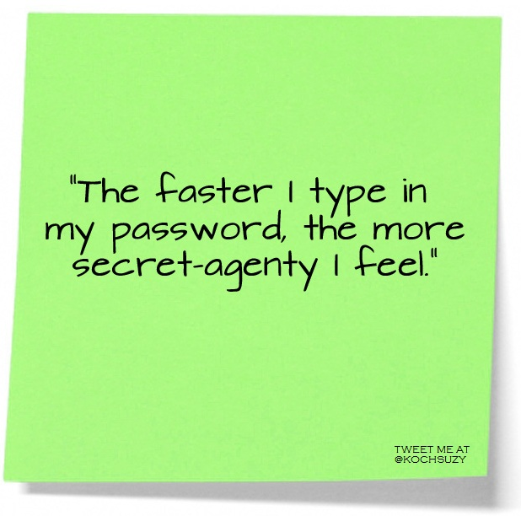
Do not share your password with others
12
Image from: https://plus.google.com/communities/103440936717695672955

Slide 32

Do not leave your computer in your car
You don’t want to make your computer sick
Image from: http://www.clipartof.com/gallery/clipart/computer_repair.html
12

Slide 33
If you have any questions, be sure to ask your teachers or visit houstonisd.org/powerup

