Slide 1
ALL Behavior is Motivated
Social and Emotional Learning (SEL) Department

Slide 2
Learning Goals
Understand behavior is not motivated by consequences only.
Differentiate between Hardwired Skills and Skills that must be Taught.
Consider the use of Social and Emotional Learning Skills Assessment
Consider myOn to promote positive behavior

Slide 3
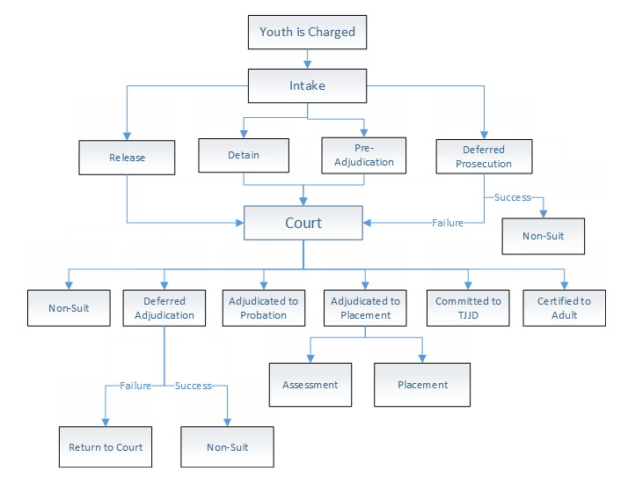
Rule is Broken
Does your campus spend more time promoting positive behavior
(OR)
reacting to negative behavior?
Teacher
Loss of Privilege
Contract
Phone Call
Parent Conf.
Administrator
Success
DAEP
OSS
ISS
JJAEP

Slide 4
All Behavior is Motivated
Expectancy Rate (Will I be successful?) | (X) Value Rate (Costs?) | = Motivation
0 | (x) 10 | = 0
10 | (x) 0 | = 0
10 | (x) 10 | = 100

Slide 5

Day One
Anger
Surprise
Joy
Fear
Disgust

Slide 6

Adolescents
Patience
Sympathy
Gratitude
Shame
Humility
Optimism
Forgiveness
Compassion
Empathy

Slide 7


Slide 8
Exclusionary Discipline (OSS)

Slide 9
Equity

Slide 10

Behavior Assessment
In School Suspensions
Office Referrals
DAEP Referrals
Out of School Suspensions
E, S, N & U

Slide 11
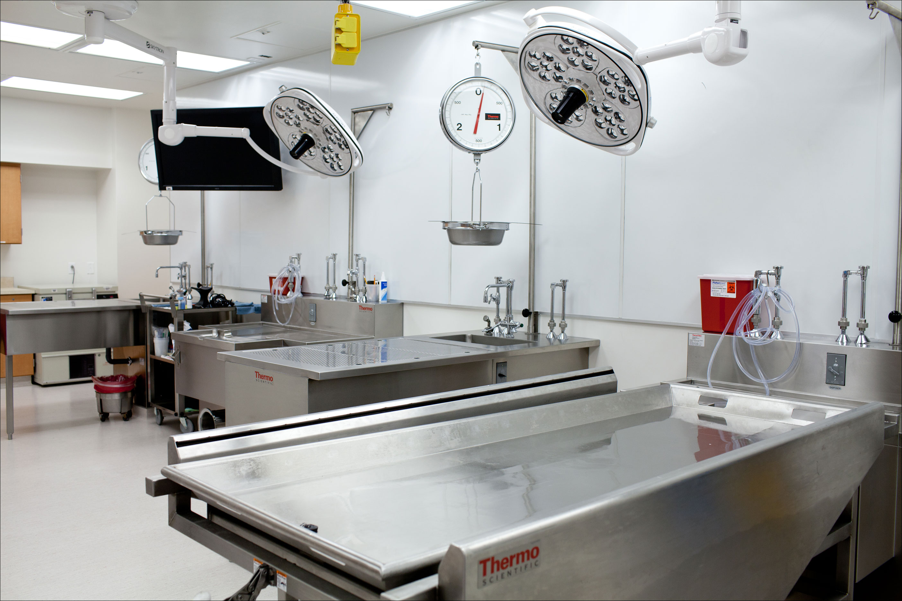
Autopsy Data

Slide 12
Social and Emotional Learning Assessment
Early Elementary
Late Elementary
Middle School
Early High School
Middle High School

Slide 13
Apply Strategies to Manage Stress and to Motivate Successful Performance
SEL Likert Ratings by Marking Period | MP 1 | MP 2 | MP 3 | MP 4
Recognize Emotions as Indicators of Situations in Need of Attention
Analyze How Personal Qualities and Temperaments Influence Choices and Successes
Reflect on Possible Consequences, Both Positive and Negative, Before Expressing an Emotion
Apply Strategies to Manage Stress and to Motivate Successful Performance
Adjust Behavior Based on Perceive Emotional Impact on Others
Differentiate Between Passive, Assertive, and Aggressive Responses
Demonstrate an Ability to Be a Team Player in Achieving Group Goals
Identify and Apply the Steps of Systematic Decision-Making
Evaluate Strategies for Resisting Pressures to Engage in Unsafe or Unethical Activities

Slide 14
Reflect on Possible Consequences, Both Positive and Negative, Before Expressing an Emotion
SEL Likert Ratings by Marking Period | MP 1 | MP 2 | MP 3 | MP 4
Recognize Emotions as Indicators of Situations in Need of Attention
Analyze How Personal Qualities and Temperaments Influence Choices and Successes
Reflect on Possible Consequences, Both Positive and Negative, Before Expressing an Emotion
Apply Strategies to Manage Stress and to Motivate Successful Performance
Adjust Behavior Based on Perceive Emotional Impact on Others
Differentiate Between Passive, Assertive, and Aggressive Responses
Demonstrate an Ability to Be a Team Player in Achieving Group Goals
Identify and Apply the Steps of Systematic Decision-Making
Evaluate Strategies for Resisting Pressures to Engage in Unsafe or Unethical Activities

Slide 15
Possible Uses of SEL Assessment
Intervention Assistance Team (IAT): Goal Setting, Feedback and Progress Monitoring
Focused Parent-Teacher meetings
Establishes goals for Classroom Teaching
Provides feedback for differentiated instruction for behavior

Slide 16
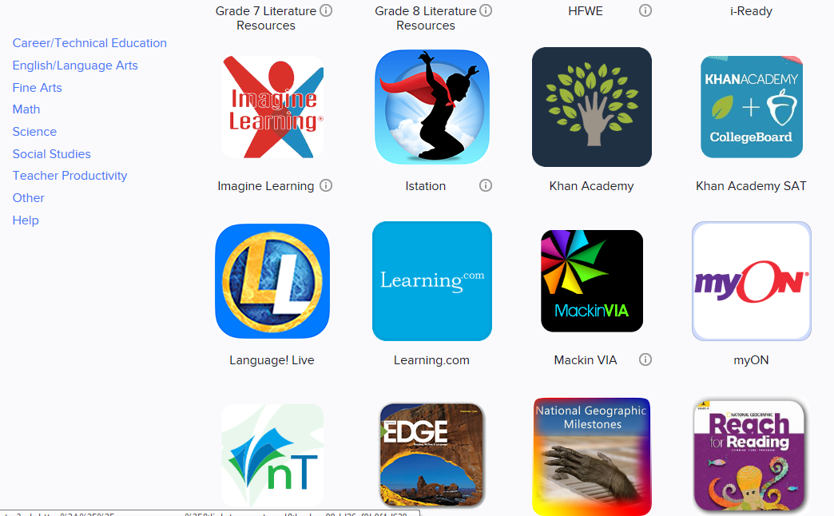

Slide 17
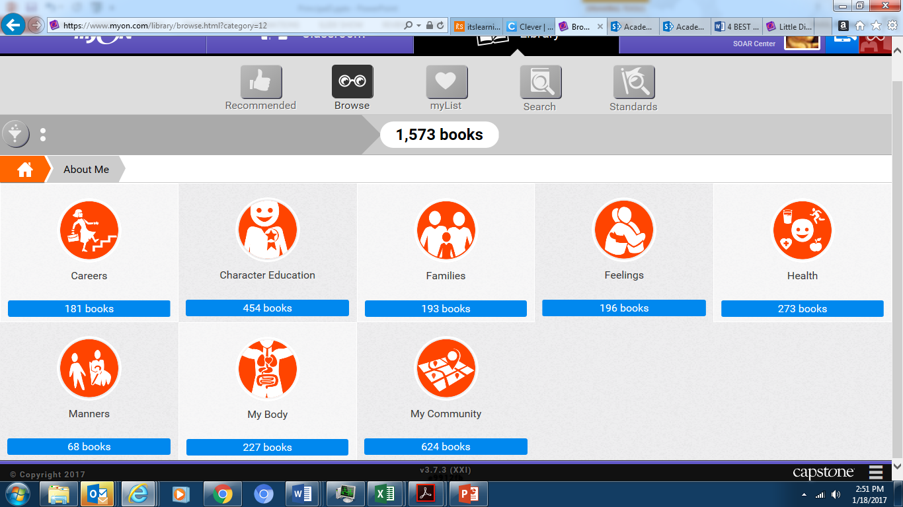

Slide 18
#SELectLOVE
Social and Emotional Learning Department

