Slide 1
Collaborative Problem Solving
Social and Emotional Learning Department

Slide 2
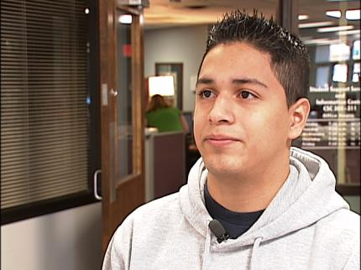
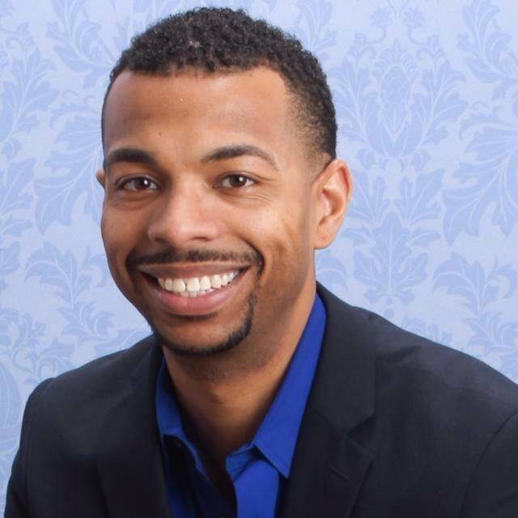
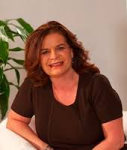

Slide 3
Can’t Do versus Don’t Want To
Notes:
When you believe students can’t do, this implies they lack critical skills to perform well, Continue treating them as unmotivated, manipulative, attention seeking, limit testing, and continue to rely heavily on consequences, often no change is seen.
Students that behave are not doing so because they understand the code of conduct, they are behaving because they have the skills to do so.
The school discipline program isn’t working for the kids who aren’t doing well and isn’t needed by the kids who are.
What is your philosophy (Plicker) If you are going to help improve behavior, pick one because it will guide your actions.
Goal of an intervention is to make the student “want” to do well instead of teaching the skills in order to adapt. What skills are lacking? Understanding why a kid is challenging is the first and most important part of helping him.

Slide 4
Change your Lens

Slide 5
Consequences
Teach basic lessons about right and wrong
Give students an incentive to behave
Notes:
Consequences are good for those that respond, but they often don’t work for the kids to whom they are most frequently applied. Most kids already know how we want them to behave.

Slide 6
When does Behavior Occur?
Behavior occurs when the demands of the environment exceed the student’s capacity to respond adaptively.
Notes:
Behavior tells us the student does not have the skills to be successful in that context.

Slide 7
Top 6 Popular Explanations
He just wants attention.
He just wants his own way.
He’s manipulating us.
He’s not motivated.
He’s making bad choices.
He has a bad attitude.
Notes:
Many of these explanations are popular, but all require skills…!
Seeking attention is maladaptive way implies the student does not have skills to seek attention adaptively.
We all want it our own way, but again seeking this maladaptively indicates we lack adaptive skills.
Manipulation requires, planning, forethought, and impulse control. The kids that are often described as manipulative are often the least likely to be able to pull it off..
He’s not motivated…leads us straight to interventions based on incentives only… Doing well is preferable.
Bad choices. Are we sure the student has the skills to make the right choices.
Bad attitudes, likely did not start that way, but it is a by product of countless years of being misunderstood and over punished.

Slide 8
The Options
PLAN A: Unilaterally solving a problem by imposing your will.
PLAN C: Capitulation or Caving.
PLAN B: ?
Notes:
Plan A greatly heightens the likelihood of challenging behavior in challenging kids…Plan A is uninformed and unilateral and based on the adult’s explanation for the behavior
PLAN B. Will the student require this type of support for the rest of his life? No, not if we solve in collaboratively now… PLAN B is not Crisis Management.
PLAN C allows us to prioritize.

Slide 9
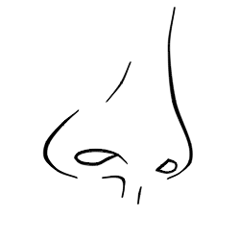
Power or Influence

Slide 10
The Options
PLAN A: Unilaterally solving a problem by imposing your will.
PLAN B: Problem solved collaboratively and not unilaterally. The adult understands the student’s perspective on the unsolved problem
PLAN C: Capitulation or Caving.
Notes:
Plan A greatly heightens the likelihood of challenging behavior in challenging kids…Plan A is uninformed and unilateral and based on the adult’s explanation for the behavior
PLAN B. Will the student require this type of support for the rest of his life? No, not if we solve in collaboratively now… PLAN B is not Crisis Management.
PLAN C allows us to prioritize.

Slide 11
Kids Do Well If They CAN
Lagging Skills
Unsolved Problems
The social and emotional learning skills the student is lacking. (WHY)
The specific conditions or situations in which challenging behavior occurs. (WHERE)
Notes:
Lagging skills contain no diagnoses.
It takes two to tango, somebody has to demand the skills

Slide 12
Getting Started with Plan B
Empathy (Gain the student’s perspective)
Define the adult concern
Invitation

Slide 13
Book Study

Slide 14
#SELectLove
Social and Emotional Learning Department

