Slide 1
Social and Emotional Learning (SEL)
#SELectLove

Slide 2
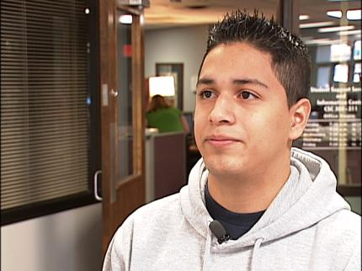

Slide 3
Can’t Do versus Don’t Want To
Notes:
When you believe students can’t do, this implies they lack critical skills to perform well, Continue treating them as unmotivated, manipulative, attention seeking, limit testing, and continue to rely heavily on consequences, often no change is seen.
Students that behave are not doing so because they understand the code of conduct, they are behaving because they have the skills to do so.
The school discipline program isn’t working for the kids who aren’t doing well and isn’t needed by the kids who are.
What is your philosophy (Plicker) If you are going to help improve behavior, pick one because it will guide your actions.
Goal of an intervention is to make the student “want” to do well instead of teaching the skills in order to adapt. What skills are lacking? Understanding why a kid is challenging is the first and most important part of helping him.

Slide 4
@SELHISD

Slide 5
Change your Lens

Slide 6
Consequences
Teach basic lessons about right and wrong
Give students an incentive to behave
Notes:
Consequences are good for those that respond, but they often don’t work for the kids to whom they are most frequently applied. Most kids already know how we want them to behave.

Slide 7
When does Behavior Occur?
Behavior occurs when the demands of the environment exceed the student’s capacity to respond adaptively.
Notes:
Behavior tells us the student does not have the skills to be successful in that context.

Slide 8
Top 6 Popular Explanations
He just wants attention.
He just wants his own way.
He’s manipulating us.
He’s not motivated.
He’s making bad choices.
He has a bad attitude.
Notes:
Many of these explanations are popular, but all require skills…!
Seeking attention is maladaptive way implies the student does not have skills to seek attention adaptively.
We all want it our own way, but again seeking this maladaptively indicates we lack adaptive skills.
Manipulation requires, planning, forethought, and impulse control. The kids that are often described as manipulative are often the least likely to be able to pull it off..
He’s not motivated…leads us straight to interventions based on incentives only… Doing well is preferable.
Bad choices. Are we sure the student has the skills to make the right choices.
Bad attitudes, likely did not start that way, but it is a by product of countless years of being misunderstood and over punished.

Slide 9
The Options
PLAN A: Unilaterally solving a problem by imposing your will.
PLAN C: Capitulation or Caving.
PLAN B: ?
Notes:
Plan A greatly heightens the likelihood of challenging behavior in challenging kids…Plan A is uninformed and unilateral and based on the adult’s explanation for the behavior
PLAN B. Will the student require this type of support for the rest of his life? No, not if we solve in collaboratively now… PLAN B is not Crisis Management.
PLAN C allows us to prioritize.

Slide 10
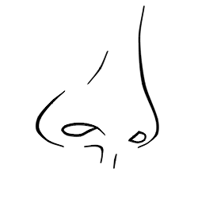
Power or Influence

Slide 11
The Options
PLAN A: Unilaterally solving a problem by imposing your will.
PLAN B: Problem solved collaboratively and not unilaterally. The adult understands the student’s perspective on the unsolved problem
PLAN C: Capitulation or Caving.
Notes:
Plan A greatly heightens the likelihood of challenging behavior in challenging kids…Plan A is uninformed and unilateral and based on the adult’s explanation for the behavior
PLAN B. Will the student require this type of support for the rest of his life? No, not if we solve in collaboratively now… PLAN B is not Crisis Management.
PLAN C allows us to prioritize.

Slide 12
Kids Do Well If They CAN
Lagging Skills
Unsolved Problems
The social and emotional learning skills the student is lacking. (WHY)
The specific conditions or situations in which challenging behavior occurs. (WHERE)
Notes:
Lagging skills contain no diagnoses.
It takes two to tango, somebody has to demand the skills

Slide 13
Getting Started with Plan B
Empathy (Gain the student’s perspective)
Define the adult concern
Invitation

Slide 14
Book Study

Slide 15
Why SEL
Notes:
Why we exist: Discuss exclusionary practices in discipline by race, socio economic status and disability.
Secondary
Group Percentage OSS
AA 25% 49%
SES 75% 84%
Disability 7% 18
(Elementary)
Group
AA 25% 65%

Slide 16
What is an Intervention?
Notes:
Begin 15 minute teach session on what is an intervention.

Slide 17
Venue versus Intervention
Notes:
Explain intervention versus venue analogy. A venue is where you go, and intervention is what is done.
Checkin Check Out System. Student checks in w/ a teacher, counselor at the beginning of each day to retrieve a goal sheet, encouragement and direction for the day, the student then checks in at the end of the day to reflect on the day.
Alternating between desired and non desired activties in order to give the student options through the school day while still completing all work. (venue)
Out of School Suspension (venue)
In School Suspension with no services (Venue)

Slide 18
Look For #1: Identify Problem Behavior
Notes:
Identify one problem behavior you have experienced this school year.

Slide 19
Look For #1: Identify Problem Behavior
Observable
Measureable
Notes:
Describe characteristics of a problem behavior. A problem behavior is not a vague description of a behavior such as aggressive, violent or disrespectful.
Direct participants to handout.

Slide 20
Problem
Behavior
Replacement
Behavior
Reinforcer
Intervention/Monitoring
Signature feature of an intervention
Signature feature of an intervention
Signature feature of an intervention
Notes:
Direct participants to complete appropriate sections

Slide 21
Look For #2: Replacement Behaviors
Notes:
Teach replacement behavior is the desired behavior that we want to occur in replace of the problem behavior.

Slide 22
Look For #2: Replacement Behaviors
Observable
Measureable
“Dead Man’s Test”
Incompatible

Slide 23
Problem
Behavior
Replacement
Behavior
Reinforcer
Intervention/Monitoring
Signature feature of an intervention
Signature feature of an intervention
Signature feature of an intervention
Notes:
Direct participants to complete appropriate sections

Slide 24
Look For #3: Reinforcers
Notes:
Differentiate one down versus one up reinforcer

Slide 25
Problem
Behavior
Replacement
Behavior
Reinforcer
Intervention/Monitoring
Signature feature of an intervention
Signature feature of an intervention
Signature feature of an intervention
Notes:
Direct participants to complete appropriate sections

Slide 26
Look For #4: Self-Monitoring

Slide 27
Look For #4: Self-Monitoring
Elementary
Secondary
Notes:
Self Monitoring (Student center) but used by adminiserator to reinforce the teacher. It is easy to miss what you are not look for. If we are only looking for the behavior to fade or go away, we are going to miss the fact that progress is being made.
Make analogy to istation, WPM, Running record or lexiles.

Slide 28
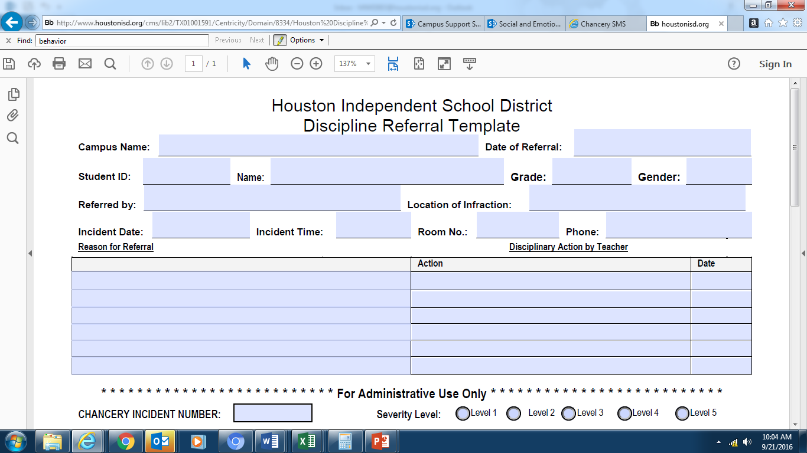
Notes:
Highlight difference between traditional office referral form and optional updated referral forms

Slide 29
Notes:
Highlight difference between traditional office referral form and optional updated referral forms

Slide 30
RESOURCES
Notes:
Show participants how to access resources (50 Alternatives to Suspension)

Slide 31
Questions

Slide 32
Thank you
Date: 00/00/2014
Presenter: First and last name
Title

