Slide 1
Social and Emotional Learning (SEL)

Slide 2
How We Look
TIER I PBIS
TIER II Student Intervention
TIER III
Crisis Intervention
School Discipline
Elementary DAEP
Community Partners
Campus Service Providers (CSP)
Behavior Specialists
Psychologists
SEL
Notes:
Review structure of SEL and role of SEL Coordinators.

Slide 3
Objectives
Why SEL?
Identify Four behavior intervention “Look- Fors”
Notes:
Introduce SEL and the SEL Vision

Slide 4
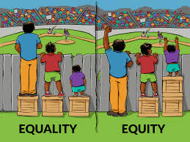
Why SEL
Notes:
Why we exist: Discuss exclusionary practices in discipline by race, socio economic status and disability.
Secondary
Group Percentage OSS
AA 25% 49%
SES 75% 84%
Disability 7% 18
(Elementary)
Group
AA 25% 65%

Slide 5

Your Early Success (Suspensions)
1,910
20%
1,516
Notes:
Suspension rate as of 9/16 has decreased 20% from this point in the 2015-2016 school year.

Slide 6

What is an Intervention?
Notes:
Begin 15 minute teach session on what is an intervention.

Slide 7
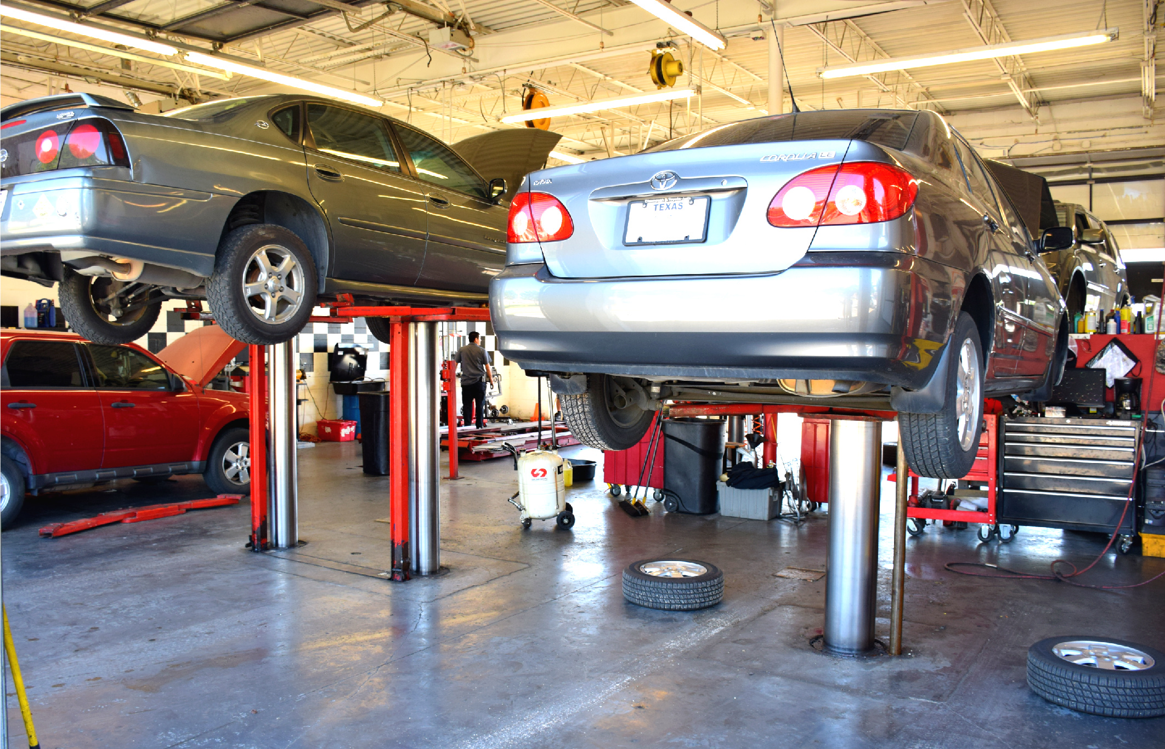
Venue versus Intervention
Notes:
Explain intervention versus venue analogy. A venue is where you go, and intervention is what is done.
Checkin Check Out System. Student checks in w/ a teacher, counselor at the beginning of each day to retrieve a goal sheet, encouragement and direction for the day, the student then checks in at the end of the day to reflect on the day.
Alternating between desired and non desired activties in order to give the student options through the school day while still completing all work. (venue)
Out of School Suspension (venue)
In School Suspension with no services (Venue)

Slide 8

Look For #1: Identify Problem Behavior
Notes:
Identify one problem behavior you have experienced this school year.

Slide 9
Look For #1: Identify Problem Behavior
Observable
Measureable
Notes:
Describe characteristics of a problem behavior. A problem behavior is not a vague description of a behavior such as aggressive, violent or disrespectful.
Direct participants to handout.

Slide 10

Problem
Behavior
Replacement
Behavior
Reinforcer
Intervention/Monitoring
Signature feature of an intervention
Signature feature of an intervention
Signature feature of an intervention
Notes:
Direct participants to complete appropriate sections

Slide 11
Top Five Problem Behaviors
Leaving without permission 123
Derogatory/ Abusive language 130
Dress code, chronic 162
Skipping, chronic 193
Fighting/Mutual Combat 261
Fail to adhere to directive 332

Slide 12

Look For #2: Replacement Behaviors
Notes:
Teach replacement behavior is the desired behavior that we want to occur in replace of the problem behavior.

Slide 13
Look For #2: Replacement Behaviors
Observable
Measureable
“Dead Man’s Test”
Incompatible

Slide 14
Problem
Behavior
Replacement
Behavior
Reinforcer
Intervention/Monitoring
Signature feature of an intervention
Signature feature of an intervention
Signature feature of an intervention
Notes:
Direct participants to complete appropriate sections

Slide 15

Look For #3: Reinforcers
Notes:
Differentiate one down versus one up reinforcer

Slide 16
Problem
Behavior
Replacement
Behavior
Reinforcer
Intervention/Monitoring
Signature feature of an intervention
Signature feature of an intervention
Signature feature of an intervention
Notes:
Direct participants to complete appropriate sections

Slide 17

Look For #4: Self-Monitoring

Slide 18
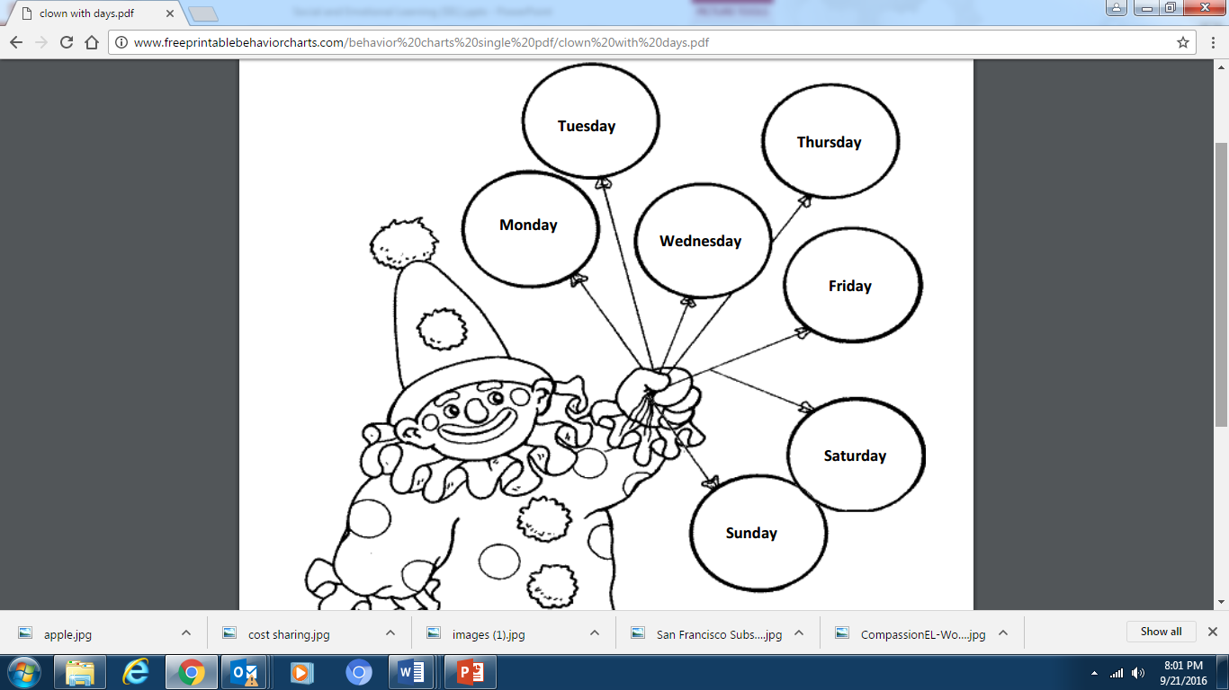
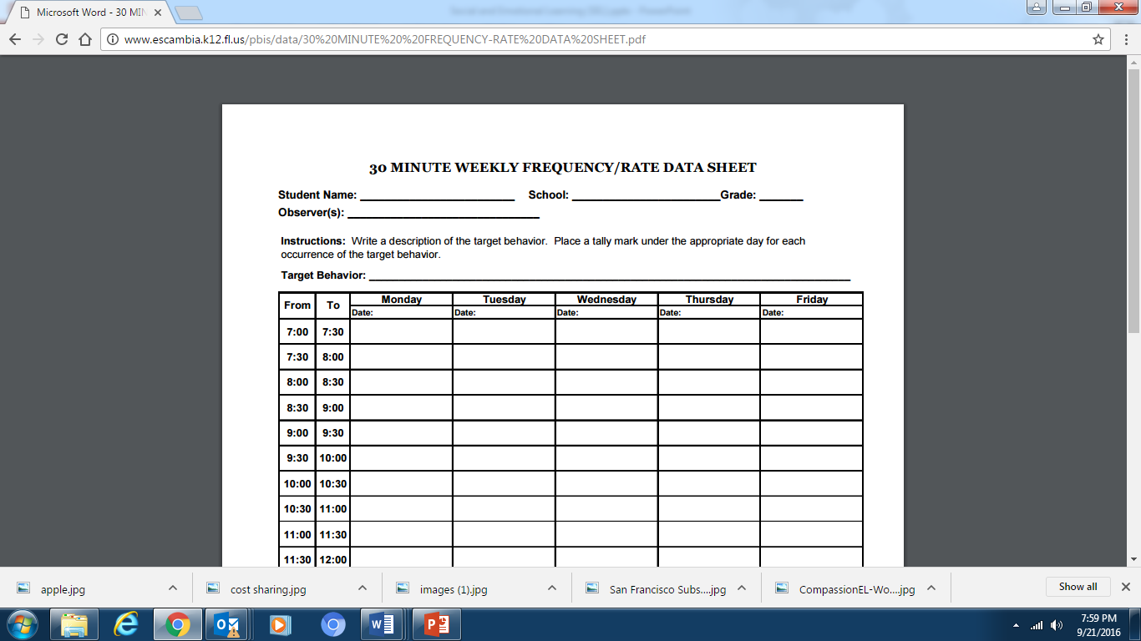
Look For #4: Self-Monitoring
Elementary
Secondary
Notes:
Self Monitoring (Student center) but used by adminiserator to reinforce the teacher. It is easy to miss what you are not look for. If we are only looking for the behavior to fade or go away, we are going to miss the fact that progress is being made.
Make analogy to istation, WPM, Running record or lexiles.

Slide 19
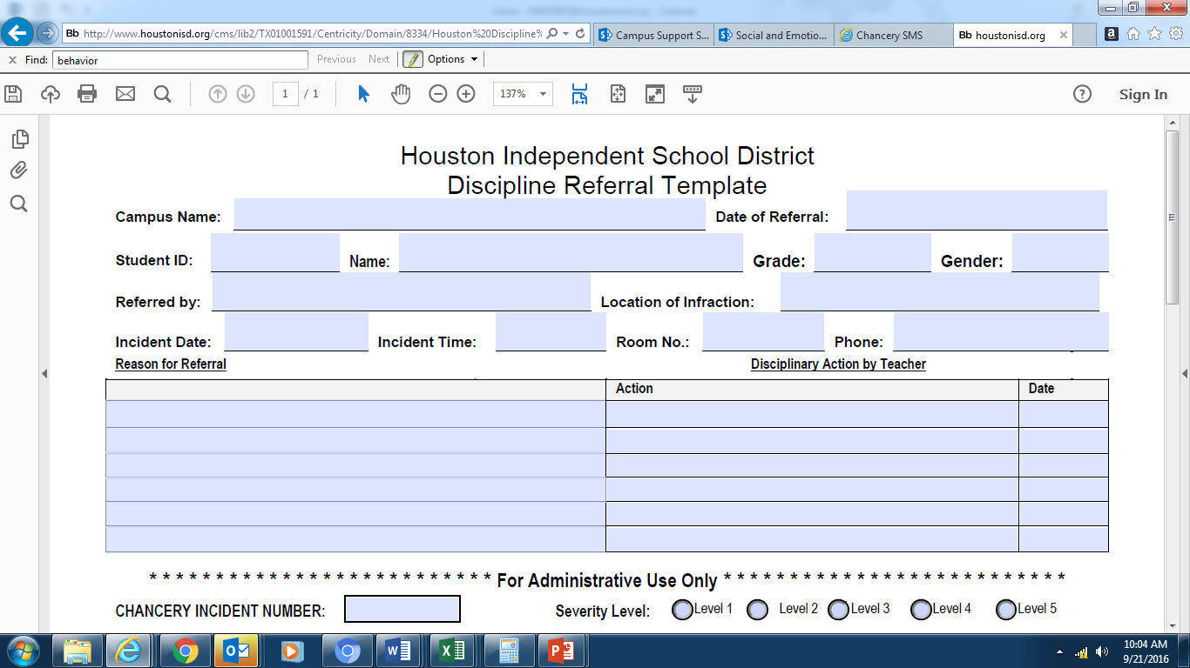
Notes:
Highlight difference between traditional office referral form and optional updated referral forms

Slide 20
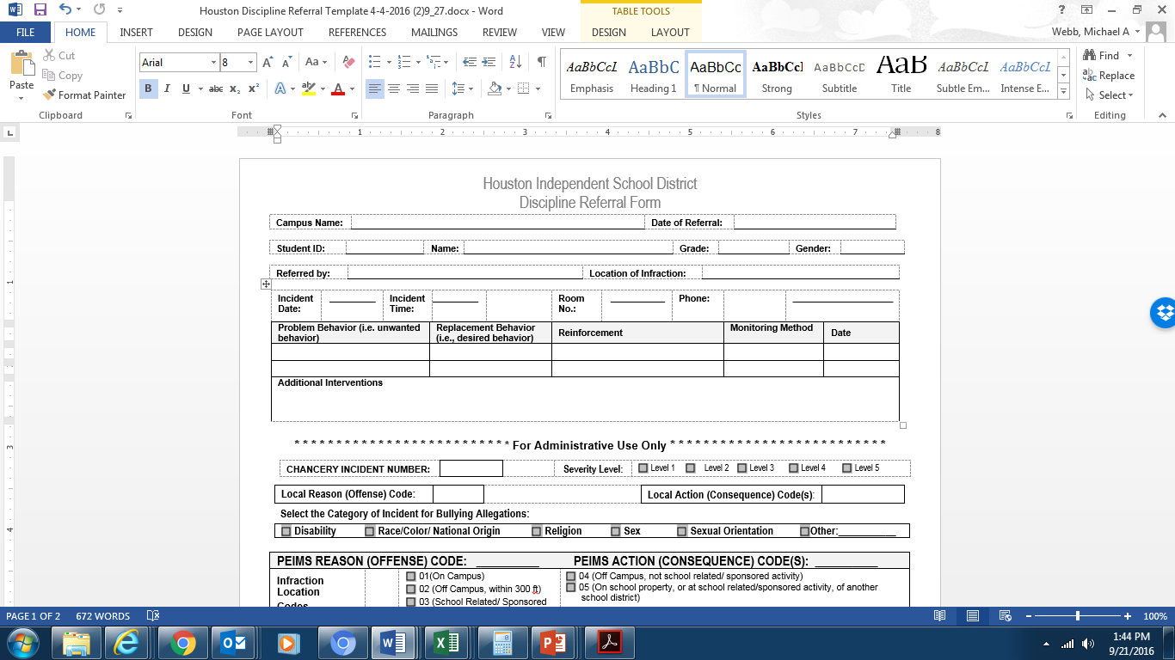
Notes:
Highlight difference between traditional office referral form and optional updated referral forms

Slide 21
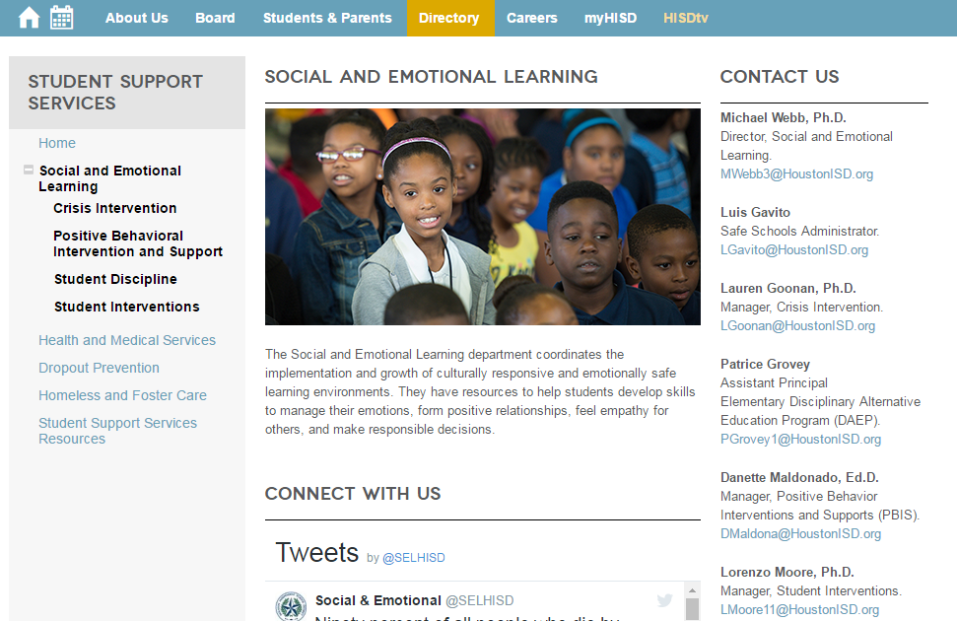
RESOURCES
Notes:
Show participants how to access resources (50 Alternatives to Suspension)

Slide 22

Questions

Slide 23
Thank you
Date: 00/00/2014
Presenter:
First and last name
Title

