Slide 1
Mr. Martinez
Personal Graduation plans – counseling – Social emotional learning – testing coordinator – attendance administrator - friend

Slide 2
All about Mr. Martinez
Academic Advising – Special Pops
Campus Testing Coordinator
504/IAT Coordinator
CTE/Attendance/PGP/SPED/TSI
Robotics / AP Spanish
SEL/Counseling/ Any other support
Father of 4 boys – Angel, Ethan, Liam, and Eric
Angel Martinez Counselor

Slide 3
Houston Academy for International Studies – Early College High School
We are a 4 year high school that offers an excellent opportunity for students to receive an associate’s degree from Houston Community College.
Our students can begin taking courses at Houston Community College beginning in 9th grade.
The only requirement that HCC has for students to begin taking entry-level courses is that students “attempt” the TSIA 2.0 at least one time. Therefore, we are asking all incoming 9th grade students to sign up to take the TSI.
HAIS will offer the TSI everyday after Phoenix Camp from 1PM to 5PM. You must sign up for it and the sign up is on a first come first served basis.
https://www.signupgenius.com/go/70A0845AEAC29A5F58-incoming

Slide 4
Personal Graduation plan – 4 year high school plan
ABOUT PGPS
When the 83rd Texas Legislature passed House Bill 5 into law, high school graduation plans changed for all students who will be freshmen during the 2014-15 school year and thereafter. The bill provides more flexibility for high school students to pursue either higher education or a career. House Bill 5 established a single graduation plan, the Foundation High School Program (FHSP). Students will also have the opportunity to build on the FHSP by earning Endorsements, Performance Acknowledgements, and a Distinguished Level of Achievement. Students will need to declare their preferred endorsement areas, in writing, by the beginning of their 9th grade year. Students will be able to change their endorsement at any time.
In our case here at HAIS, I am going to ask you to fill out a google form with your choices. Now on to 4 year plan…

Slide 5
4 year high school plan at HAIS
High School Graduation Requirements from State of Texas
4 years of English (English 1, English 2, AP English Language, AP English Literature)
4 years of Math (Algebra 1, Algebra 2, Geometry, 4th year of Math)
4 years of Science (Biology, Chemistry, Physics, 4th year of Science)
4 years of Social Studies (AP Human Geography, AP World History, U.S. History, Government, Economics)
2 years of Foreign Language (must be same language)
1 year of Physical Education
1 year of Fine Arts
½ year of Health
ALL OF THE ABOVE ARE REQUIRED BY THE STATE
5 ½ years of Electives (CTE, AVID, extra foreign language, HCC electives, etc.)

Slide 6
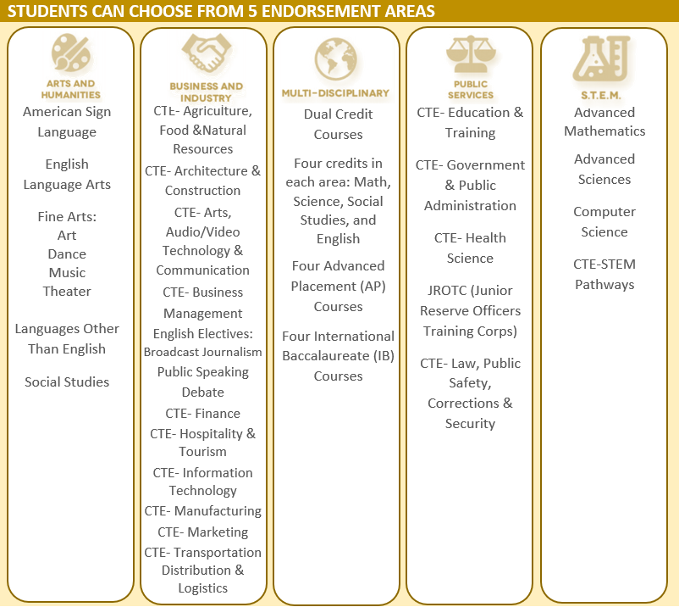
Endorsements
Endorsements are like specializations that students can choose to focus on during their high school career.
Everyone at HAIS will receive a Multi-Disciplinary endorsement because you will take AP courses, dual credit courses, and at least 4 credits in each area of Math, Science, Social Studies, and English
Students that do 4 years of Languages other than English or 5 years of Social Studies will receive an Arts and Humanities endorsement
STEM endorsement can be acquired with 5 years of math or science or with a Computer Science CTE pathway. (CTE pathways on next slide)

Slide 7
CTE Pathways (Career, Technical Education)
These courses are designed to help you with technology, college readiness, and they can also be geared towards your career interest.
Some of these CTE pathways, when they are completed can also earn you an endorsement:
Business and Industry pathway (endorsement) –
Business and Information Management Systems (every 9th grader takes this course at HCC)
Mobile App Development (10th grade)
Project Based Research (11th grade)
Career Prep (12th grade)
Public Service pathway (endorsement) –
Principles of Government and Public Policy (every 9th grader takes this course at HCC)
Political Science 1 (10th grade)
Political Science 2 (11th grade)
Practicum in local state and federal government (12th grade)
STEM pathway (endorsement) -
Fundamentals of Computer Science
AP Computer Science Principles (10th grade)
Mobile App Development (11th grade)
Career Prep (12th grade)

Slide 8
Other items to consider on PGP
Career Interest – what would you like to do after you finish with school?
Post High School Plans – for most of you, you will select – 4 year university, but you can also select employment
Post Secondary Training – You need to check the following: PSAT, TSI, SAT, and ACT (we plan on having you do all of those tests to get you ready for college)
Endorsement Choice – You need to select at least 1 endorsement, but you can choose up to 4. You will also have the ability to change these at any time. All you have to do is email Mr. Martinez.
Comments – write anything that you would like for me to know or if you want to have a follow up meeting to discuss this further.

Slide 9
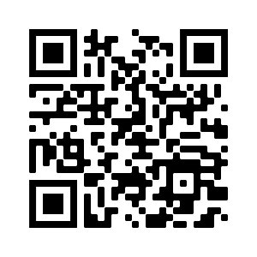
Google Form – Personal Graduation plan
https://forms.gle/N1a9RAsbqJ9t7MpG8

Slide 10
Houston Academy for International Studies – Early College High School
We are a 4 year high school that offers an excellent opportunity for students to receive an associate’s degree from Houston Community College.
Our students can begin taking courses at Houston Community College beginning in 9th grade.
The only requirement that HCC has for students to begin taking entry-level courses is that students “attempt” the TSIA 2.0 at least one time. Therefore, we are asking all incoming 9th grade students to sign up to take the TSI.
HAIS will offer the TSI everyday after Phoenix Camp from 1PM to 5PM. You must sign up for it and the sign up is on a first come first served basis.
https://www.signupgenius.com/go/70A0845AEAC29A5F58-incoming

