Slide 1
Getting to Bookshelf

Slide 2
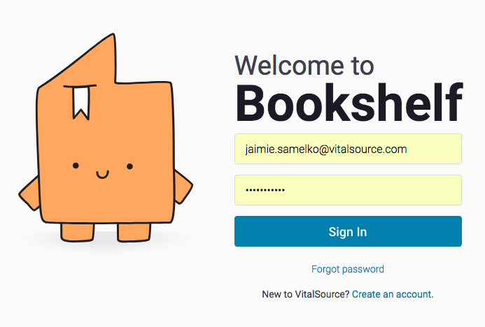
ACCESS BOOKSHELF
Go to https://online.vitalsource.com/#/user/signin
Returning users will use the same credentials used when logging into your previous Bridge account.
New users will create an account, using their HISD student email address using a lowercase “s and follow the instructions.
Sign into your Houston ISD Outlook email and look for the email from Do.Not.Reply@vitalsource.com
Follow instructions to complete your setup

Slide 3
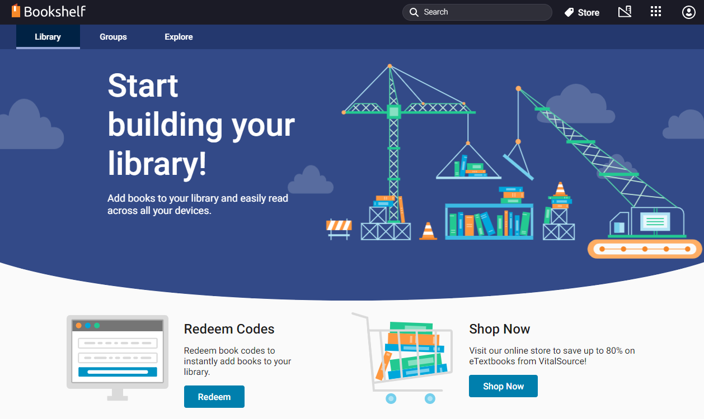
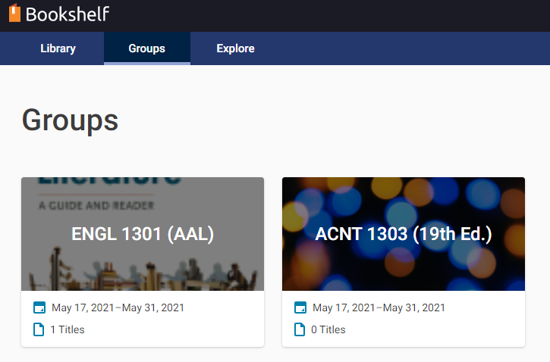
ACCESS MATERIALS
Once users are logged in, they will see three tabs in the top, left-side of window: Library, Groups, and Explore
Library Tab
Users will see the course materials they have opened/added to their library
Groups Tab
Users will see the course name assigned to them. Hover over the desired course and select “View Group” (users will see course materials they have access to)
Explore Tab
Users will see the text they have access to. Hover over the desired course and select “Open Book” (users will see text/code they have access to)

Slide 4
Get Access Code

Slide 5
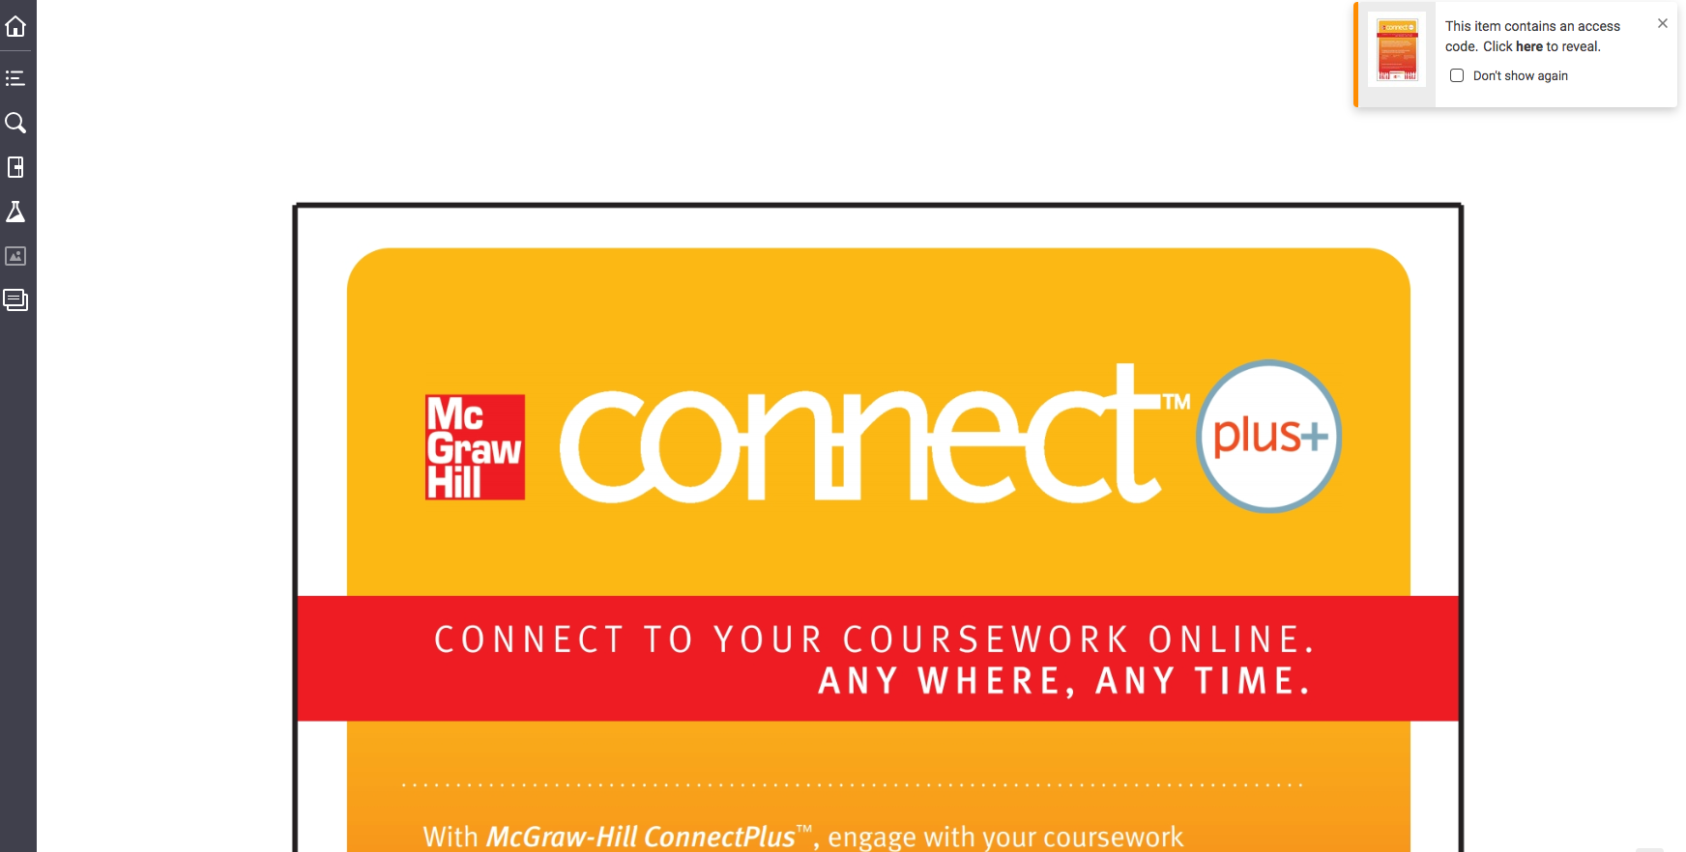
GET ACCESS CODE
STEP 1: Hover over the Connect icon and click “Open Book”
STEP 2: The Connect window will open and a small pop-up window will appear in the top, right corner
STEP 3: Click on the “here” link in the description.
STEP 4: Follow the prompts until your code is revealed.
NOTE: Codes may appear as any of the three windows reflected above.

Slide 6
Follow the prompts to view the code. The course instructor will provide the appropriate URL where the user will input the access code.

Slide 7
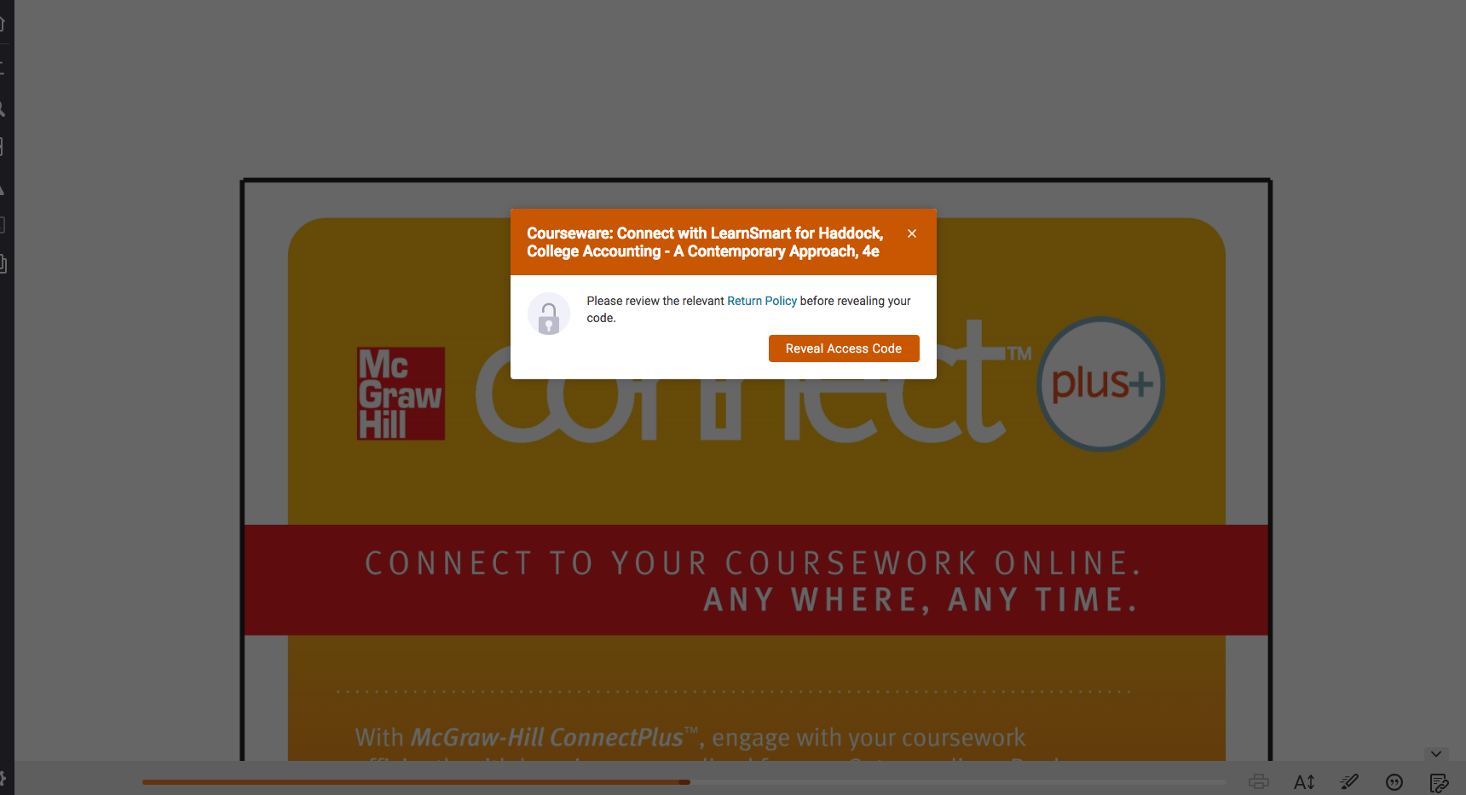

Slide 9
Thank You

