Slide 1
Dual Credit

Slide 2
What is Dual Credit?
The Texas Higher Education Coordinating Board (THECB) defines dual credit as a system in which an eligible high school student enrolls in college course(s) and receives credit for the course(s) from both the college and high school.
Dual Credit courses may be taught on the high school campus by an approved instructor or on the college campus.
Dual Credit courses include both academic and technical courses.

Slide 3
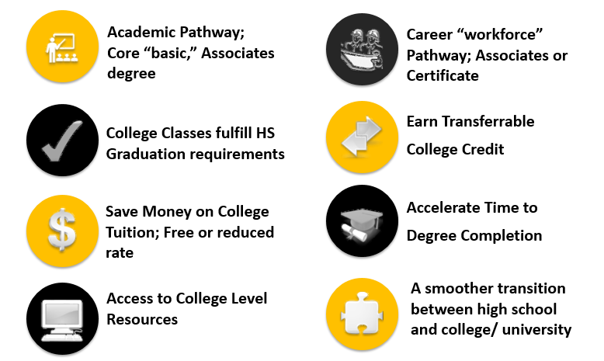
Benefits of Dual Credit

Slide 4
Areas of Study
Art & Design
Business
Construction Industry & Manufacturing
Health Sciences
Social & Behavioral Sciences
Science, Technology Engineering & Math
Public Safety, Transportation & Consumer Services
Liberal Arts, Humanities & Education

Slide 5
Program Eligibility and Requirements

Slide 6
Student Responsibilities
Meet with HS HCC Liaison / Counselor
Meet the HCC Dual Credit Success Coach
Be prepared & Attend class
Maintain at least a 2.0 Grade Point Average (GPA)
Syllabus & Academic Calendar
Keep Parent informed
Adhere to the Student Code of Conduct

Slide 7
Differences Between High School & College
COLLEGE | HIGH SCHOOL
College classes require great amounts of time management, focus and attention are needed to pass college courses. | High school classes may pass over some topics superficially, while College classes go in depth on issues.
In college much more material is covered in each class. This means there is not as much time to do homework as in high school. College moves at a faster pace. | Time spent in class is less in college, but time spent working on assignments out of class is much more. Therefore, a greater amount of reading and studying is required in college.
Unlike high school, college professors expect that you learn material independently. Due to the speed of class if you do not do the homework you will quickly fall behind. | In high school teachers often run through the next day’s assignments. In college the professors expect you to read the course syllabus, that includes course assignments and when it is due, exam dates and how you will be graded.
High school teachers repeat themselves, so students understand what’s required of them. College professors tend to leave it up to the student’s responsibility for information on syllabus whether it is covered in class or not. | High school teaches you mostly from textbooks. College professors expect you to understand the text and teach in many different ways.
Self-Advocacy (watch out for and be on top of your classes yourself). | Parents and teachers are your advocates.
Colleges provide a different level of support services, and it is the student’s responsibility to ask for help and advocate for themselves. | High school provides a high level of support and takes responsibility.
Professors are usually open and helpful however; they expect you to initiate the contact if you need help. | High school teachers ask if you need help and are available before and after school.

Slide 8
Family Educational Rights and Privacy Act (FERPA)
The Family Educational Rights and Privacy Act (FERPA) is a Federal law that protects the privacy of student education records. The law applies to all schools that receive funds under an applicable program of the U.S Department of Education.
“If a student is attending a postsecondary institution - at any age - the rights under FERPA have transferred to the student. However, in a situation where a student is enrolled in both a high school and a postsecondary institution, the two schools may exchange information on that student. If the student is under 18, the parents still retain the rights under FERPA at the high school and may inspect and review any records sent by the postsecondary institution to the high school. Additionally, the postsecondary institution may disclose personally identifiable information from the student’s education records to the parents, without the consent of the eligible student, if the student is a dependent for tax purposes under the IRS rules.” (US Department of Education, 2020)
https://studentprivacy.ed.gov/faq/if-student-under-18-enrolled-both-high-school-and-local-college-do-parents-have-right-inspect

Slide 9
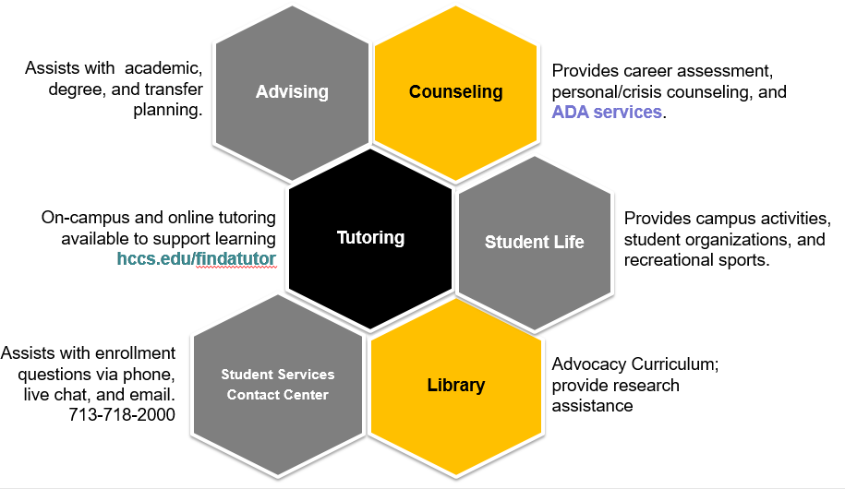
College Campus Resources

Slide 10
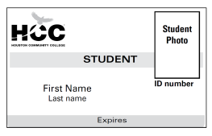
HCC Student ID Card and Email
HCC Student ID Card
HCC Student Email
STUDENT
Technical Support
Password reset : 713.718.8800
Eagle Online Canvas:713.718.5275
When contacting HCC Staff/ Faculty you will need to use your HCC email.
Notes:
District numbers

Slide 11
Dual Credit Contact Information

Slide 12
Q & A

