Slide 1
Public Hearing on Budget & Tax Rate 2025-2026 Proposed Fiscal Year Budget June 12, 2025

Slide 2
School Year 25-26 Budget Goals
Prioritize district resources to sustain transformation: Resource key district priorities to sustain early transformation progress, accomplish Board Goals
Align resources to enrollment to ensure sustainability: Create central office department budgets and ensure direct-to-school budget allocations align to the Action Plan and account for enrollment decreases. Ultimately, these allocations aim to ensure minimal disruptions to programming.

Slide 3
Our Guiding Principles
Keep cuts as far away from the classroom as possible. We are ensuring that every school gets the per-pupil allowance they are supposed to receive. The District will provide the necessary funds for each school to maintain high quality instruction and a safe and supportive school environment.
Prioritize resources to meet District goals. The District Action Plan provides an outline of the highest priority items that will help the District accomplish the School Board’s goals and the District’s mission.
Make decisions now that will support long term financial sustainability. The District will be one step closer to a balanced budget, will allocate necessary funds to accomplish Board Goals and actualize District vision while maintaining District fiscal stability.

Slide 4
Budget Workshop Series Scope and Sequence
Workshop Series Goals
Socialize HISD’s approach to budgeting
Connect the 25-26 budget to District goals and priorities
Outline areas for proposed spending reductions
Provide transparency into the department and school budget allocations
February 27th
March 26th
April 23rd
May 1st
May 22nd
June 12th
Overview of District Financial Position
Overview of Best-in-Class District Budget Development Practices
HISD’s School Year 25-26 Budget Approach and Timeline, Assumptions and Methodology
School Year 25-26 District Action Plan and Alignment to Board Goals
School Budget Approach Preview
Central Office Department Budget Allocations
PUA School Budget Overview
NES Budget Overview
Preliminary high-level budget
PUA | NES Campus Budget Update
Facilities Review
May 22: Proposed Budget Review + Board Discussion
June 12: Budget Vote

Slide 5
Development Timeline
January 2025
February 2025
March 2025
April 2025
May 2025
June 2025
Informed by District Progress Data, Superintendent drafts District Action Plan
Confirm Budget Development timeline
Review and approve Department Action Plans
Train school and district leaders on action planning and budget development
Departments and schools develop budgets based on allocations
Budget Workshop 2: District Action Plan
Review and approve school Action Plans
Finalize school budgets
Budget Workshop 4: Facilities overview, draft high-level budget review
Budget Workshop 5: Wrap-up budget discussion + Board questions
Central Office Teams develop Department Action Plans
Develop Budget assumptions and initial parameters
Budget Workshop 1: The Budget development process, budget principles, assumptions, initial parameters
Schools submit Action Plans
Finalize department budgets
Budget Workshop 3: School and central office budget overview
June Regular Board Meeting: Budget Vote

Slide 6
Agenda
Property Values
Budgets for Adoptions
General Fund
Debt Service Fund
Nutrition Services Fund
Budget Form to be Adopted

Slide 7
Property Values

Slide 8
Tax Year 2025 Property Values

Slide 9
Estimated FY2026 Tax Collections
Projected Taxable Value = $241,143,766,896
M&O Tax Rate = .6923
Estimated M&O Tax Revenue = $1,558,545,630
I&S Tax Rate = .1667
Estimated I&S Tax Revenue = $367,333,733

Slide 10
General Fund (M&O)

Slide 11
Proposed General Fund Budget FY26
See attachment

Slide 12
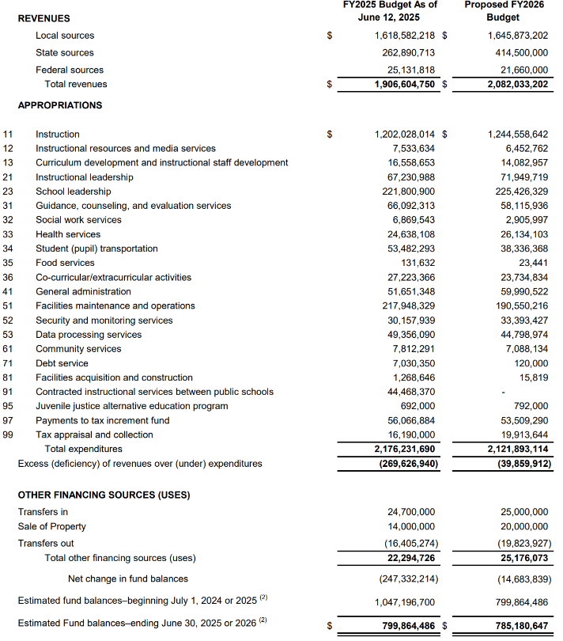
Proposed General Fund Budget FY26

Slide 13
Revenue
Revenue/ Savings | Budget Estimates
Budgeted Revenue FY2025 | $1,906,604,750
Local Revenue: Property Taxes/Interest Earnings (4) | $27,290,984
State Funding
Basic Allotment and State Entitlements | $83,884,702
Teacher Retention Allotment | $36,550,000
Support Staff Retention Allotment | $6,287,135
School Safety Allotment | $6,636,919
Allotment for Basic Costs | $18,250,531
Federal Sources: Indirect Cost (1) | ($3,471,818)
Revenue Increase | $175,428,453
Estimated Revenue FY2026 | $2,082,033,203

Slide 14
Expenditures
Increase/Decrease in Expenditures | Budget Estimate
Budgeted Expenditures FY2025 | $2,176,231,690
Pre-K Expansion | $5,000,000
Other District Action Plan (5) | $3,000,000
Teacher Pay Raise | $11,710,000
Support Staff Pay Raise | $5,800,000
Special Education - Teachers and Teaching Assistants | $13,728,691
Schools-Charter, DAEP, JJAEP, HCC Lifeskills, Community Services | $10,861,591
Safety & Security | $3,235,488
Appraisal Fee Increase | $3,723,644
Districtwide | $6,709,676
Maintenance Tax Notes | $4,000,000
Increase in expenditures | $67,769,090
Departments | ($29,230,451)
PUA Campuses | ($14,118,621)
NES Campuses | ($21,509,955)
One-Time Expenses | ($12,780,269)
Recapture (2) | ($44,468,370)
Reductions in expenditures | ($122,107,666)
Expenditures (decrease) | ($54,338,576)
Estimated Expenditure F20Y26 | $2,121,893,114

Slide 15
Summary
Estimated Revenue FY2026 | $2,082,033,203
Estimated Expenditure F20Y26 | $2,121,893,114
Revenue - Expenditures FY2026 | ($39,859,911)
Other Sources
Transfers In Other Funds (6) | $25,000,000
Sale of Property | $20,000,000
Transfers (Out) Debt (3) | ($19,823,927)
Total Other sources/uses | $25,176,073
Net change in Fund Balance | ($14,683,838)
Forecasted FY 2025 Fund Balance | $799,864,486
Forecasted FY 2026 Fund Balance | $785,180,648

Slide 16
Debt Services Fund

Slide 17
Debt Service Fund (I&S)
The Debt Service Fund pays back the district's principal and interest on long-term, general debt obligations.
Primary source of revenues – Property Taxes
Proposed Interest & Sinking (I&S) tax rate – 0.1667
This is the same tax rate as the prior year.
The school board will adopt an I&S tax rate in September or October.
Current bond ratings:
Moody's: AAA (highest possible rating)
Standard and Poor's: AA+

Slide 18
Bond Profile

Slide 19
FY26 Recommended Debt Service Fund (I&S) Statement of Revenues & Expenditures
 | REVENUES | Projected FYE 2025 Budget | Projected FY2026 Budget
 | Local sources | 369,108,048 | 374,083,733
 | State sources | 16,323,934 | 15,665,576
 | Federal sources | - | -
 | Total revenues | 385,431,982 | 389,749,309
 | APPROPRIATIONS
71 | Debt service | 373,118,145 | 397,003,334
 | Total expenditures | 373,118,145 | 397,003,334
 | Excess (deficiency) of revenues over (under) expenditures | 12,313,837 | (7,254,025)
 | OTHER FINANCING SOURCES (USES)
 | Transfers in | 20,977,900 | 20,643,677
 | Issuance of refunding debt | 435,175,000 | -
 | Premium on the sale of refunding debt | 26,483,255 | -
 | Payment of refunding bonds to escrow agent | (452,435,000) | -
 | Total other financing sources (uses) | 30,201,155 | 20,643,677
 | Net change in fund balances | 42,514,991 | 13,389,653
 | Estimated fund balances–beginning July 1, 2024 or 2025 ⁽¹⁾ | 126,657,122 | 169,172,113
 | Estimated Fund balances–ending June 30, 2025 or 2026 ⁽¹⁾ | 169,172,113 | 182,561,766
(1) Fund balances will be updated once the 2024-2025 Annual Comprehensive Financial Report (ACFR) is complete.
Estimates based on current data; subject to change

Slide 20
Nutrition Services Fund

Slide 21
FY26 Recommended Nutrition Services Fund Statement of Revenues & Expenditures
 | REVENUES | Projected FYE 2025 Budget | Projected FY2026 Budget
 | Local sources | 8,739,835 | 9,966,373
 | State sources | 458,239 | 491,957
 | Federal sources | 133,280,661 | 136,992,532
 | Total revenues | 142,478,735 | 147,450,862
 | APPROPRIATIONS | Projected FYE 2025 Budget | Projected FY2026 Budget
35 | Food services | 149,632,418 | 134,844,512
41 | General administration | 655,308 | 427,672
51 | Facilities maintenance and operations | 2,443,723 | 10,147,005
 | Total expenditures | 152,731,449 | 145,419,189
 | Excess (deficiency) of revenues over (under) expenditures | (10,252,714) | 2,031,673
 | Net change in fund balances | (10,252,714) | 2,031,673
 | Estimated fund balances–beginning July 1, 2024 or 2025 ⁽¹⁾ | 62,689,022 | 52,436,308
 | Estimated Fund balances–ending June 30, 2025 or 2026 ⁽¹⁾ | 52,436,308 | 54,467,981
 | (1) Fund balances will be updated once the 2024-2025 Annual Comprehensive Financial Report (ACFR) is complete.
 | Estimates based on current data; subject to change

Slide 22
Proposed Budget

Slide 23
Proposed Budget
See attachment

Slide 24
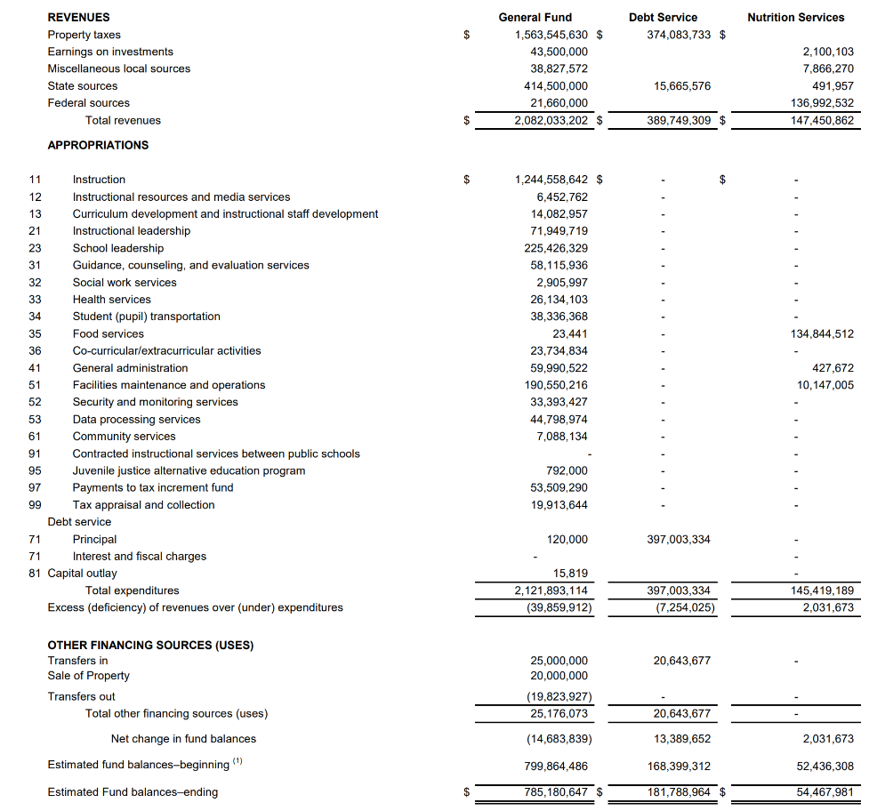
Proposed Budget FY26

