Slide 1
Create Your Own
CS HERO Poster
Agriculture, Food & Natural Resources
Arts, Information & Communication
Business, Marketing & Management
Health Sciences
Human Services & Education
Industrial & Engineering Systems
#CSEverywhere

Slide 2
Table of Contents
Lesson Plan
Sample Posters
Basic Digital Format
Poster Templates
(by Career Industries)
‘Unplugged’ Lesson Plan
Blank Printable Copy
Generic CS Templates
Link to CS Poster Heros
Link to Poster Submission (CSTA)
#CSEverywhere

Slide 3
My CS Hero Poster
Create a poster of your CS Hero that describes the positive change the person has on others.
PLAN Content
Identify images and information that will be on the poster.
DESIGN Posters
Use Google Slides and other platforms to create a digital poster.
SHARE with Others
Showcase posters to the class and/or share with a wider audience.
#CSEverywhere

Slide 4
My CS Hero Poster
CONTENT VOCABULARY
View the list of vocabulary words that relate to the content of the Future Me Poster activity. Prior to the lesson, go over the terms with your students and consider having a Word Wall that includes definitions, images and translations to other student home languages.
Career - a job or profession that someone does for a long time
Computer science - using the power of computers to solve problems
Hero - a person who is greatly admired
Industry - a group of businesses that provide a particular product or service
Transform - to change (something) completely and usually in a good way
Leverage - to use (something valuable) to achieve a desired result
Industry Categories
Agriculture, Food & Natural Resources
Arts, Information & Communications
Business, Marketing & Management
Health Sciences
Human Services & Education
Industrial & Engineering Systems
Note: We simplified a large list of industries into six clusters listed above, but don’t be limited by this. You may want to use your state list or a more detailed list to make it easy for students to pick one.
These clusters will be used to tag CS Heroes on csedweek.org/teach.
#CSEverywhere
Notes:
Vocabulary (all grades)
Suggestion: Cover content vocabulary prior to lesson, especially for lower grade levels and English Language Learners.

Slide 5
My CS Hero Poster
PLAN
Identify images and information that will be on the poster.
Complete the table below.
Name |  | Position
Location |  | Company
How did you find out about this CS Hero?
What industry does your CS Hero belong to?
What type of work does your CS Hero do?
How does your CS Hero positively change the lives of others?
Write one sentence that describes the work that your CS Hero does. Begin with your CS Hero’s first name.
First Name …
Complete the sentence by entering the type how your CS Hero’s work helps others.
Computer science helps …
What images could you put on the poster to show this?
#CSEverywhere
K-5
Notes:
Content Digital Worksheet (K-5th grades)

Slide 6
My CS Hero Poster
PLAN
Identify images and information that will be on the poster.
Complete the table below.
Name | Mark Dean | Position | Computer Engineer
Location | Knox County, Tennessee, USA | Company | University of Tennessee
How did you find out about this CS Hero? |  | I Googled black computer scientists.
What industry does your CS Hero belong to? |  | Computer engineering
What type of work does your CS Hero do? |  | He invents computer hardware. He created the gigahertz (processing chip).
How does your CS Hero positively change the lives of others? |  | Faster computers allows people to access information faster.
Write one sentence that describes the work that your CS Hero does. Begin with your CS Hero’s first name.
Mark invents computers and processing chips.
Complete the sentence by entering the type how your CS Hero’s work helps others.
Computer science helps people access information faster.
What images could you put on the poster to show this? |  | Computer, processing chip, maybe a machine that is creating the processing chip
#CSEverywhere
K-5
Notes:
Content Digital Worksheet (K-5th grades) - SAMPLE
Sample response are in bold.

Slide 7
My CS Hero Poster
PLAN
Identify images and information that will be on the poster.
Complete the table below.
Name |  | Position
Location |  | Company
How did you find out about this CS Hero?
What type of work does your CS Hero do?
How does your CS Hero positively change the lives of others?
What industry does your CS Hero belong to?
Write one sentence that describes what your CS Hero’s work and how it helps others. Begin with your CS Hero’s first name.
First name ...
Complete the sentence by entering industry your CS Hero belongs to.
Computer science is transforming ...
What images could you put on the poster to show this?
#CSEverywhere
6-12
Notes:
Content Digital Worksheet (6th-12th grades)

Slide 8
My CS Hero Poster
PLAN
Identify images and information that will be on the poster.
Complete the table below.
Name | Mark Dean | Position | Computer Engineer
Location | Knox County, Tennessee, USA | Company | University of Tennessee
How did you find out about this CS Hero? |  | I Googled black computer scientists.
What type of work does your CS Hero do? |  | He invents computer hardware. He created the gigahertz (processing chip).
How does your CS Hero positively change the lives of others? |  | His work allows people to access information faster.
What industry does your CS Hero belong to? |  | Computer engineering
Write one sentence that describes what your CS Hero’s work and how it helps others. Begin with your CS Hero’s first name.
Mark invents computer and processing chips that allow people to access information faster.
Complete the sentence by entering industry your CS Hero belongs to.
Computer science is transforming computer engineering.
What images could you put on the poster to show this? |  | Computer, processing chip, machine creating a processing chip
#CSEverywhere
6-12
Notes:
Content Digital Worksheet (6th-12th grades) - SAMPLE
Sample response are in bold.

Slide 9
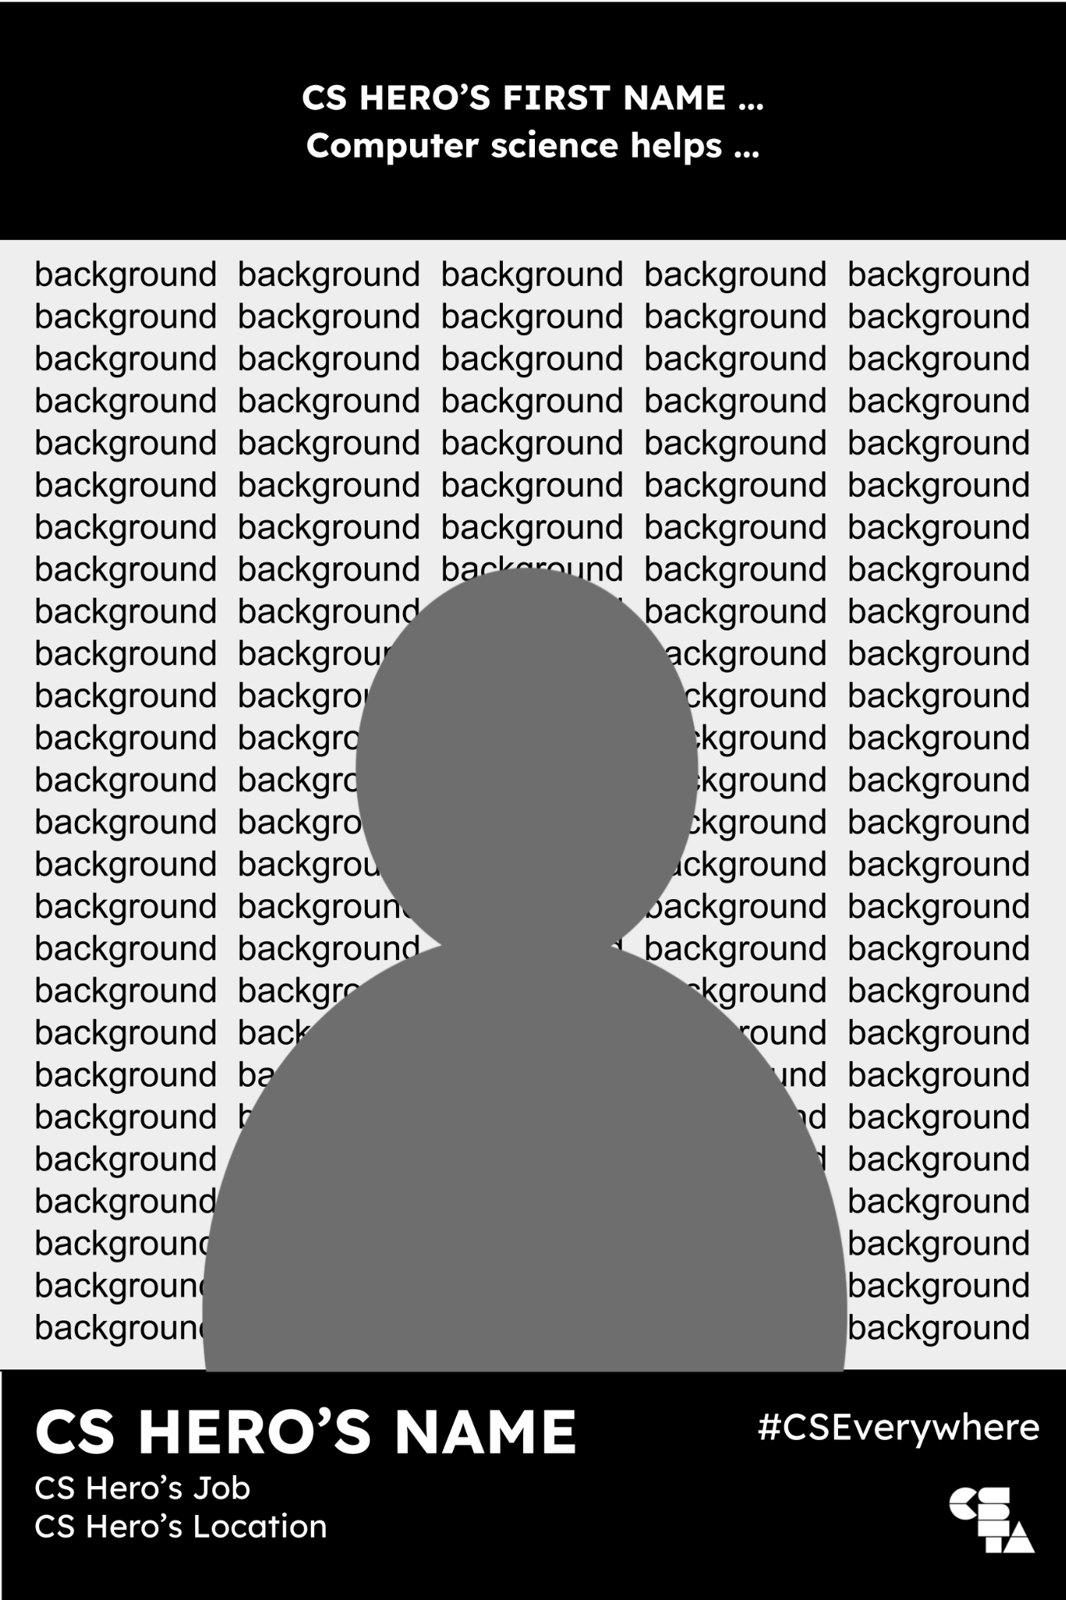
My CS Hero Poster
DESIGN
Use Google Slides and other platforms to create a digital poster.
Input the CS Hero tagline from PLAN Slide.
Order: SEND your background image TO BACK.
Order: BRING the CS Hero profile image TO FRONT.
Input the CS Hero’s name, job and location.
How to Layer Objects
Click on object
Click Arrange
Click Order
Click Send to Back OR Bring to Front
OR: Right click on object, then Steps 3 & 4
Additional Tech Resources
How to Change Layer Order in Google Slides - Guide
How to Layer Objects in Google Slides - Video (1:31)
#CSEverywhere
K-5
Notes:
Design Guide: K-5

Slide 10
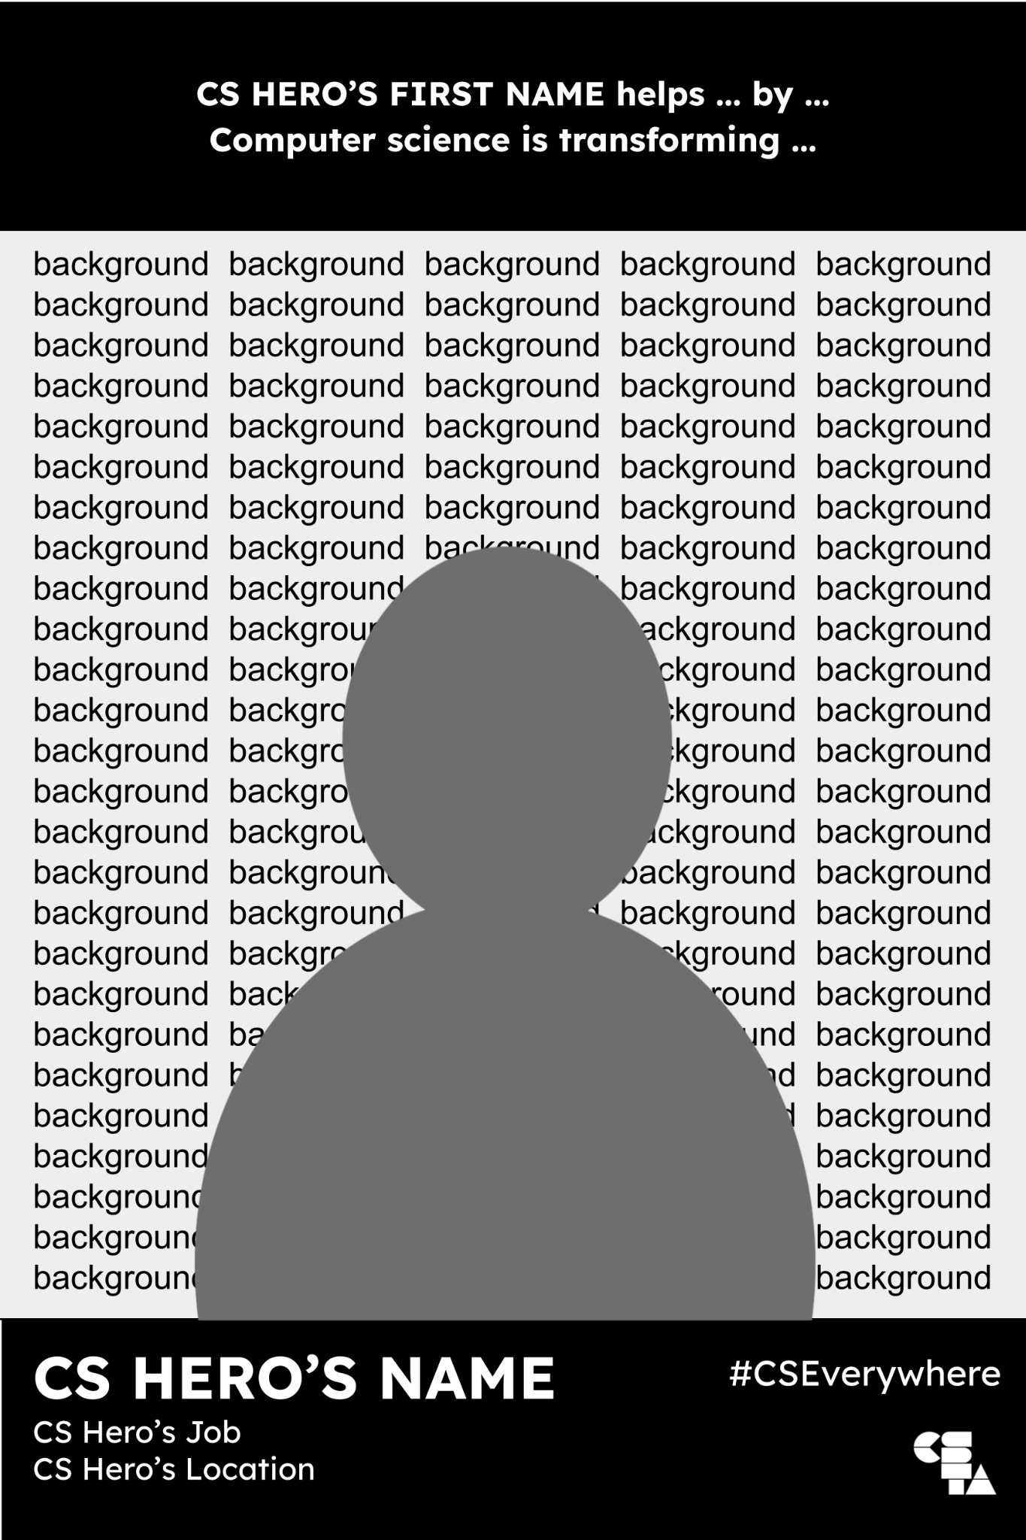
My CS Hero Poster
DESIGN
Use Google Slides and other platforms to create a digital poster.
Input the CS Hero tagline from PLAN Slide.
Order: SEND your background image TO BACK.
Order: BRING the CS Hero profile image TO FRONT.
Input the CS Hero’s name, job and location.
How to Layer Objects
Click on object
Click Arrange
Click Order
Click Send to Back OR Bring to Front
OR: Right click on object, then Steps 3 & 4
Additional Tech Resources
How to Change Layer Order in Google Slides - Guide
How to Layer Objects in Google Slides - Video (1:31)
#CSEverywhere
6-12
Notes:
Design Guide: 6-12

Slide 11
My CS Hero Poster
Remove Image Background
How to remove a background image to create a person profile
Instructions
Go to remove.bg
Upload image.
Download.
Insert your new image.
#CSEverywhere
Notes:
Remove Image Background - Instructions

Slide 12
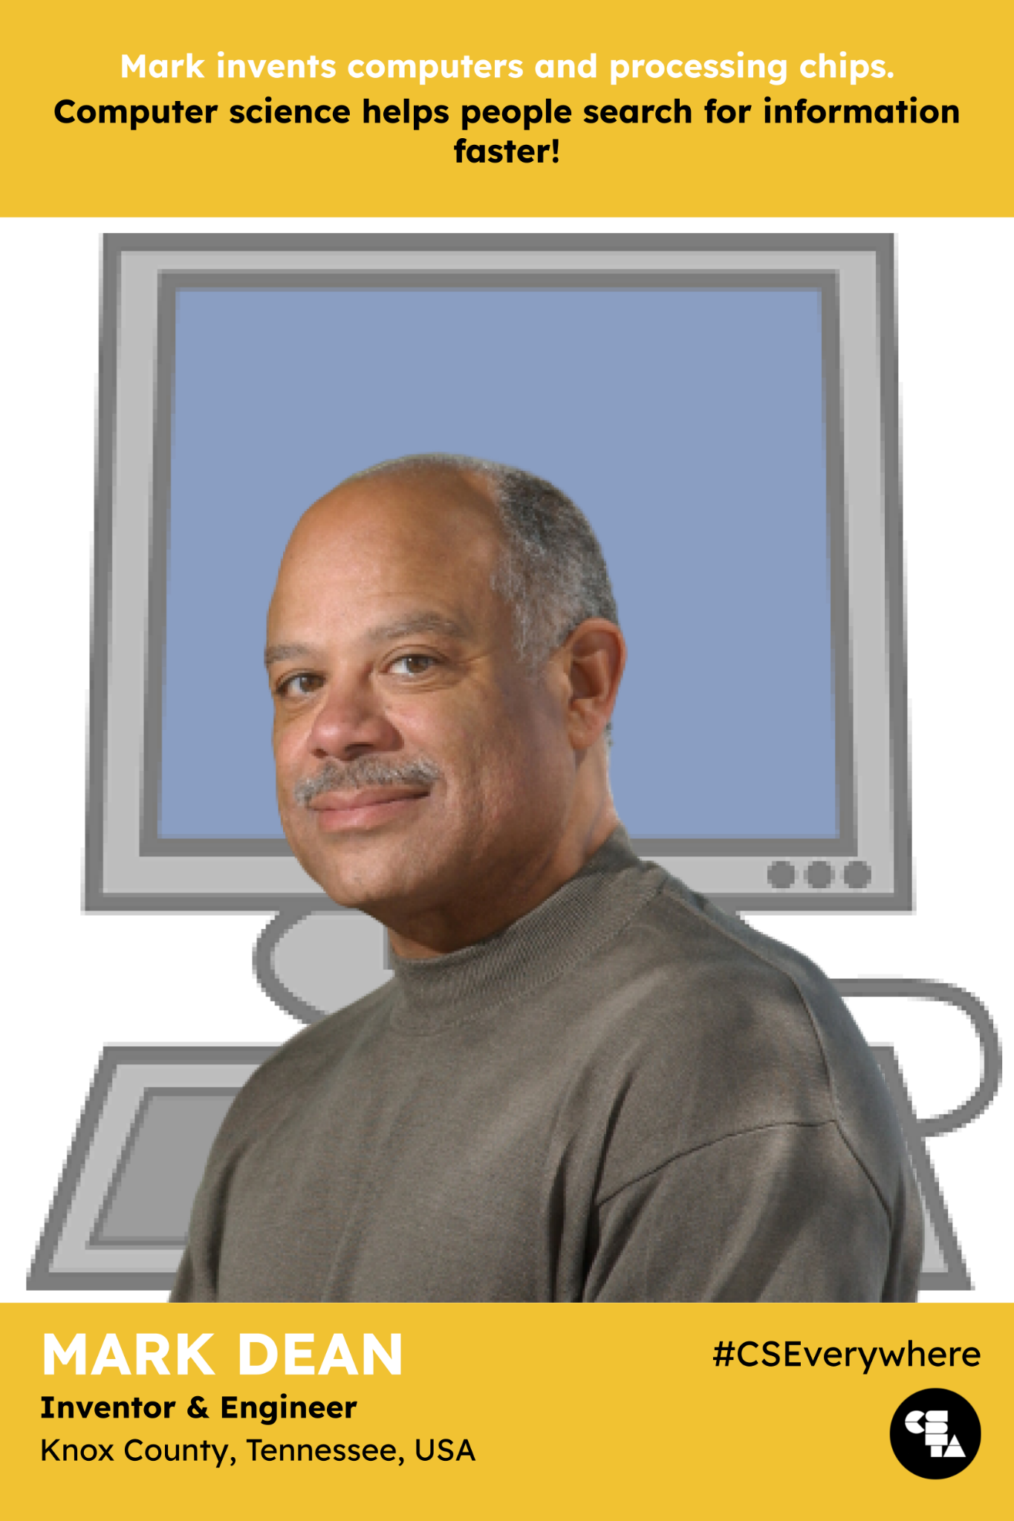
My CS Hero Poster
DESIGN - SAMPLE
Use Google Slides and other platforms to create a digital poster.
Input the CS Hero tagline from PLAN Slide.
Order: SEND your background image TO BACK.
Order: BRING the CS Hero profile image TO FRONT.
Input the CS Hero’s name, job and location.
#CSEverywhere
Notes:
Digital Creation - Sample (K-5th grades)

Slide 13
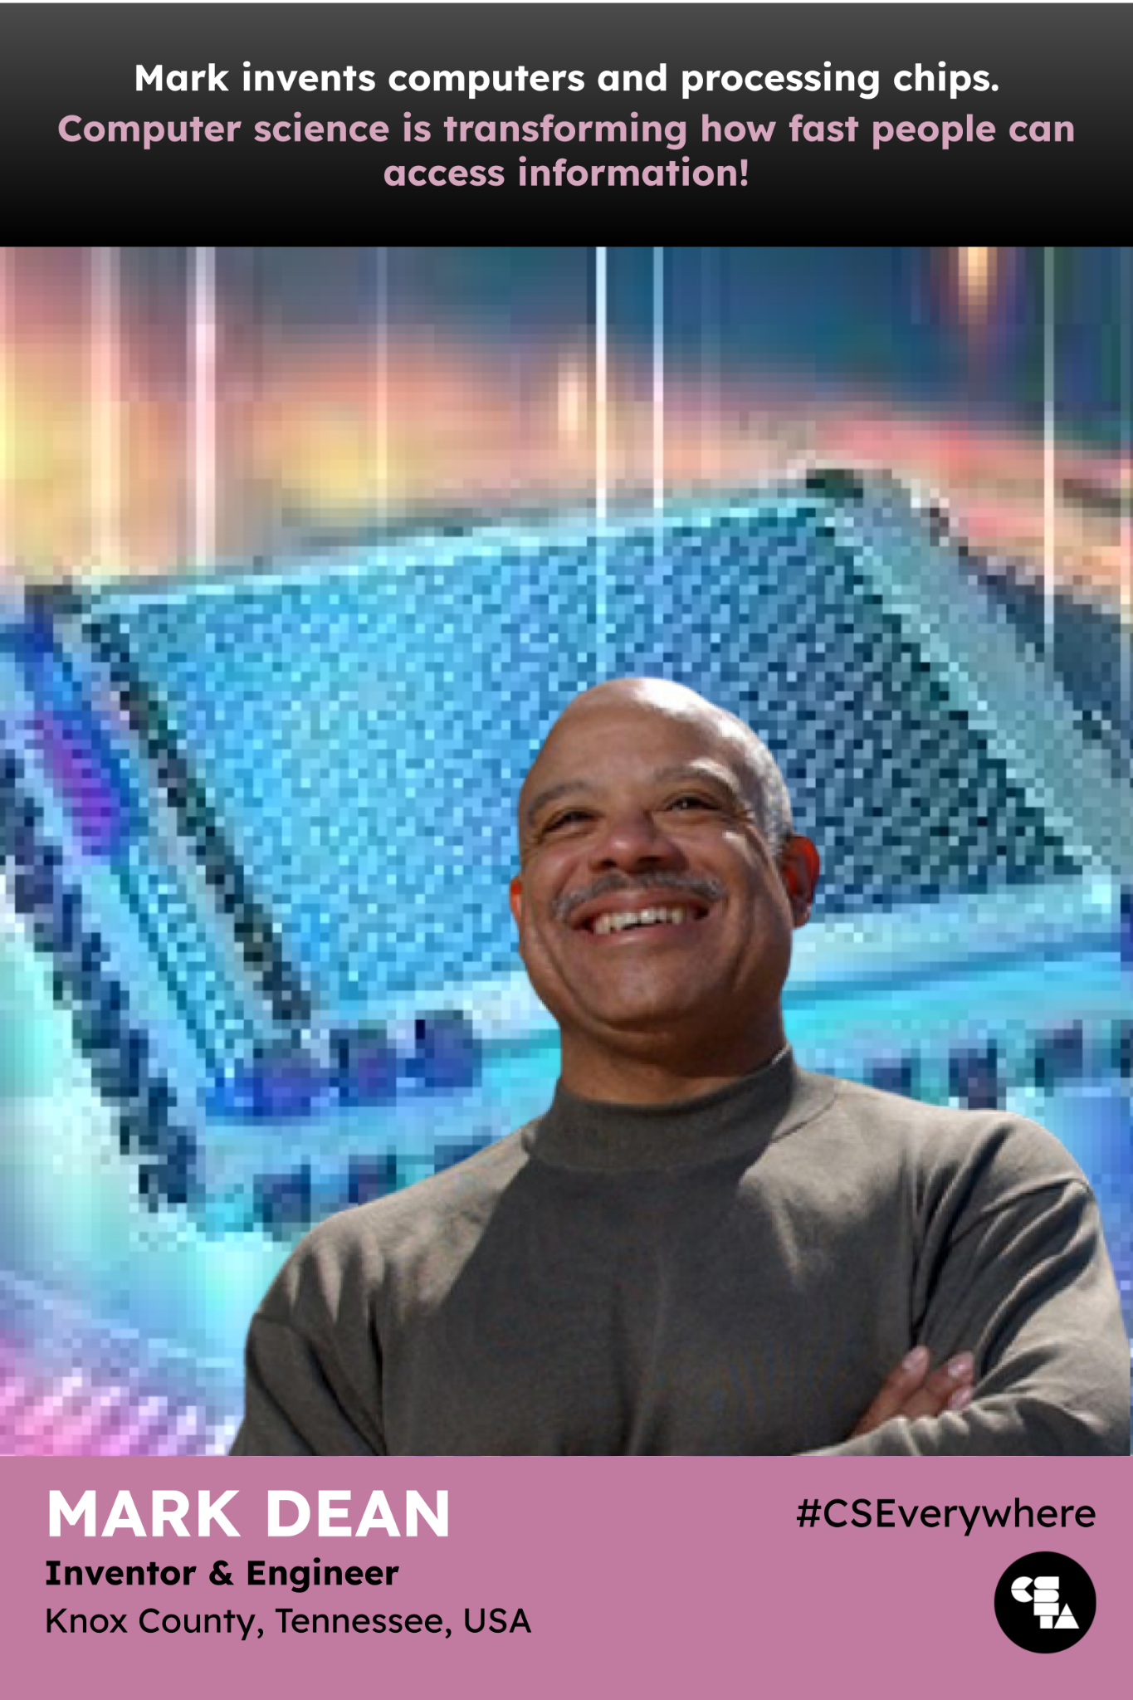
My CS Hero Poster
DESIGN - SAMPLE
Use Google Slides and other platforms to create a digital poster.
Input the CS Hero tagline from PLAN Slide.
Order: SEND your background image TO BACK.
Order: BRING the CS Hero profile image TO FRONT.
Input the CS Hero’s name, job and location.
#CSEverywhere
Notes:
Digital Creation - Sample (K-5th grades)

Slide 14
My CS Hero Poster
SHARE
Ways to Share My CS Hero Posters
CSTA Share | Submit posters to CSTA to share with CS Education Community! https://forms.gle/9HRzUSBkTCdsJ4ZLA
Student Presentations | Students present their posters to each other in pairs, groups, or to the entire class.
Classroom Gallery | Post completed posters around the room or designated area in classroom for others to view. Using devices, students have preview their poster from device and walk around to view all posters.
Virtual Banner | Create a virtual banner compiling posters into a collage and use to personalize your Google Classroom banner.
Parent Conferences | Feature posters during parent conferences and other individualized meetings.
Open House (ex. Back-to-School) | Post posters around classroom or have posters on top of student desks for attendees to view. Post posters outside of classroom (ex. hallways) to share with others during after-hours events.
Social Media | Post posters on social media platforms. Add hashtags: #CSEdWeek #CSEverywhere #CSHeroes
Suggestions:
To keep record of posters, scan/copy/take pictures of completed posters.
To protect original copies (hand-drawn) or color printouts, laminate/place posters in clear sheet protectors. This is ideal prior to posting posters around classroom.
A gallery walk (in-person or virtual) can be use to retrieve feedback from others during the poster creation process.
#CSEverywhere

Slide 15
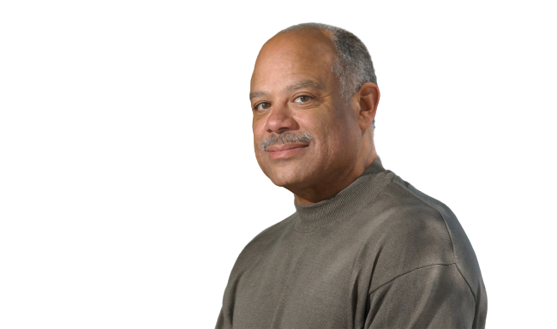
Mark invents computers and processing chips.
Computer science helps people search for information faster!
MARK DEAN Inventor & Engineer
Knox County, Tennessee, USA
#CSEverywhere
Notes:
K-5 Sample Poster

Slide 16
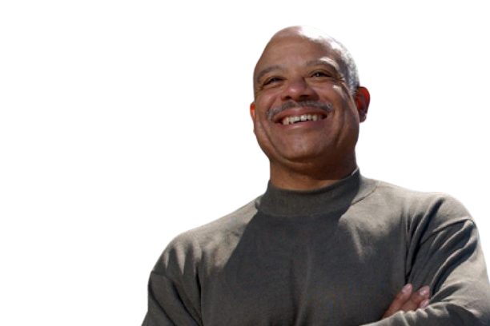
Mark invents computers and processing chips that allow people to access information faster.
Computer science is transforming computer engineering!
MARK DEAN Inventor & Engineer
Knox County, Tennessee, USA
#CSEverywhere
Notes:
6-12 Sample Poster

Slide 17
CS HERO’S FIRST NAME ...
Computer science helps ...
background background background background background background background background background background background background background background background background background background background background background background background background background background background background background background background background background background background background background background background background background background background background background background background background background background background background background background background background background background background background background background background background background background background background background background background background background background background background background background background background background background background background background background background background background background background background background background background background background background background background background background background background background background background background background background background background background background background background background background background background background background background background background background background background background background
CS HERO’S NAME CS Hero’s Job
CS Hero’s Location
#CSEverywhere
Notes:
Basic Digital Format: K-5

Slide 18
CS HERO’S FIRST NAME helps ... by ...
Computer science is transforming ...
background background background background background background background background background background background background background background background background background background background background background background background background background background background background background background background background background background background background background background background background background background background background background background background background background background background background background background background background background background background background background background background background background background background background background background background background background background background background background background background background background background background background background background background background background background background background background background background background background background background background background background background background background background background background background background background background background background background background background background background background background background background background background background background background background background
CS HERO’S NAME CS Hero’s Job
CS Hero’s Location
#CSEverywhere
Notes:
Basic Digital Format: 6-12

Slide 19
Poster Templates
Click on any of the career industries circles below to access the poster template for the that category.
Agriculture, Food & Natural Resources
Arts, Information & Communication
Business, Marketing & Management
Health Sciences
Human Services & Education
Industrial & Engineering Systems
#CSEverywhere
Notes:
Poster

Slide 20
CS HERO’S FIRST NAME ...
Computer science helps ...
CS HERO’S NAME CS Hero’s Job
Location
#CSEverywhere
Notes:
Agriculture, Food & Natural Resources Poster (K-5)

Slide 21
CS HERO’S FIRST NAME helps ... by ...
Computer science is transforming ...
CS HERO’S NAME CS Hero’s Job
Location
#CSEverywhere
Notes:
Agriculture, Food & Natural Resources Poster (6-12)

Slide 22
CS HERO’S FIRST NAME ...
Computer science helps ...
CS HERO’S NAME CS Hero’s Job
Location
#CSEverywhere
Notes:
Arts, Information & Communication Poster (K-5)

Slide 23
CS HERO’S FIRST NAME ...
Computer science is transforming ...
CS HERO’S NAME CS Hero’s Job
Location
#CSEverywhere
Notes:
Arts, Information & Communication Poster (6-12)

Slide 24
CS HERO’S FIRST NAME ...
Computer science helps ...
CS HERO’S NAME CS Hero’s Job
Location
#CSEverywhere
Notes:
Business, Marketing & Management Poster (K-5)

Slide 25
CS HERO’S FIRST NAME helps ... by ...
Computer science is transforming ...
CS HERO’S NAME CS Hero’s Job
Location
#CSEverywhere
Notes:
Business, Marketing & Management Poster (6-12)

Slide 26
CS HERO’S FIRST NAME ...
Computer science helps ...
CS HERO’S NAME CS Hero’s Job
Location
#CSEverywhere
Notes:
Health Sciences Poster (K-5)

Slide 27
CS HERO’S FIRST NAME helps ... by ...
Computer science is transforming ...
CS HERO’S NAME CS Hero’s Job
Location
#CSEverywhere
Notes:
Health Sciences Poster (6-12)

Slide 28
CS HERO’S FIRST NAME ...
Computer science helps ...
CS HERO’S NAME CS Hero’s Job
Location
#CSEverywhere
Notes:
Human Services & Education Poster (K-5)

Slide 29
CS HERO’S FIRST NAME helps ... by ...
Computer science is transforming ...
CS HERO’S NAME CS Hero’s Job
Location
#CSEverywhere
Notes:
Human Services & Education Poster (6-12)

Slide 30
CS HERO’S FIRST NAME ...
Computer science helps ...
CS HERO’S NAME CS Hero’s Job
Location
#CSEverywhere
Notes:
Industrial & Engineering Systems Poster (K-5)

Slide 31
CS HERO’S FIRST NAME helps ... by ...
Computer science is transforming ...
CS HERO’S NAME CS Hero’s Job
Location
#CSEverywhere
Notes:
Industrial & Engineering Systems Poster (6-12)

Slide 32
CS HERO’S FIRST NAME ...
Computer science helps ...
CS HERO’S NAME CS Hero’s Job
Location
#CSEverywhere
Notes:
Transportation Poster (K-5)

Slide 33
CS HERO’S FIRST NAME helps ... by ...
Computer science is transforming ...
Transportation Poster (K-5)
CS HERO’S NAME CS Hero’s Job
Location
#CSEverywhere
Notes:
Transportation Poster (6-12)

Slide 34
CS HERO’S FIRST NAME ...
Computer science helps ...
CS HERO’S NAME CS Hero’s Job
Location
#CSEverywhere
Notes:
Medical/Health Sciences Technology Poster (K-5)

Slide 35
CS HERO’S FIRST NAME helps ... by ...
Computer science is transforming ...
CS HERO’S NAME CS Hero’s Job
Location
#CSEverywhere
Notes:
Medical/Health Sciences Technology Poster (6-12)

Slide 36
CS HERO’S FIRST NAME ...
Computer science helps ...
CS HERO’S NAME CS Hero’s Job
Location
#CSEverywhere
Notes:
Sample Poster (K-5)

Slide 37
CS HERO’S FIRST NAME helps ... by ...
Computer science is transforming ...
CS HERO’S NAME CS Hero’s Job
Location
#CSEverywhere
Notes:
Sample Poster (6-12)

Slide 38
CS HERO’S FIRST NAME ...
Computer science helps ...
CS HERO’S NAME CS Hero’s Job
Location
#CSEverywhere
Notes:
Sample Poster (K-5)

Slide 39
CS HERO’S FIRST NAME helps ... by ...
Computer science is transforming ...
CS HERO’S NAME CS Hero’s Job
Location
#CSEverywhere
Notes:
Sample Poster (6-12)

Slide 40
CS HERO’S FIRST NAME ...
Computer science helps ...
CS HERO’S NAME CS Hero’s Job
Location
#CSEverywhere
Notes:
Sample Poster (K-5)

Slide 41
CS HERO’S FIRST NAME helps ... by ...
Computer science is transforming ...
CS HERO’S NAME CS Hero’s Job
Location
#CSEverywhere
Notes:
Sample Poster (6-12)

Slide 42
CS HERO’S FIRST NAME ...
Computer science helps ...
CS HERO’S NAME CS Hero’s Job
Location
#CSEverywhere
Notes:
Sample Poster (K-5)

Slide 43
CS HERO’S FIRST NAME helps ... by ...
Computer science is transforming ...
CS HERO’S NAME CS Hero’s Job
Location
#CSEverywhere
Notes:
Sample Poster (6-12)

Slide 44
My CS Hero Poster
Unplugged Activity
Create a poster of your CS Hero that describes the positive change your CS Hero’s work
has on others.
PLAN Content
Identify images and information that will be on the poster.
DESIGN Posters
Use Google Slides and other platforms to create a digital poster.
SHARE with Others
Showcase posters to the class and/or share with a wider audience.
#CSEverywhere
Notes:
Unplugged - Hard Copy Format (K-5th grades)
Teacher Reference: Print to fitable area.

Slide 45
Notes:
Blank Print Copy

Slide 46
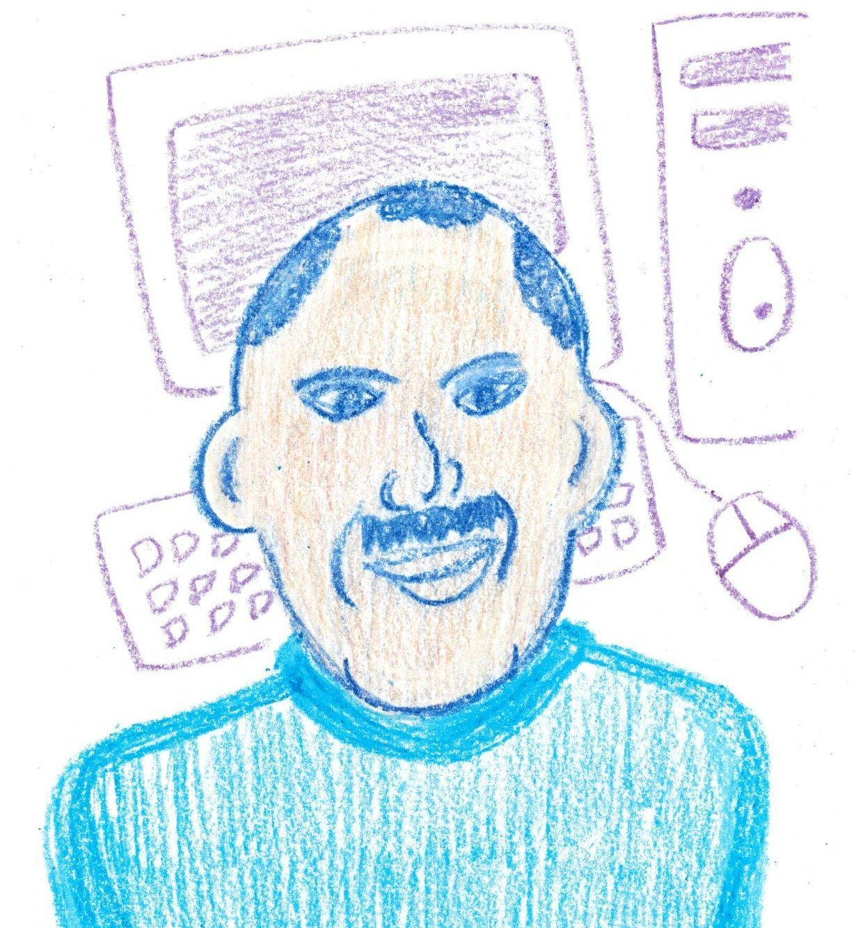
Notes:
Blank Print Copy

Slide 47
CS HERO’S FIRST NAME ...
Computer science helps ...
background background background background background background background background background background background background background background background background background background background background background background background background background background background background background background background background background background background background background background background background background background background background background background background background background background background background background background background background background background background background background background background background background background background background background background background background background background background background background background background background background background background background background background background background background background background background background background background background background background background background background background background background background background background background background background background background background background background background background background background background background background background background background background background background background background
YOUR NAME Your Future Job
Location
#CSEverywhere
Notes:
Teacher Instructional Print Copy (K-5)

Slide 48
CS HERO’S FIRST NAME helps ... by ...
Computer science is transforming ...
background background background background background background background background background background background background background background background background background background background background background background background background background background background background background background background background background background background background background background background background background background background background background background background background background background background background background background background background background background background background background background background background background background background background background background background background background background background background background background background background background background background background background background background background background background background background background background background background background background background background background background background background background background background background background background background background background background background background background background background background background background background background background background background background background background
YOUR NAME Your Future Job
Location
#CSEverywhere
Notes:
Teacher Instructional Print Copy: 6-12

Slide 49
My CS Hero Poster
PLAN
Identify images and information that will be on the poster.
Complete the table below.
Name |  | Position
Location |  | Company
How did you find out about this CS Hero?
What industry does your CS Hero belong to?
What type of work does your CS Hero do?
How does your CS Hero positively change the lives of others?
Write one sentence that describes the work that your CS Hero does. Begin with your CS Hero’s first name.
Complete the sentence by entering the type how your CS Hero’s work helps others.
Computer science helps …
What images could you put on the poster to show this?
#CSEverywhere
Notes:
Unplugged Hard Copy - Content Worksheet (K-5th grades)
Print Tip: Click More Settings, Click Scale, Select Fit to Printable Area

Slide 50
My CS Hero Poster
PLAN
Identify images and information that will be on the poster.
Complete the table below.
Name |  | Position
Location |  | Company
How did you find out about this CS Hero?
What type of work does your CS Hero do?
How does your CS Hero positively change the lives of others?
What industry does your CS Hero belong to?
Write one sentence that describes what your CS Hero’s work and how it helps others. Begin with your CS Hero’s first name.
Complete the sentence by entering industry your CS Hero belongs to.
Computer science is transforming
What images could you put on the poster to show this?
#CSEverywhere
Notes:
Unplugged Hard Copy - Content Worksheet (6-12th grades)
Print Tip: Click More Settings, Click Scale, Select Fit to Printable Area

Slide 51
My CS Hero Poster
CREATION
Create your Future Me Poster.
Write the CS Hero statement here.
Draw things that relate to the CS Hero’s work in the background.
Draw the CS Hero.
Write the CS Hero’s name, job and location.
#CSEverywhere
Notes:
Unplugged - Hard Copy Format (K-5th grades)
Teacher Reference: Print to fitable area.

Slide 52
My CS Hero Poster
CREATION
Create your Future Me Poster.
Write the CS Hero statement here.
Draw things that relate to the CS Hero’s work in the background.
Draw the CS Hero.
Write the CS Hero’s name, job and location.
#CSEverywhere
Notes:
Unplugged - Hard Copy Format (6-12th grades)
Teacher Reference: Print to fitable area.

Slide 53
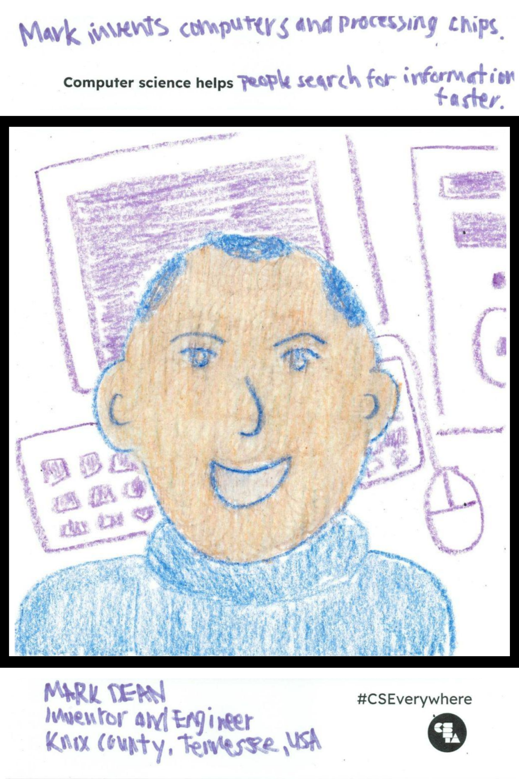
My CS Hero Poster
CREATION
Create your Future Me Poster.
Write the CS Hero statement here.
Draw things that relate to the CS Hero’s work in the background.
Draw the CS Hero.
Write the CS Hero’s name, job and location.
#CSEverywhere
Notes:
Unplugged - Hard Copy Format (K-5th grades)
Teacher Reference: Print to fitable area.

Slide 54
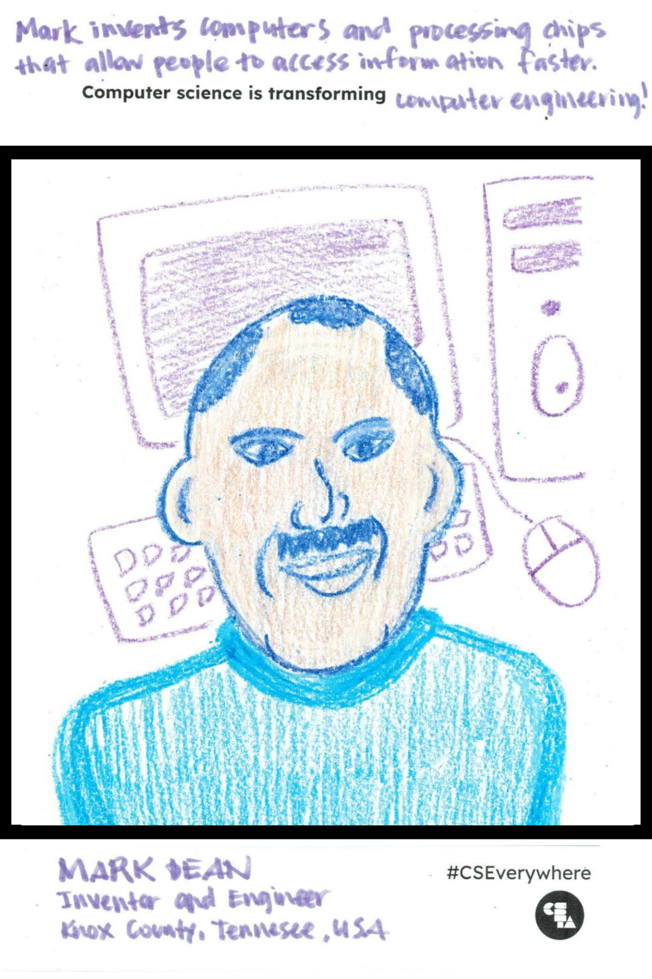
My CS Hero Poster
CREATION
Create your Future Me Poster.
Write the CS Hero statement here.
Draw things that relate to the CS Hero’s work in the background.
Draw the CS Hero.
Write the CS Hero’s name, job and location.
#CSEverywhere
Notes:
Unplugged - Hard Copy Format (6-12th grades)
Teacher Reference: Print to fitable area.

Slide 55
...
Computer science helps
#CSEverywhere
Notes:
Blank Print Copy K-5
Teacher Reference: Print to fitable area.

Slide 56
...
Computer science is transforming
#CSEverywhere
Notes:
Blank Print Copy 6-12
Teacher Reference: Print to fitable area.

