Slide 1
Hobby Mustangs Fall 2020 Parent Information Session
Wednesday, August 12th
5:30 p.m.

Slide 4
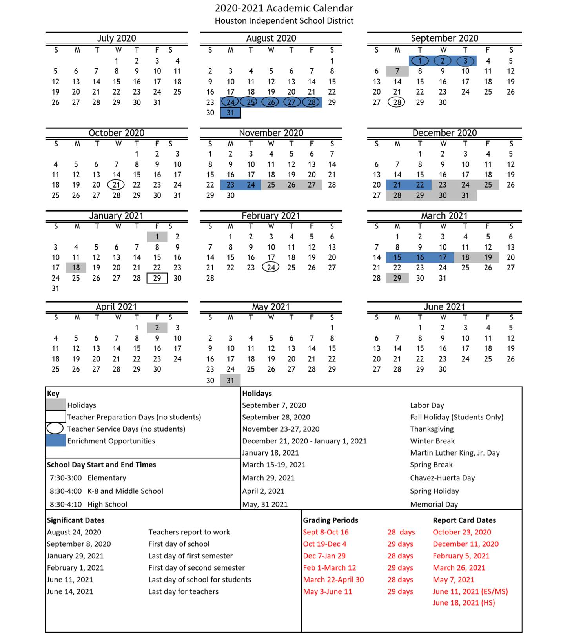

Slide 5
Academic Boot Camp
Opportunity for students with the greatest need for Math and/or Reading Intervention
Certified teachers
“Bridge” to get prepared for a strong start to the 2020-2021 school year
September 1st-3rd – Boot Camp
More details will be provided in the next couple of weeks

Slide 6
Other Important Dates
Tuesday, September 8th – First day of school
Friday, January 29th – Last day of 1st Semester
Monday, February 1st – First Day of 2nd Semester
Friday, June 11th – Last Day for Students

Slide 7
Open House & Meet the Teacher
Meet the Teacher Event
Thursday, September 3rd
Elementary – 9:30-11:00 a.m.
Open House Event
Wednesday, September 16th
5:30 p.m.
Both events will occur online

Slide 8
General Updates
Our revised school day times: 7:30 a.m.-3:00 p.m.
Remote Learning for six weeks
September 8th – October 16th
Face-to-face classes begin on October 19th
This date may change based on Covid-19 updates in our area

Slide 9
Learning Format Options
After the first six-weeks
Parents have the option for their children to participate in traditional face-to-face instruction or virtual instruction
October 19th, 2020 – June 11th, 2021

Slide 10
General Updates
District will provide PPE for staff and students when we return to the campus
Face shields for teachers
Masks provided daily for staff & students
Gloves & hand sanitizer also available
No athletics or other extra-curricular activities
Includes practices and competitive events

Slide 11
Instruction
Live lessons in Microsoft Teams
Whole group & small group instruction
Live lessons will be recorded and students will be able to access them later if they miss the live lesson
Daily lesson activities and assignments will be posted, completed, and graded in the HUB

Slide 12
Instruction
Teachers will develop a daily instructional schedule (based on the schedule for your grade level) and publish it to students & parents in the HUB
The schedule may also be shared via
Parent Newsletter (Emailed)
Class Dojo

Slide 13
Instruction & SEL
Teachers’ lessons will frequently include Social-Emotional Learning themes such as:
Conflict-resolution
Problem-solving
Developing positive character traits
Making good choices
Reading passages, lab activities, writing prompts

Slide 14
Grades & Attendance
Grades and Attendance will be recorded from the first day of school
Attendance will be taken daily
Grades will be entered each week (min. 2)
Students must attend classes & complete assignments daily

Slide 15
HISD @ H.O.M.E
HISD@HOME online & TV broadcasts will continue
The HISD@HOME parent hotline resumed operation on Monday, August 3rd
Parents are strongly encouraged to take the course titled “Introduction to Virtual Instruction”
Available on the HUB beginning July 31st

Slide 16
Technology
We will distribute laptops & iPads on campus to students in need:
Households who have not received a device will be helped first
Households with multiple scholars will receive an additional device after all households are covered.

Slide 17
Meals for Students
Curbside meals will be available to students at specified locations
Food distribution buses will go to large apartment complexes/ communities

Slide 18
Stay tuned for updates…
Watch the local news
Check the district website

Slide 19
Reminders
This semester will be “different”, but we will continue to provide excellent instruction and a safe & nurturing educational environment for our scholars!

Slide 20
Enjoy the rest of your summer!
See you soon!

