Slide 1
9th grade Math
with Ms. Nguyen =)

Slide 2
Ms. Nguyen
pronounced as “win”, it’s Vietnamese!
graduated from UH with degrees in Mathematics and Economics
8th year teaching, 4th year at HAIS
only hobbies nowadays: eating and reading

Slide 3
Which math class?
Algebra 1
Algebra 2
if you DID NOT take and pass algebra 1 in 8th grade, you will be taking algebra 1 this year with me
If you DID take and pass algebra 1 in 8th grade, you will be taking algebra 2 this year with either me or Mr. Polly

Slide 4
Both courses are required!!

Slide 5
The algebra 1 staar is a graduation requirement for everyone!!

Slide 6
What does this mean?
My incoming algebra 1 students, you will be taking the algebra 1 staar in May.
My incoming algebra 2 students:
If you have already passed the algebra 1 staar last year, good job! You do not have to worry about another math staar again throughout high school.
If you have NOT passed the algebra 1 staar last year, you WILL be taking it this year in May.

Slide 7
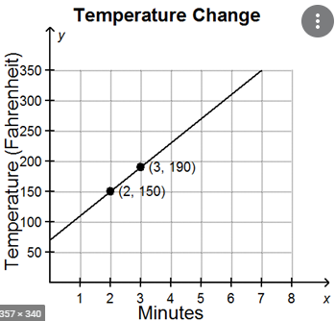
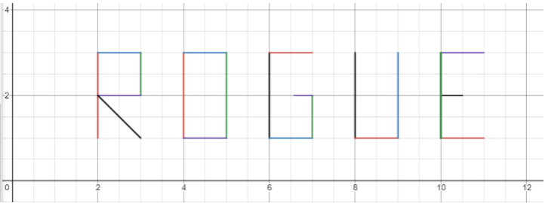
Algebra 1- Linear Functions

Slide 8
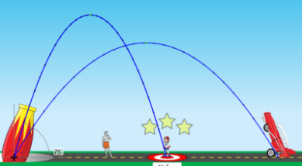
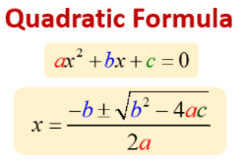
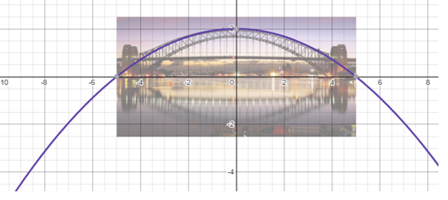
Algebra 1 – Quadratic Functions

Slide 9
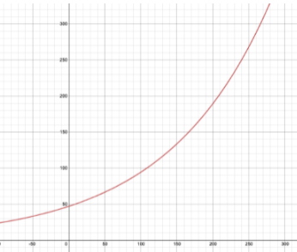
Algebra 1 – Exponential function

Slide 10
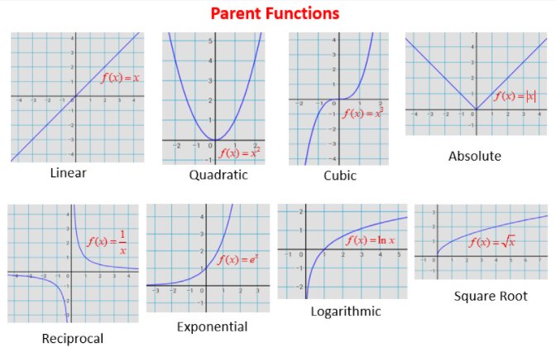
Algebra 2

Slide 11
How to prepare
Things you NEED to know BEFORE
Operations with fractions
Operations with integers
Your MULTIPLICATION TABLE
Order of Operation (PEMDAS)
1 step and 2 steps equations

Slide 12
Tips to succeed
DO NOT ALLOW YOURSELF TO FALL BEHIND….EVERYTHING IN MATH BUILDS ON TOP OF EACH OTHER
PRACTICE PRACTICE PRACTICE……DO YOUR ASSIGNMENTS ON TIME
ASK FOR HELP AS SOON AS YOU NEED IT…..DO NOT WAIT

