Slide 1
Tutoring
Academic Success Centers
Amanda Guerrero
Director, Instructional Support
Your Partners in Excellence!

Slide 2
Welcome
Goal:
Introduce you to the Tutoring Services Department and how you can connect with us to partner in your success

Slide 3
Get help early & often… Tutoring options
Option 1:
For synchronous/videoconference tutoring, use our Virtual Academic Success Centers by calling 713-718-8184. Tutors are available Monday & Thursday 8am-8pm, Tuesday & Wednesday 8am-10pm, Friday 8am-4pm, and Saturday 9am-3pm. www.hccs.edu/tutoring
Option 2:
For in-person/1:1 tutoring, use our Academic Success Centers by calling 713-718-8184 OR by stopping by. Hours vary by location and subject. www.hccs.edu/findatutor
Option 3:
For asynchronous tutoring, use Upswing (hccs.upswing.io). All submissions will be returned, generally within 18-24 hours. Managed by a different department under the Online College
Alex Kanakis, Interim Manager, Online Tutoring

Slide 4
Tutoring at HCCS

Slide 5
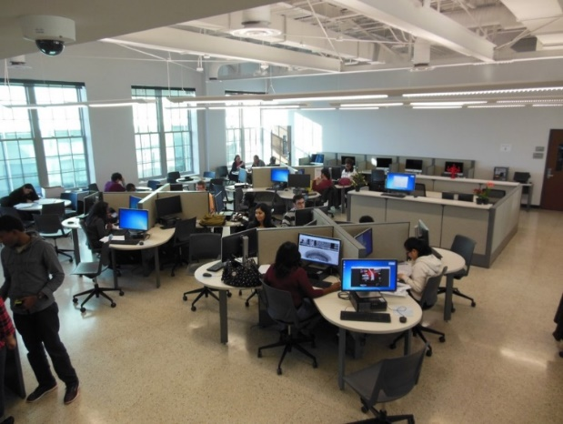
HCC Virtual Academic Success Centers Who we are!
We offer free/real-time video conference tutoring to our students through Microsoft TEAMs, which is accessible through Microsoft 365 and your HCC email. Our Call Center Representatives are available to assist with setting up/installing Microsoft TEAMs and scheduling your appointment to meet with a tutor.
We have Faculty & peer tutors who are available to help with English, Math, Biology, Physics, Chemistry, Accounting, Spanish, ESOL, workforce programs and much more!
We help our students stay on track with coursework, understand assignments, and improve study skills.
We offer extended hours of operations!
Hope to offer on-campus services around 10/5/20
Call: 713-718-8184
Website: hccs.edu/alltutoring
Tutoring schedules: hccs.edu/findatutor

Slide 6
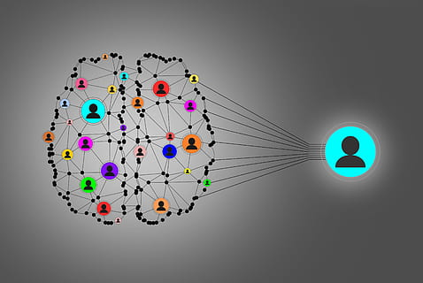
What Tutors can help with…..
English Tutors Do…
Make notes and comments throughout your paper to help you know what needs to be improved or corrected and how to make the necessary changes.
Ask questions to help you think through your ideas. provide you with resources to help you become a better reader and writer.
Math and Science Tutors Do…
Help you see where you became lost on a problem.
Explain math concepts about which you are confused.
Solve similar problems that you can apply to your own work
Content Tutors Do…
Ask questions to help you think through your ideas.
Explain concepts about which you are confused.
Provide you with resources to help you understand content subject matter
English Tutors Don’t…
Grade your work.
Correct your work.
Edit your work.
Do your work.
Give you topic ideas for your work.
Math and Science Tutors Don’t…
Grade your work.
Solve problems for you.
Content Tutors Don’t…
Grade your work.
Correct your work.
Do your work.
Tell you what to write.

Slide 7
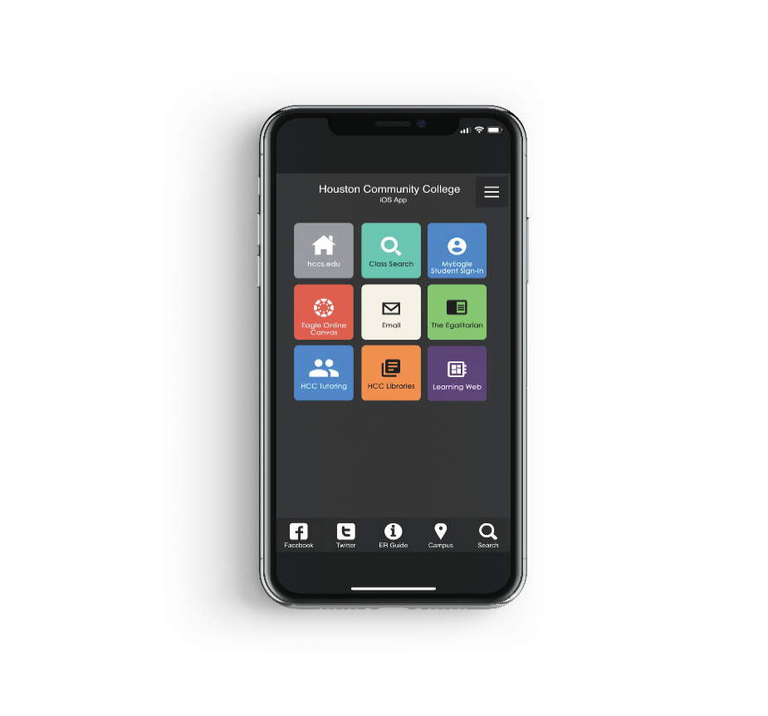
Accessible: Walk-through “Find-a-tutor”
Mobile App Find on Apple App Store or Google Play Store
Find a Tutor hccs.edu/findatutor
HCC Tutoring Website hccs.edu/tutoring
Online Tutoring hccs.upswing.io
Notes:
In addition to information regarding tutoring being provided via NSO and SLIP Sessions, there is a standardized syllabus statement, we conduct class visits, attend departmental meetings, market at the campuses through fliers and posters/signage and attend campus events. These are the resources for our students in locating the tutoring schedules, locations, and times.
Transition: Our next Academic Support Service that is rapidly growing is our Supplemental Instruction program, which also occurs in the classroom and in our Academic Success Centers

Slide 8
Student Feedback 1200+ responses
97.6% of respondents feel better prepared to succeed in the courses they were tutored in
85% of respondents rate their tutoring experience as “outstanding”
98.7% of respondents felt the tutor “met” or exceeded” their expectations in being prepared for their session
94.2% of respondents felt the tutor “always” communicates concepts and ideas clearly
92.5% of respondents believe their tutor is “always” knowledgeable and understand the topic he/she is tutoring

Slide 9
Student Feedback 1200+ responses
“Excellent tutor! I really appreciate the time she spends with me explaining everything in detail! You have helped me improve in my class! Thank you so much.”
“I appreciated him always being there for us every Saturday. He was always attentive, patient and willing to help.”
“You were an amazing help! I felt helpless when I arrived but you helped motivate me by breaking down what we received.”

Slide 11
Ask us a question!
Ex: I struggle with Math, how can a tutor help me prepare for my class?
Ex: Can a tutor help with question on a quiz or test?

