Slide 1
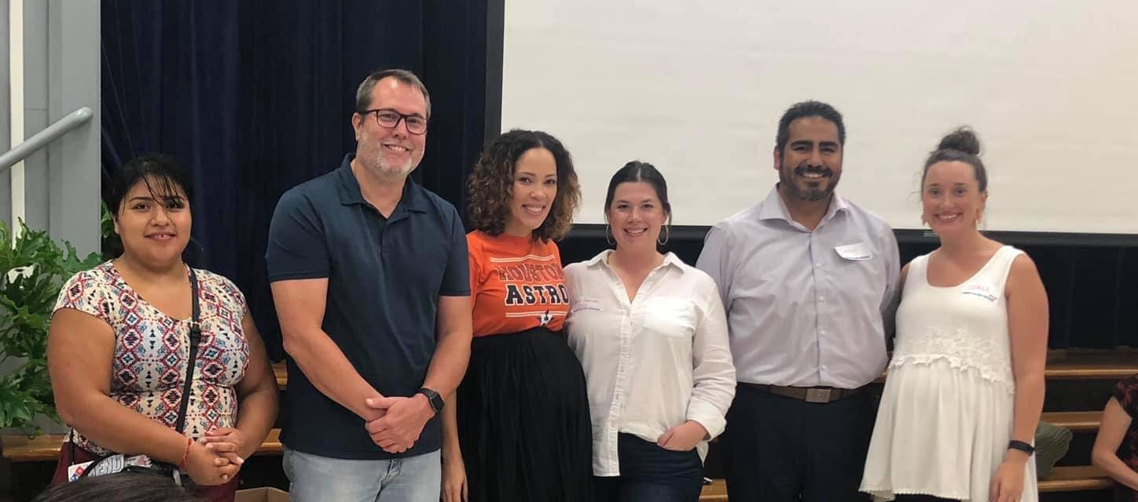
Meet Your PTCO Board for 2019/2020!
Jessy Alcorta – President
Ashli Garcia – Vice President of Fundraising
Dulce Duarte – Vice President of Education
Chris Harrison – Vice President of Community Building
Coree Laabs – Secretary
Tim Weltin –Parliamentarian
We will be electing new officers for the 2020/2021 school year in September. If you are interesting in serving as an officer, please contact us at stevenspto.hou@gmail.com.
Shown Left to Right: Dulce Duarte, John Moak, Mrs. Trent, Ashli Garcia, Jessy Alcorta and Coree Laabs

Slide 2
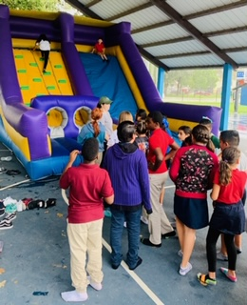
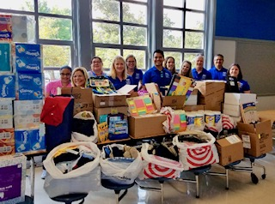
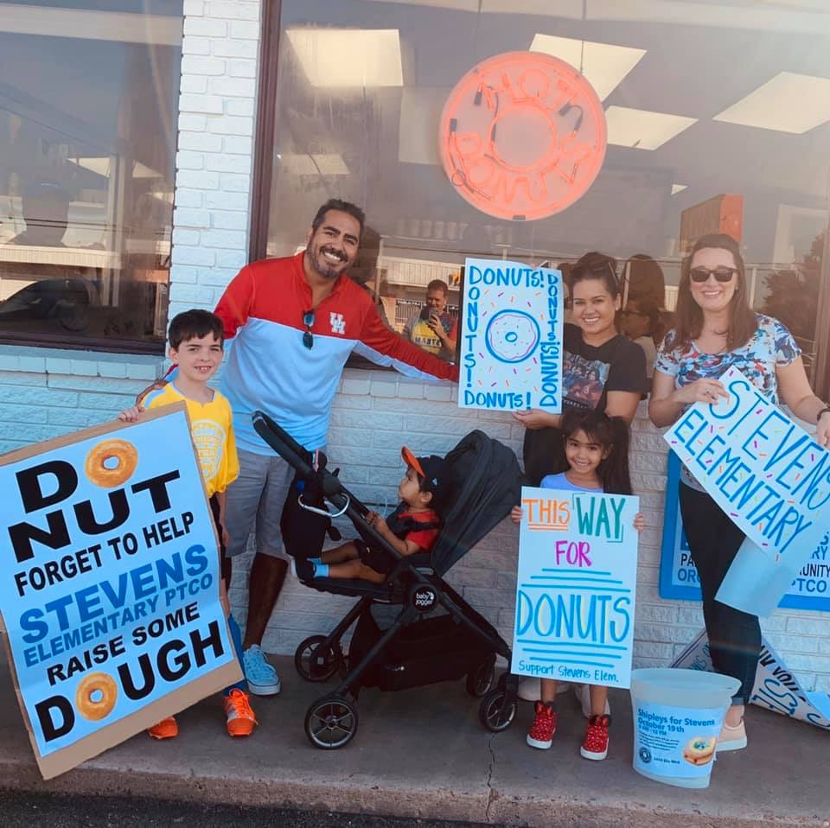
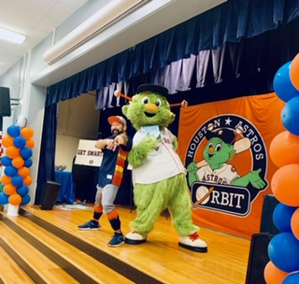
Fundraising – Committee position available for 2020/2021 school year
Dream Team Celebrations – Led by Terra Snow

Slide 3
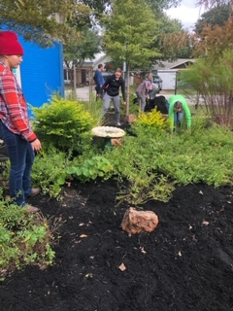
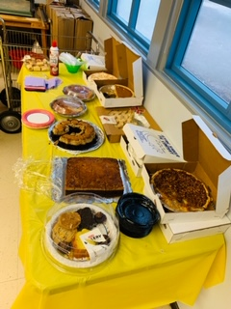
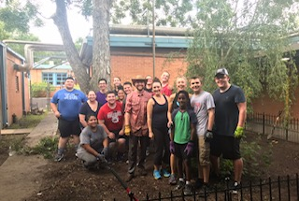
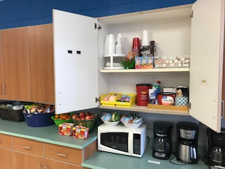
Campus Beautification – Led by Coree Laabs
Teacher Appreciation – Committee position available for 2020/2021 school year

Slide 4
Here are a few more ways to help our amazing school!
Box Tops are DIGITAL! Download the *free* Box Tops app and earn funding by scanning your shopping receipt that contains Box Tops products.
You can still clip Box Tops and drop them off at school in our new Box Tops mail box located in the foyer next to the cafeteria.
Amazon donates 0.5% of every purchase you make through the AmazonSmile program. Simply choose “Stevens Elementary School PTO” when you shop at www.smile.amazon.com.
And now Amazon Smile is available on the Amazon app! Open the app, go to the main menu and tap into ‘Settings’. Tap ‘AmazonSmile’ and follow the on-screens instructions to complete the process.
Kroger Community Rewards makes fund-raising easy by donating to Stevens based on the shopping you do every day. Once you link your card to Stevens, all you have to do is shop at Kroger and swipe your Plus Card!
A digital account is needed to participate in Kroger Community Rewards. Go to www.kroger.com/account/community rewards and select “Stevens Elementary School PTO” to link your Plus Card!
We also take direct donations through the Stevens Elementary PTCO PayPal account. Just login to your PayPal account online and click the “Send” option. Our email address is
StevensPTO.HOU@gmail.com.
** Don’t forget to select the “Sending to a Friend” option before submitting.

